Slide 1
Neighborhood Resilience Teams: Getting Ready for an Uncertain Future
Greg Smith,
Sustainability Advisory Board
gasmith@lclark.edu

Slide 2
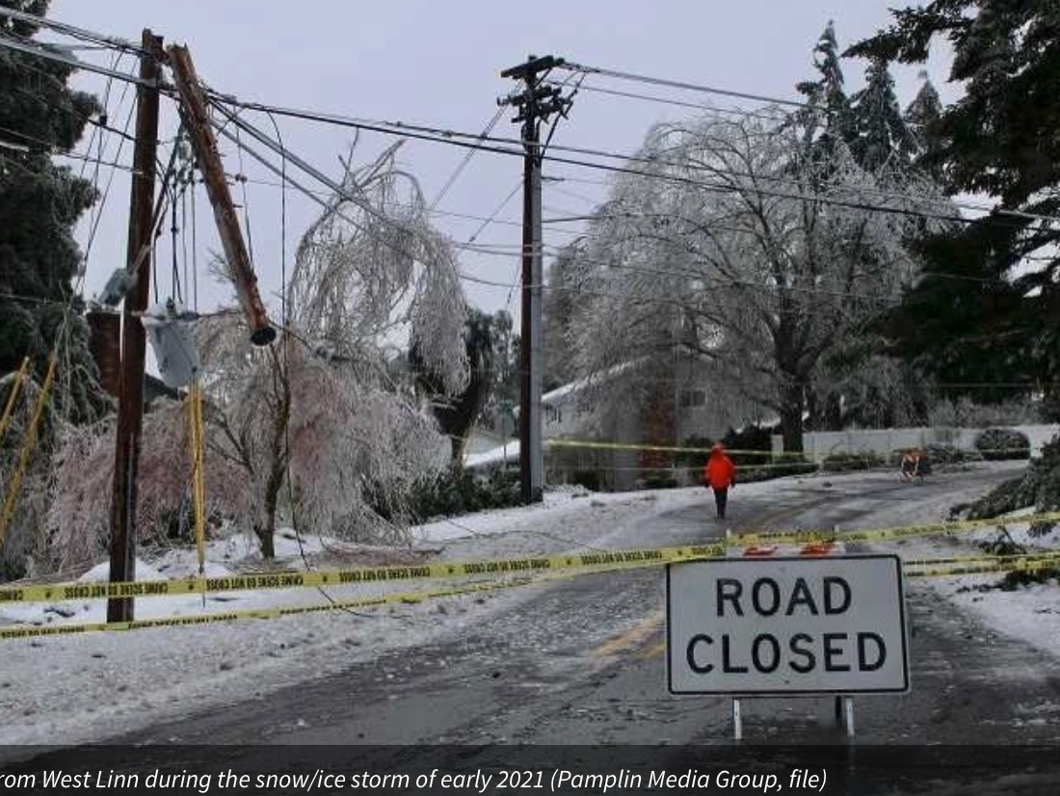
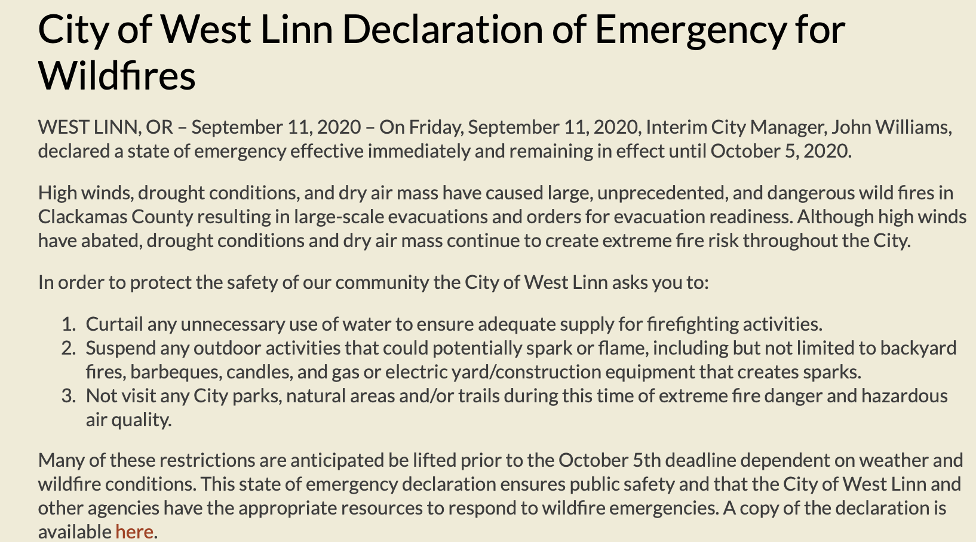

Slide 3
What do I mean by resilience?
Resilient communities are those able to respond safely and effectively to disruptive events—both human and natural—in ways that sustain the well-being and health of their citizens.

Slide 8
Causes for uncertainty looking to the future
Diminished access to affordable food as a result of droughts and water shortages
Influx of climate refugees
More expensive energy sources
Continued wildfires and extreme weather events
Economic instability

Slide 9
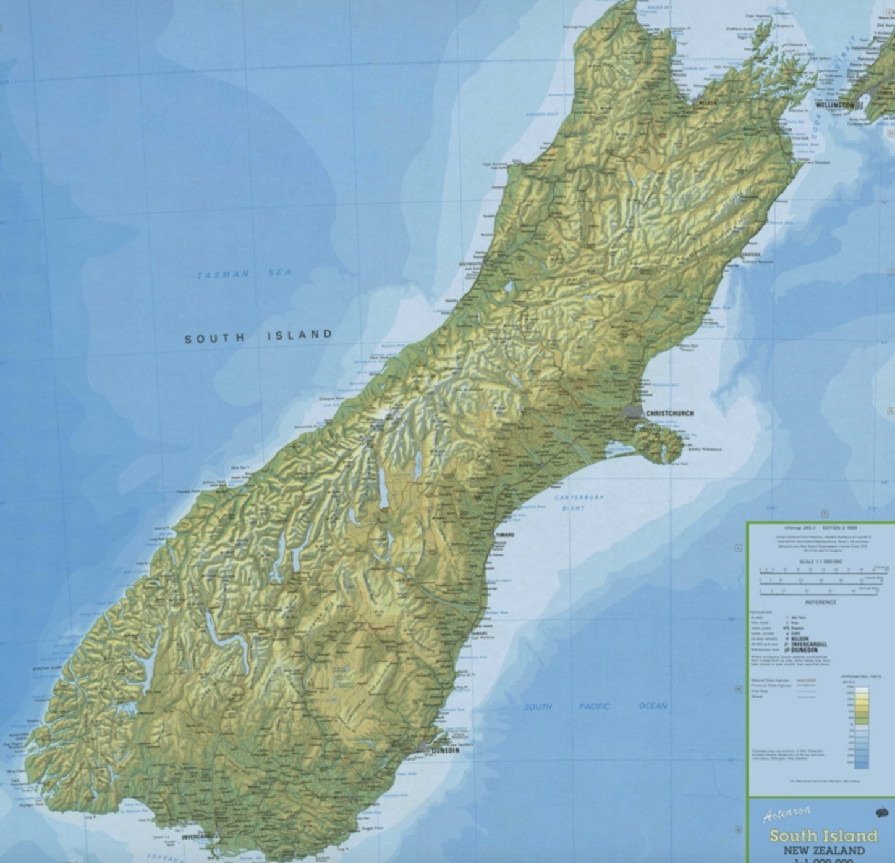
New Zealand
Project Lyttleton

Slide 11
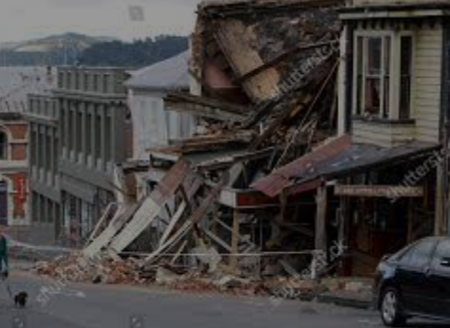
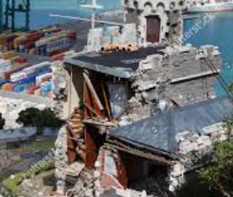
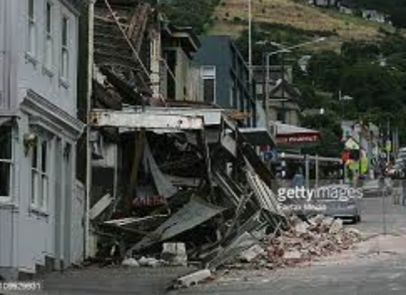
Earthquake damage in Lyttelton - 2011

Slide 13
Volunteers offer their skills and labor to other members of the time bank through an organized process of non-monetized exchange. For one hour of labor you become eligible for an hour of labor provided by someone else. For example, if someone drives a person to the doctor, they can request an equivalent amount of service-–like help with taking a load of trash to the dump—from another willing volunteer.

Slide 14
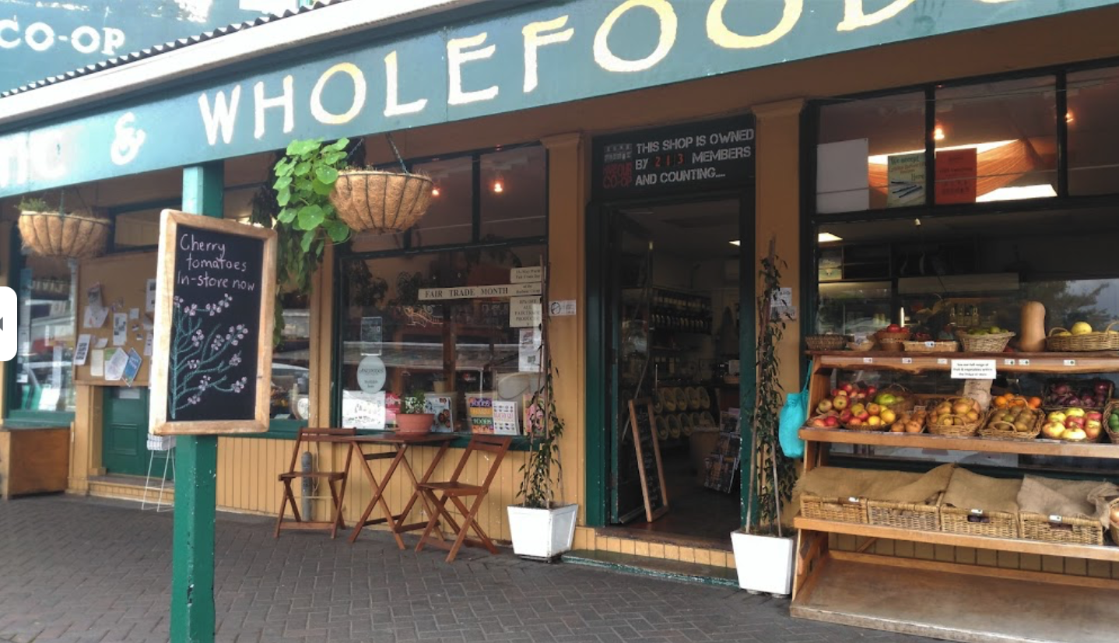

Slide 15
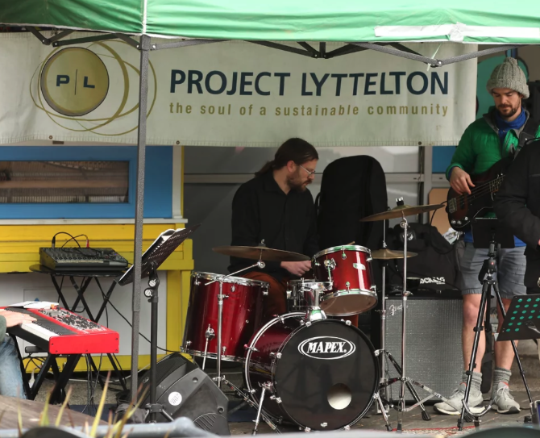
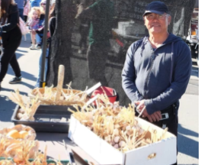

Slide 16
Lyttelton Garage Sale Mending Day

Slide 17
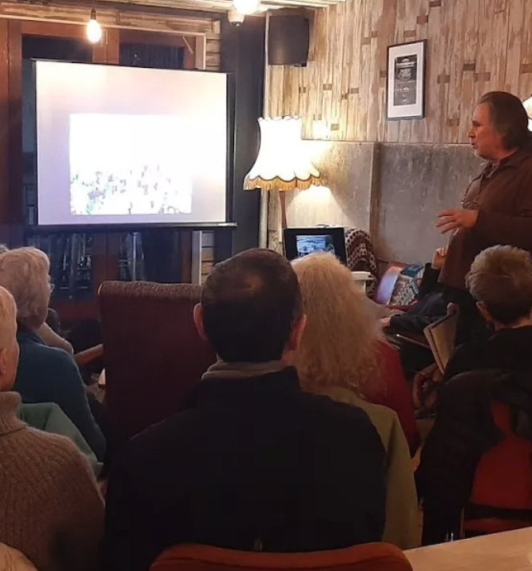

Slide 18
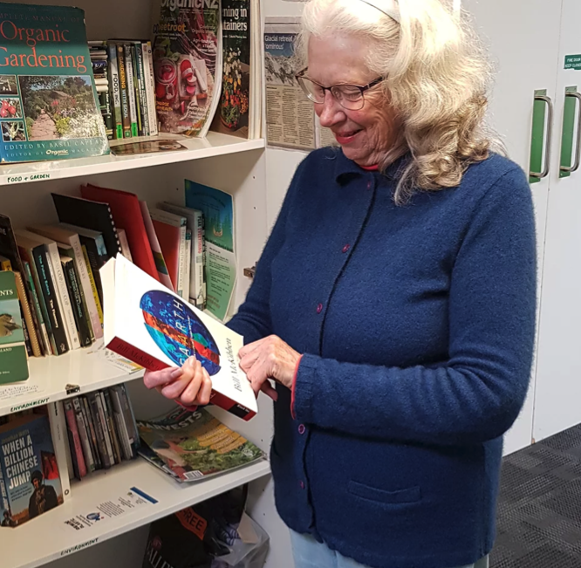
LIFT Library
The LIFT library is a diverse collection of resources to inform and empower change.

Slide 19
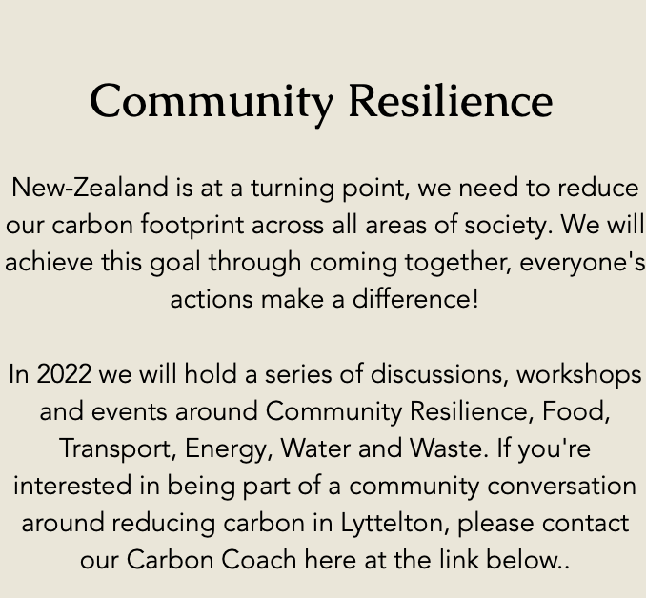

Slide 20
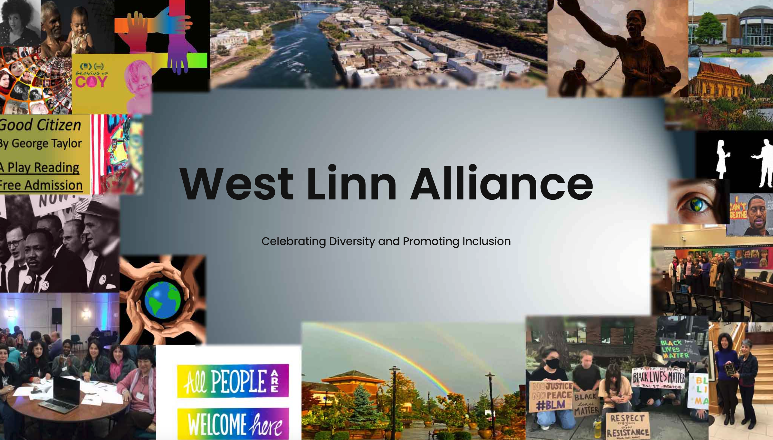
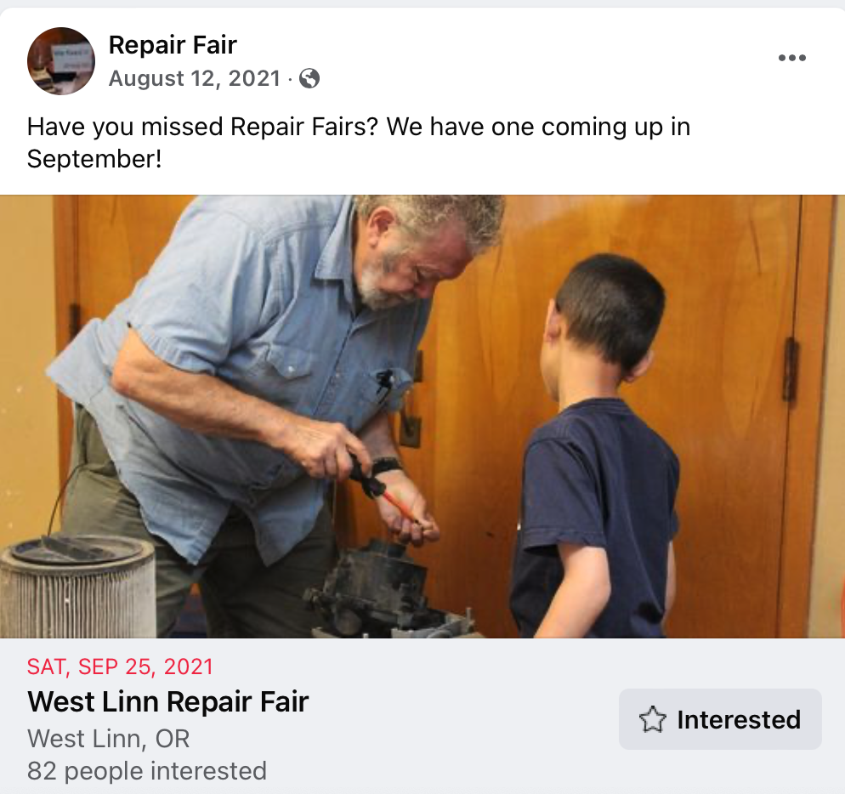
West Linn parallels to Lyttelton

Slide 21
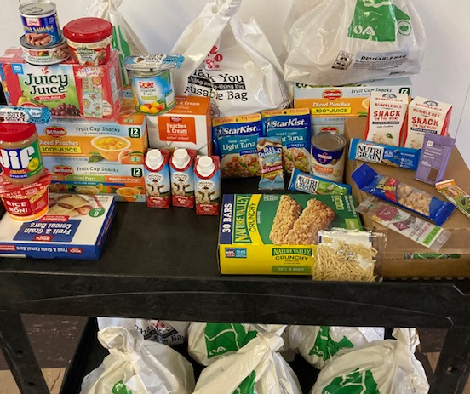
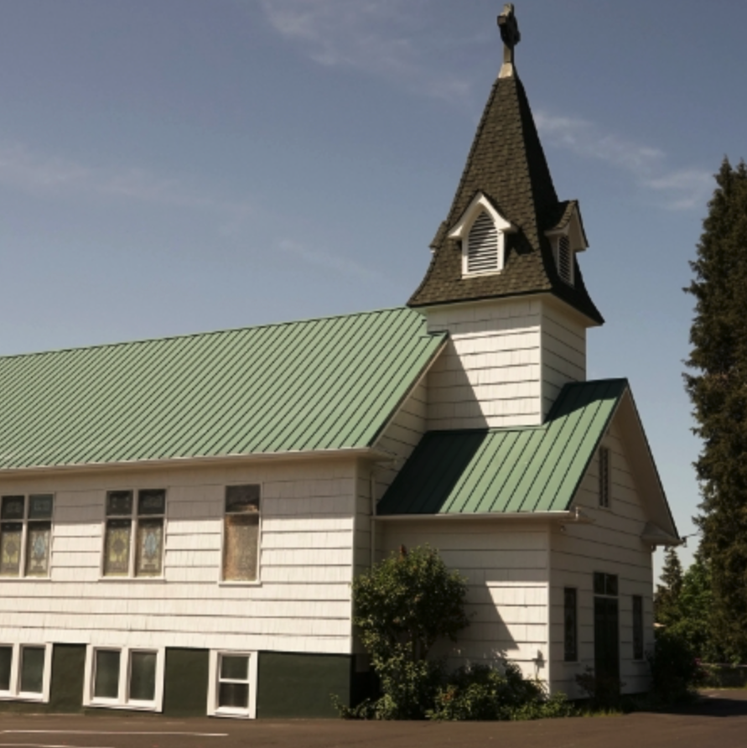
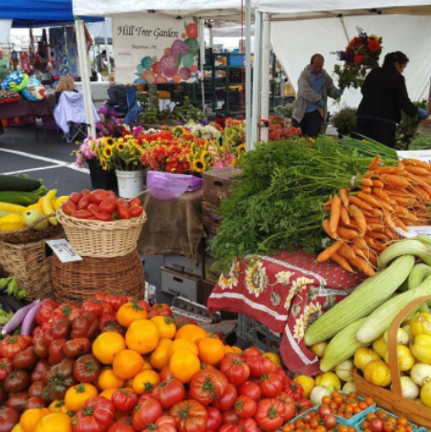
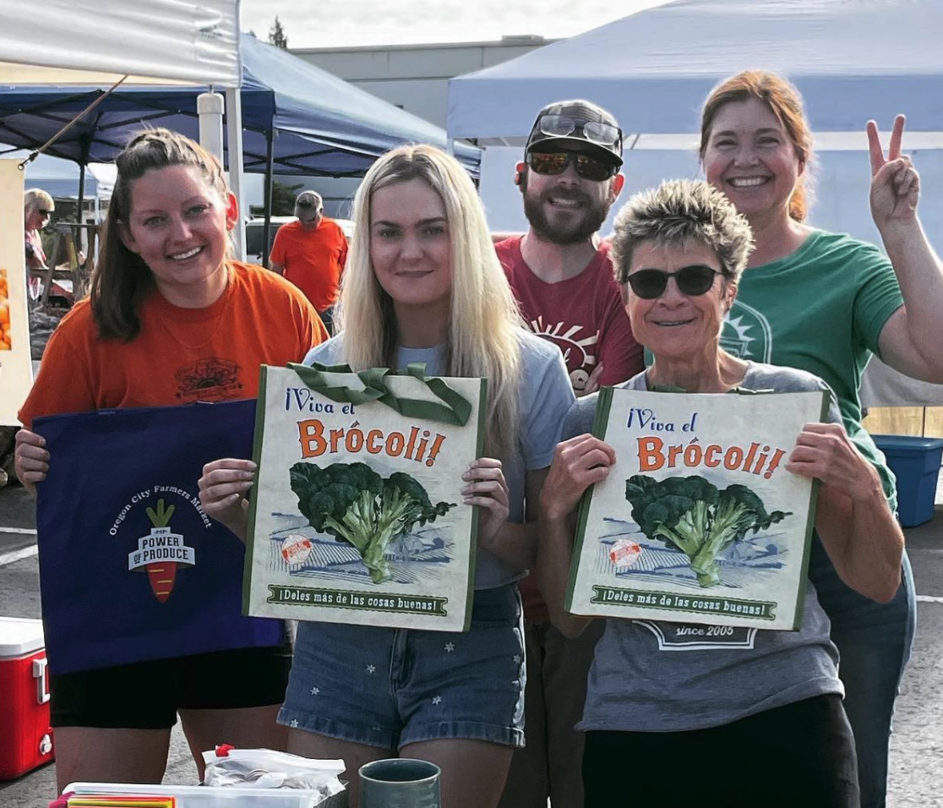
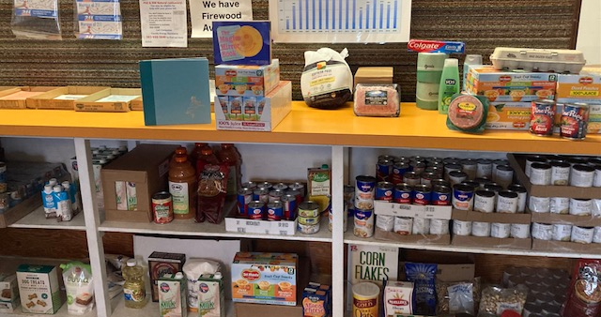
Oregon City/Beaver Creek parallels
Food pantry
Backpack Buddy Program
Oregon City Farmers’ Market
UCC Disaster Hub

Slide 22
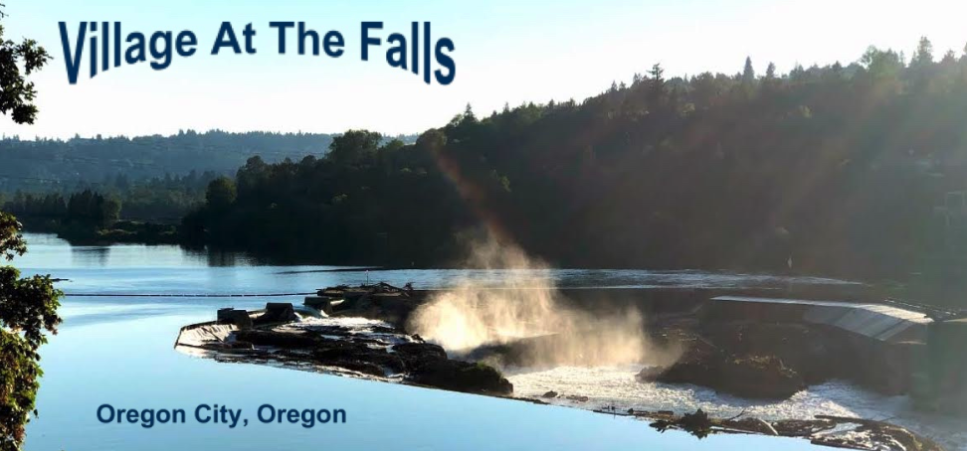

Slide 23
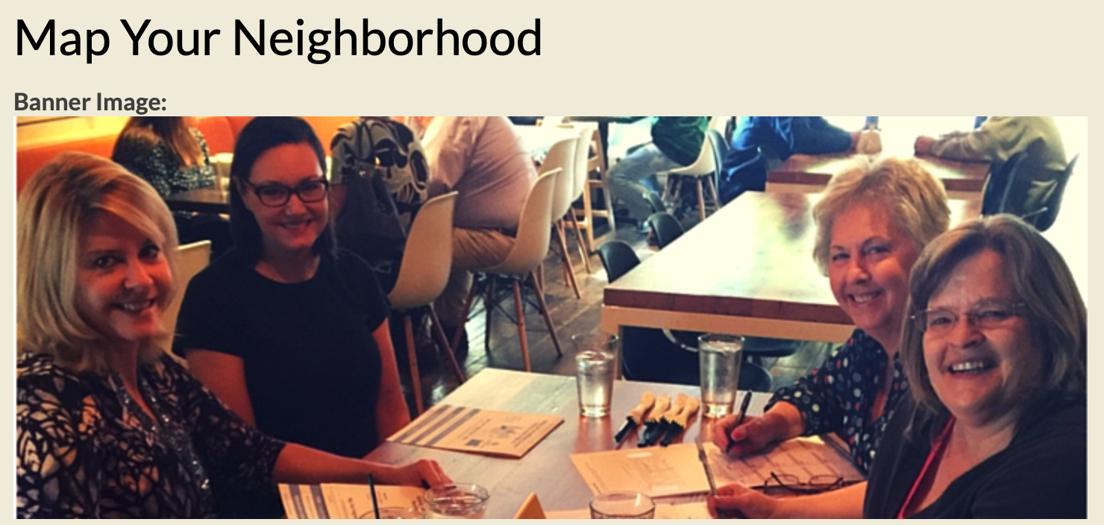
IDENTIFY
- Skills (practical, medical, technical)
- Equipment (portable generators, chain saws)
- People with special needs (elderly, children, differently abled)
- Location of gas, electricity, and water shut-offs for each home
- Hazards specific to neighborhood (trees, river, creeks)
COLLECT
- Contact information
EDUCATE
- About creating an emergency kit and storing food and water for two-weeks or more

Slide 24
Deepening mutual support
Encourage more local gardening and food sharing or yard sharing as happens through the Yarducopia program in Anchorage
Invite neighbors to cider making or other harvest parties
Hold annual or more frequent block parties, holiday get togethers/picnics, or regular potlucks
Collect e-mail addresses of neighbors so that when things come up you believe other people should know about, you can contact – like Nextdoor but more local

Slide 25
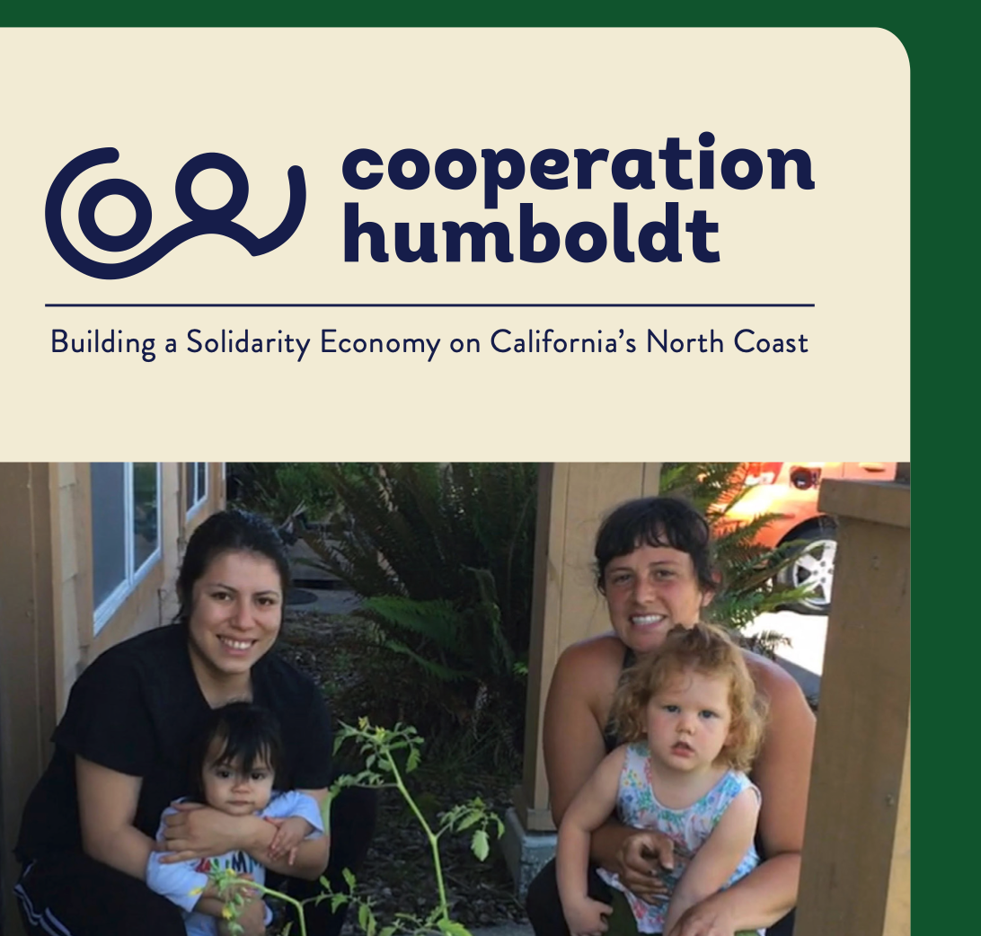
Neighborhood work parties
Crops swaps
Bulk buying programs
Planting fruit trees in parking strips
Form neighborhood book and tool libraries

Slide 26
Oakland Ecoblock Project

Slide 27
LIVE WELL WHILE USING LESS FOSSIL FUEL:
Conserve water
Cut energy use and waste
Make less carbon-intensive food choices
Select non-fossil fuel transportation options

Slide 28
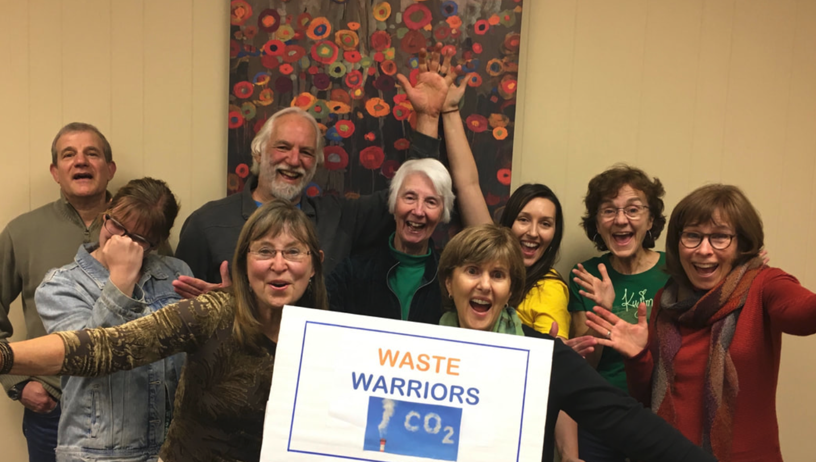
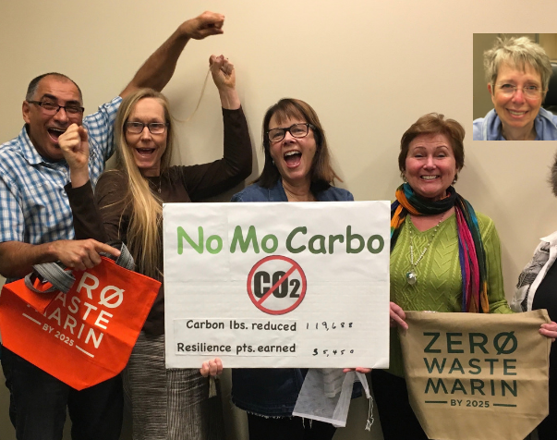
10 million pounds of carbon kept from being released into the atmosphere

Slide 30
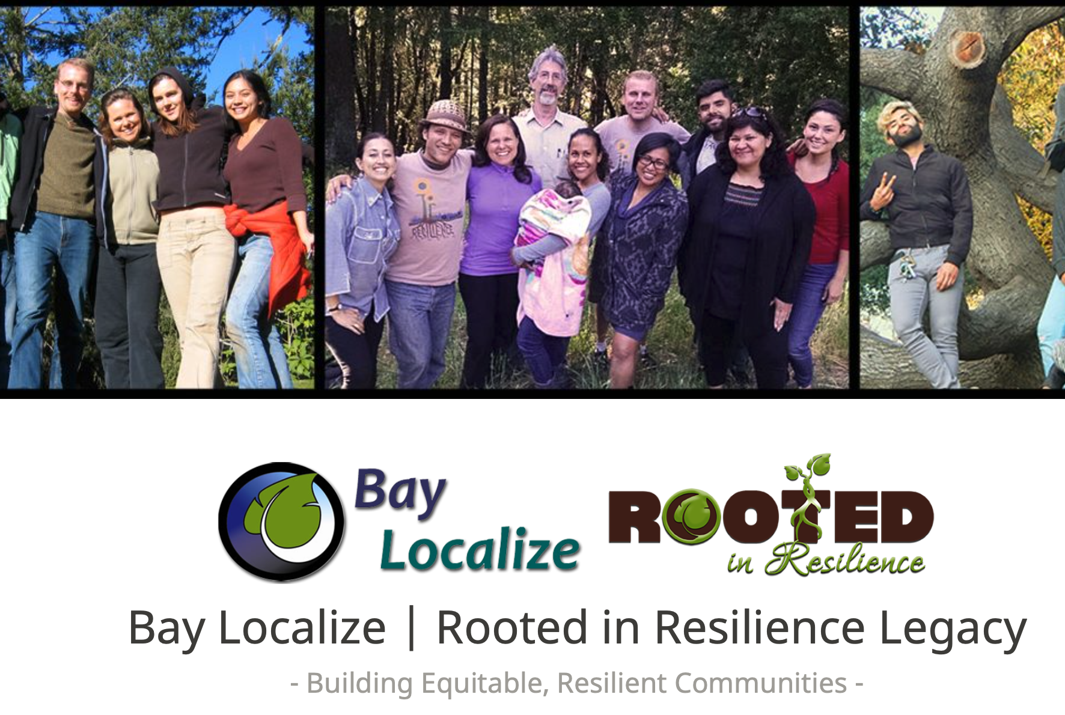
Encourages local action regarding:
food
water
energy
transportation
jobs
social support

Slide 31
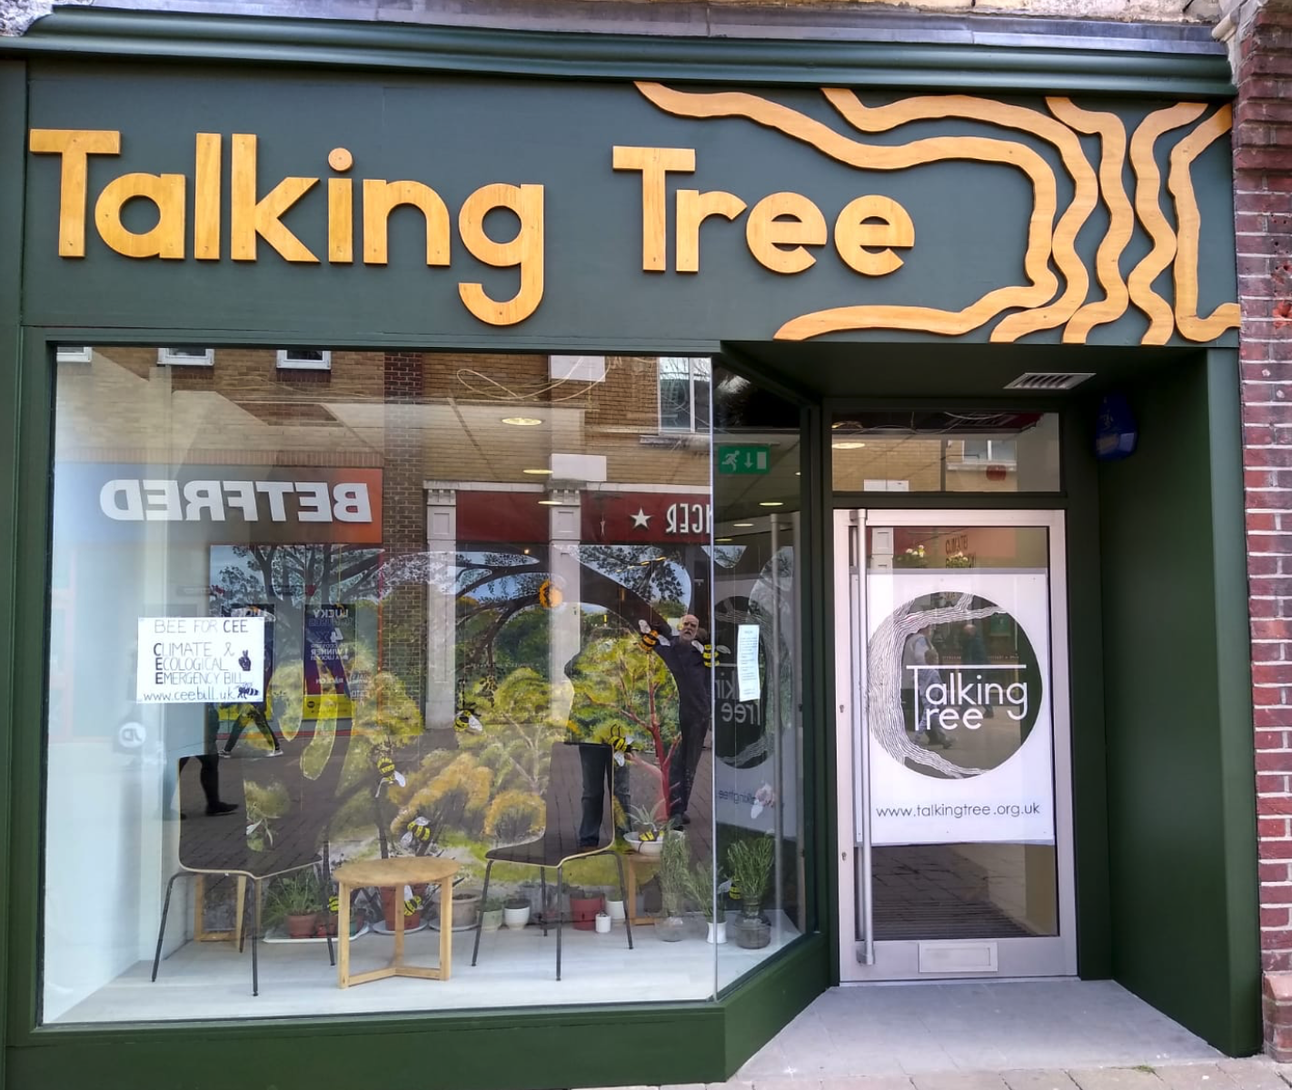
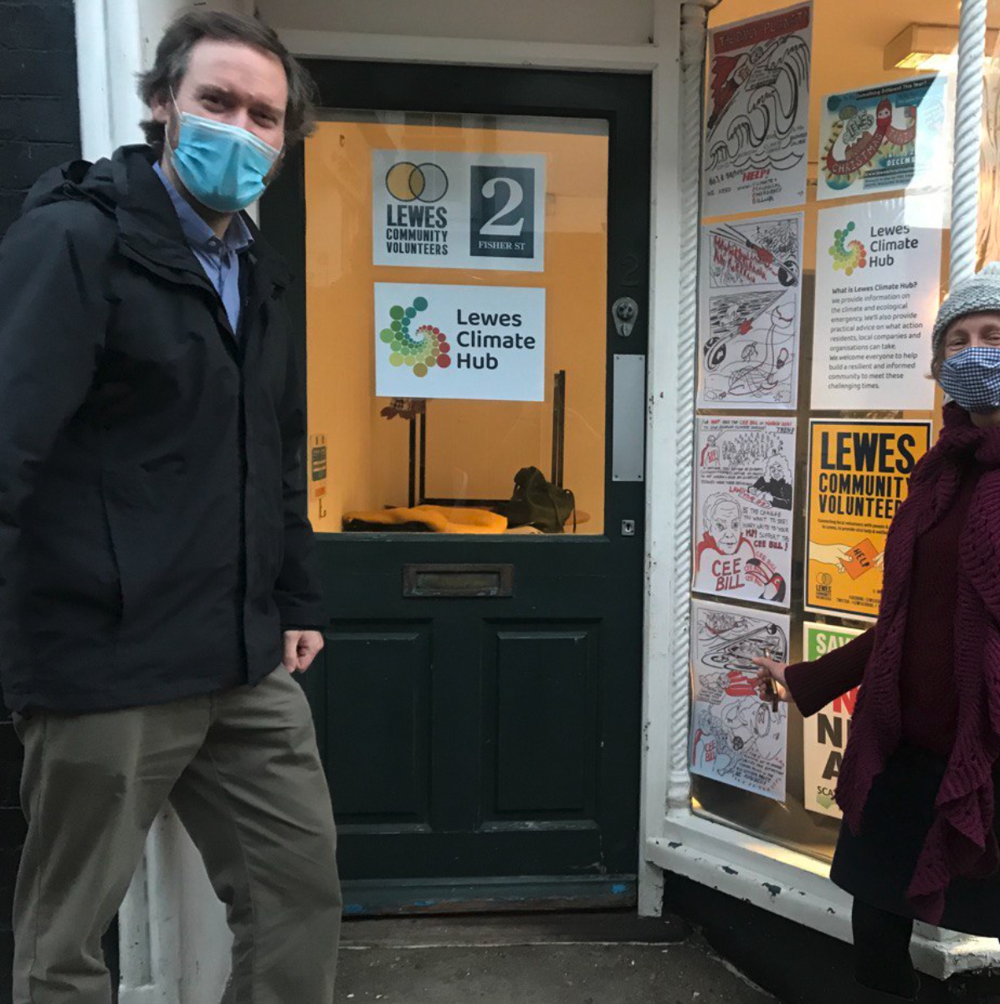
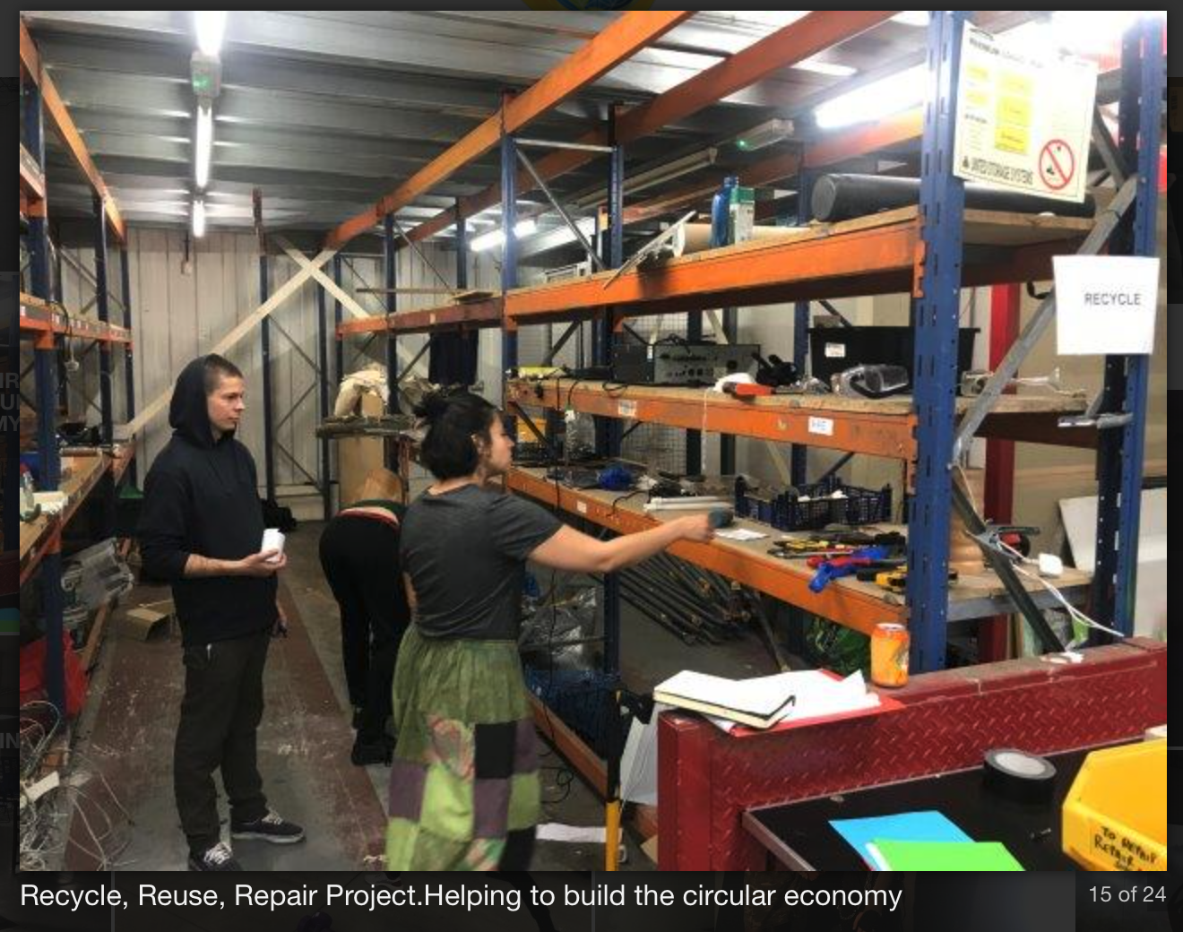
Climate Emergency Hubs
Solutions focus for people and planet
Local and inclusive attention to community needs
Active part of a wider network for mutual support and cooperation

Slide 32
Neighborhood Resilience Teams
Complete community mapping exercise
Plan for emergencies
Collect neighbors’ e-mail addresses to facilitate information exchange/invitations
Help organize neighborhood gatherings
Explore ways to share garden plots and food
Support elders and young parents
Neighborhood work parties
Educate one another about how to reduce our dependence on fossil fuels
Explore possibility of community solar
? ? ? ? ?

Slide 33
Discussion questions:
•. Spend a minute jotting down some of your thoughts about this idea.
What examples of mutual support do you see happening already in your neighborhood or other neighborhoods you know about?
Over and beyond the initiatives I mentioned in the talk are there other efforts or people you believe are already trying to do something similar?
Are there other things you believe Neighborhood Resilience Teams could focus on developing?
What factors do you think will make it tough to get a project like this going?
What individuals or groups should be contacted to help make this kind of plan a reality in West Linn, Oregon City, or Beaver Creek?

