Slide 1
West Linn Parks and Recreation
Cedaroak Boat Ramp Rehabilitation Project

Slide 2
Need for the Project

Slide 3
The Ramp Itself is 45 Years Old

Slide 4
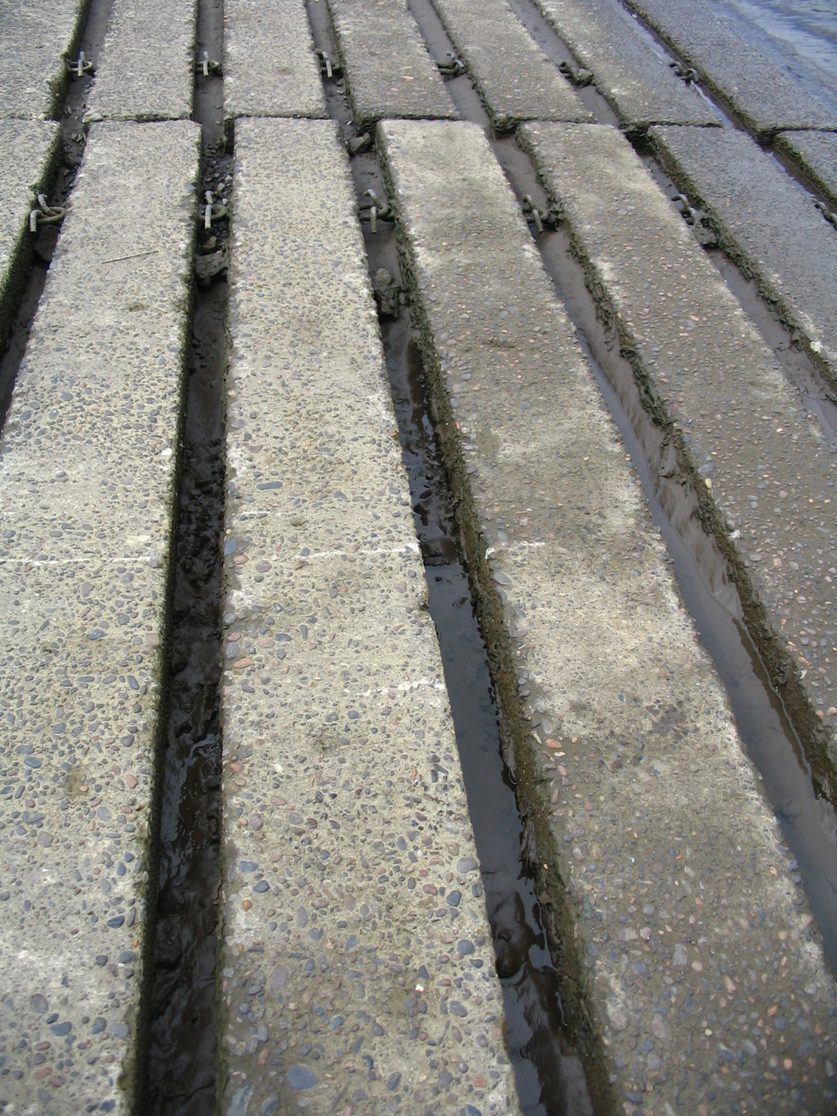

Slide 5
Lots of Damage From Floods

Slide 6
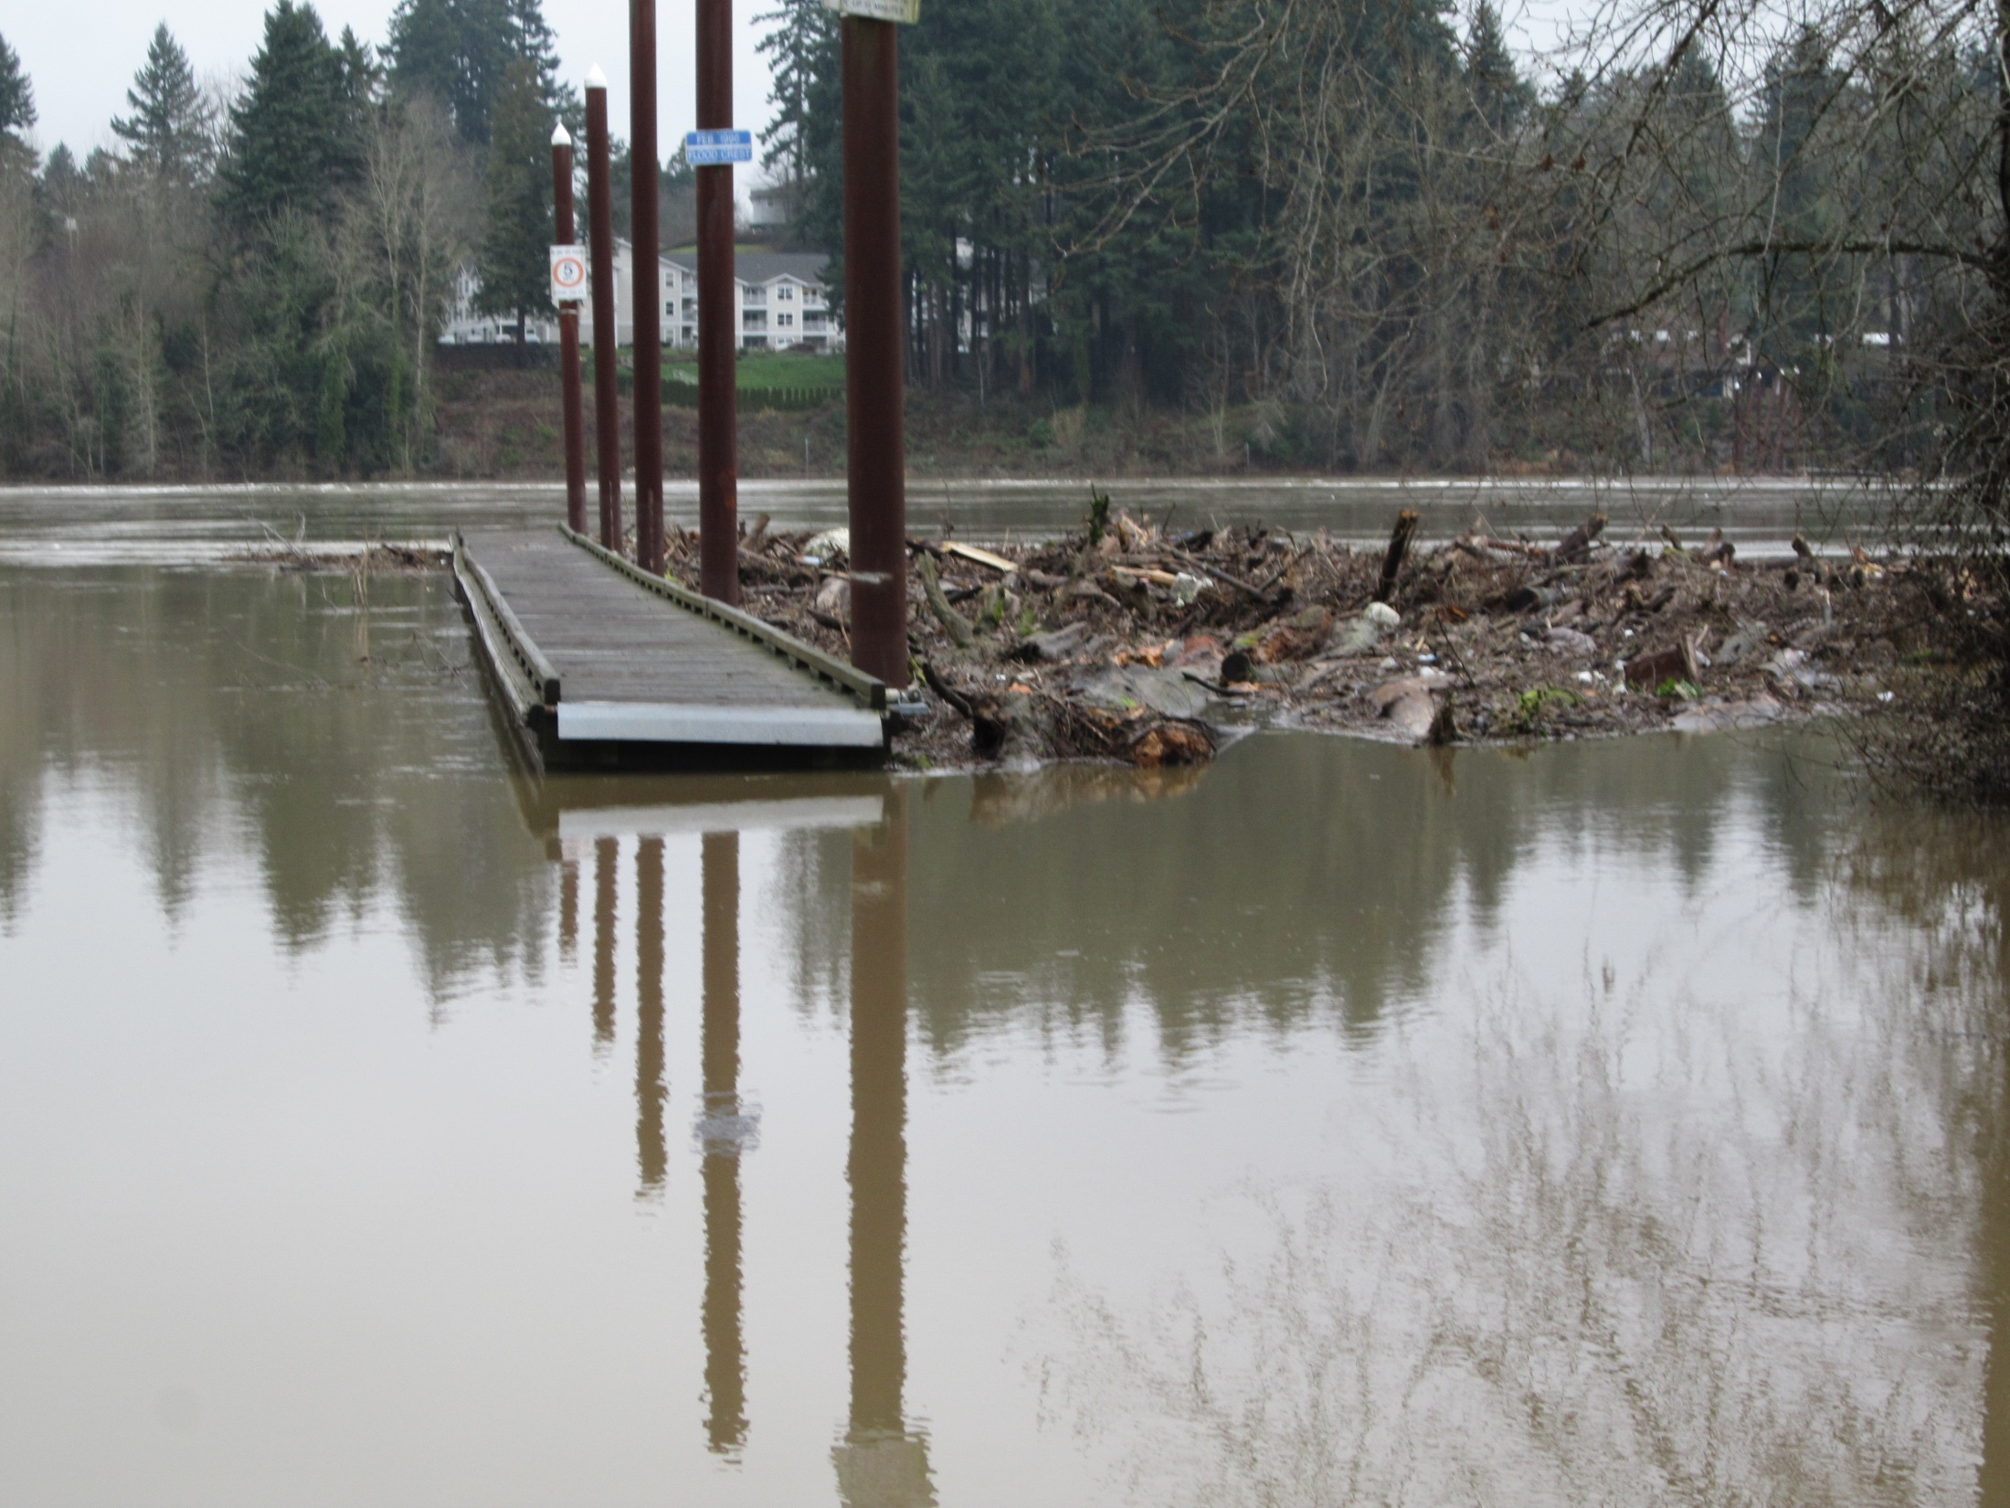

Slide 7
Barely Usable in Low Water Conditions

Slide 8
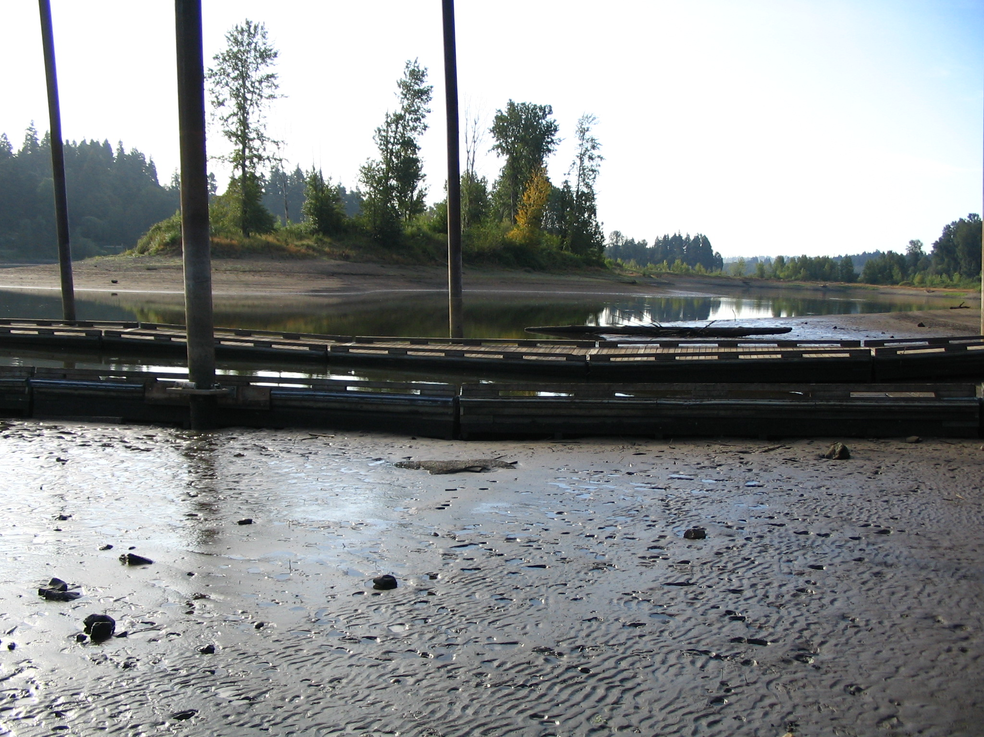

Slide 9
Dredging is Temporary, Expensive and Hard to Obtain Permits

Slide 10
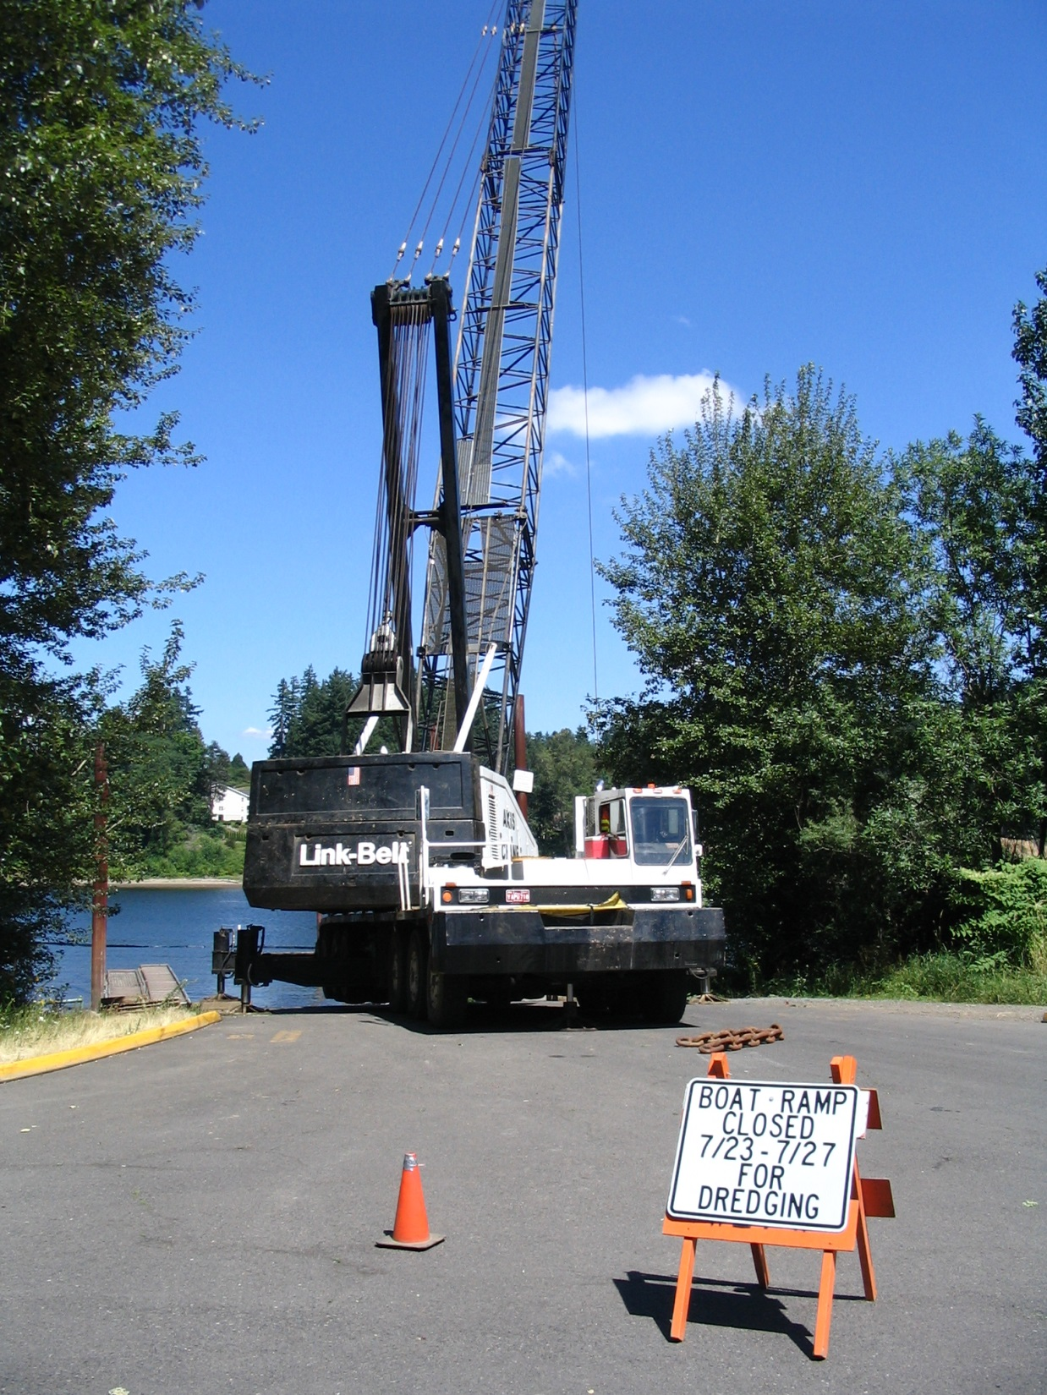

Slide 11
Partners and Supporters $1.4 Million
Oregon State Marine Board
Oregon Department of Fish and Wildlife
Oregon Department of State Lands
US Department of Fish and Wildlife
Tualatin Valley Fire and Rescue
Lake Oswego Fire Department
Clackamas County Sheriff Marine Patrol Division
Oregon Bass and Panfish Club
Association of Northwest Steelheaders
Oregon Anglers Research Society
West Linn Boaters and Residents

