Slide 1
Historic Review Board
Public Hearing: DR-18-09
1748 Willamette Falls Drive
March 19, 2019

Slide 2
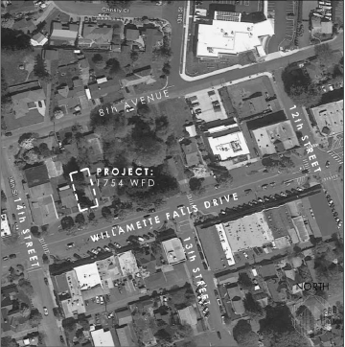

Decision Before the HRB
2017 approval after HRB recommendation on Chapter 58
  5,000 sq. ft. commercial mixed-use building
Current review limited to proposed modifications to approval
  Window sizes/locations
  Chap. 58 variance to replace wood siding with Hardie-Plank siding
Recommendation by HRB on proposed modifications to Planning Manager

Slide 3
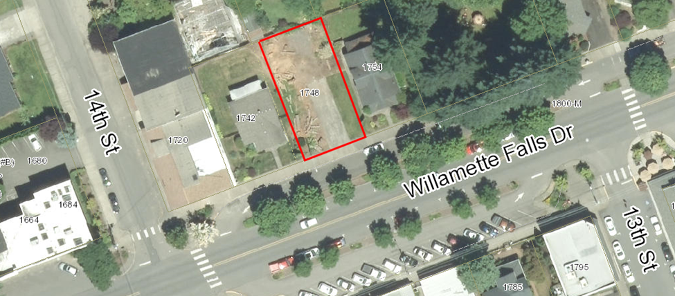
Property Characteristics
WF Drive near 14th Street
Located in WF Drive Commercial Design District
Not located in Historic District
Zoning – General Commercial
Comp Plan - Commercial

Slide 4

Review Criteria – CDC Chapter 58
Modification of window sizes/locations
  CDC 58.090.C(16)
  Staff Finding:
  Staff Finding 2: The applicant received design review approval to install double-hung second story windows with height to width ratios satisfying the 3:1 ratio requirement in March 2017 (DR-17-01). The applicant is not proposing any changes to the approved window configuration on the front elevation facing Willamette Falls Drive. The applicant is proposing to modify the window configuration on the west side elevation. All proposed windows are double-hung and have a minimum of two lights. The proposed change will result in 30.2% transparency on the west side elevation from the originally approved 59% transparency. This criterion is met.

Slide 5
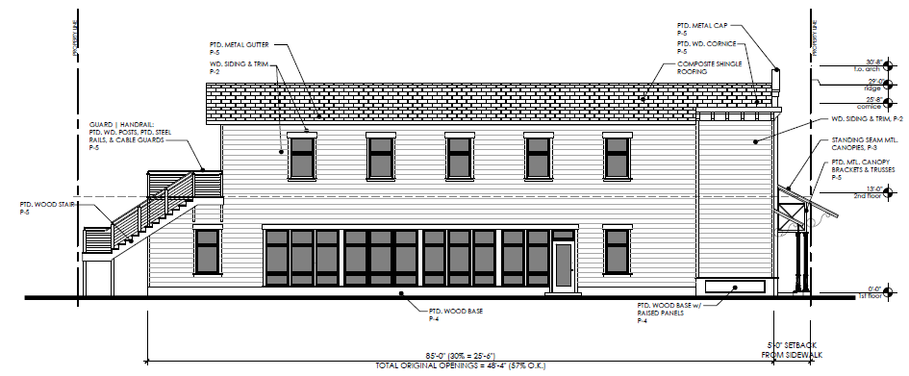
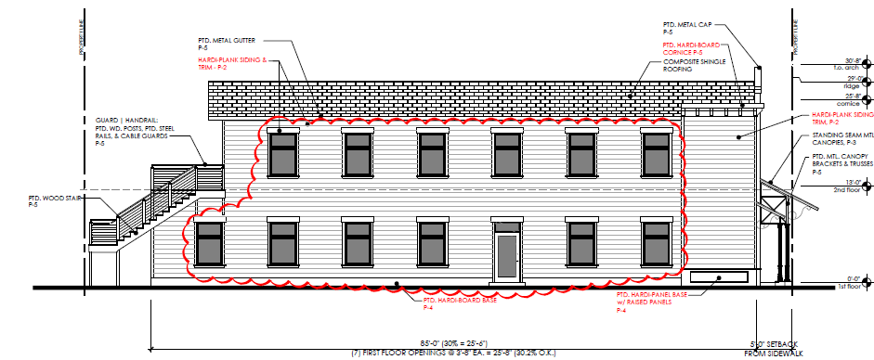
Modification of Second Story Windows (West Elevation)

Slide 6

Review Criteria – CDC Chapter 58
Chapter 58 Variance to use Hardie-Plank instead of wood siding
  CDC 58.090.C(10)
  CDC 58.090.C(28):
  Staff Finding:
  Staff Finding 1: The applicant received approval by the HRB to install horizontal wood siding in March 2017 (DR-17-01). The applicant is now proposing a variance to utilize Hardie-Plank siding in place of the wood siding approved in March 2017 (DR-17-01). Please see Exhibit HRB-3 for more detailed information. Subject to approval of the variance request, this criterion is met.

Slide 7

Variance Criteria – CDC Chapter 58
The applicant requests a variance to use HardiePlank siding in place of wood siding approved in 2016, which requires one of the following criteria is met:
  A. The applicant can demonstrate by review of historical records or photographs that the alternative is correct and appropriate to architecture in the region, and especially West Linn, in 1880-1915.
  B. The applicant is incorporating exceptional 1880-1915 architecture into the building which overcompensates for an omission. The emphasis is on superior design, detail, or workmanship.

Slide 8
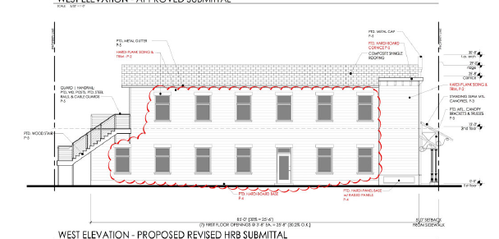
Staff Analysis
Recommendation:
Subject to the HRB’s decision on the variance request, staff recommends the Historic Review Board recommend approval of the proposal with at least one, but potentially more conditions of approval.
1. Site Plan, Elevations, and Narrative. The project shall conform to the plans, elevations, and narrative submitted in Exhibit HRB-3.

Slide 9
Historic Review Board – DR-18-09
QUESTIONS OF STAFF?

