Slide 1
Planning Commission
Mixed-Use Working Group Recommendations
Worksession: CDC-18-02
May 2, 2018

Slide 2
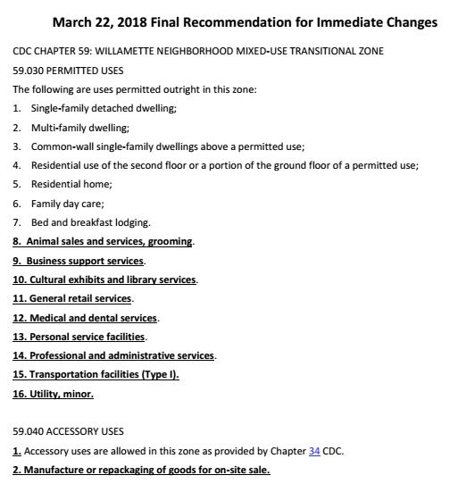
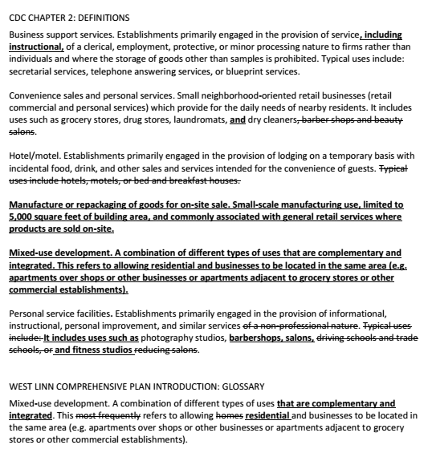
Planning Commission Agenda Packet
Staff Memo
  Link to MU Working Group materials
MU Working Group Memo/Recommendation
  Immediate legislative changes
    CDC Chap. 59 use list
    CDC Chap. 19 use addition
    CDC definition amendments
    Comp Plan mixed-use definition
  Planning docket additions
Map, Purpose & Goal, Membership
CDC Chapter 59

Slide 3
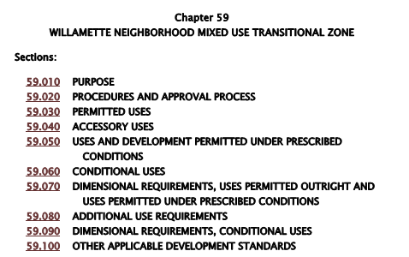
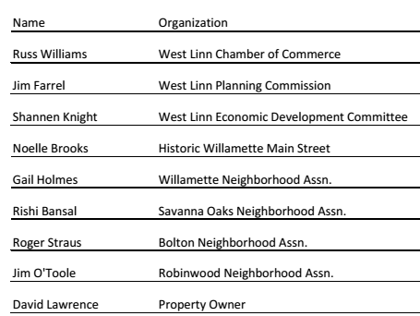
Mixed-Use Working Group: Background
CC/PC/EDC Meeting – Summer 2017
  Priority of CC
  Directed CCI to propose
    Purpose
    Goal
    Membership
City Council appointed group on 11/13/2017
  8 Members
  2 Purposes
  1 Goal

Slide 4
Mixed-Use Working Group: Purpose & Goal
City Council prescribed purposes for group
  First Purpose: To review and update as necessary the list of permitted and conditional uses in the Willamette Neighborhood Mixed-Use Transitional Zone (MU Zone – Chapter 59)
  Second Purpose: Consider a definition of mixed-use
City Council prescribed goal for the group
  Updated lists are needed to reflect current business culture and categories (terminology or categories of uses) and to facilitate compatible mixed-use, commercial, and residential uses. Updated lists will support community and economic goals and will assure appropriate transition between the Historic Willamette commercial core and surrounding Willamette neighborhood.

Slide 5
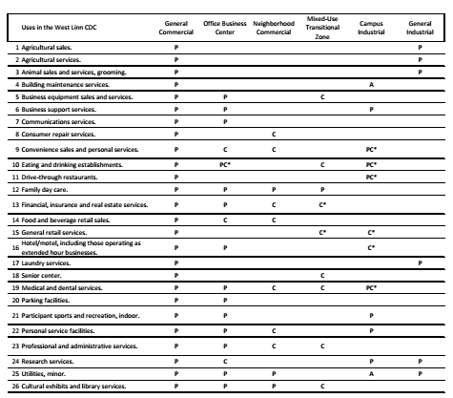
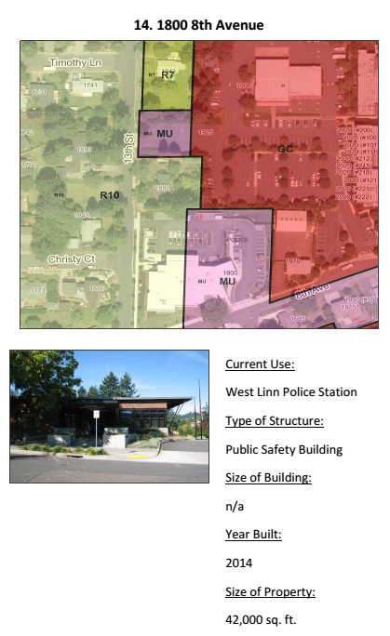
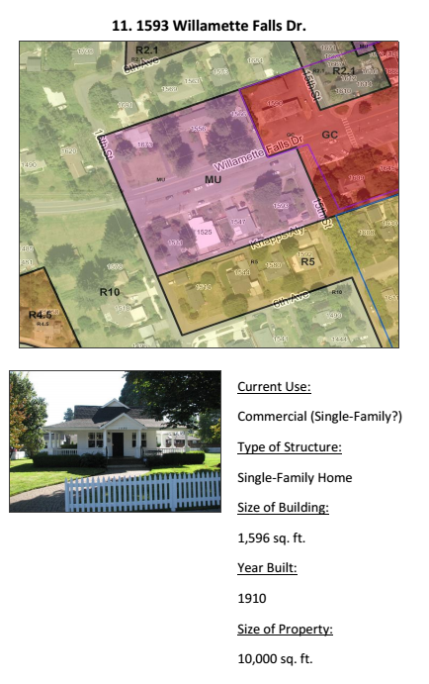
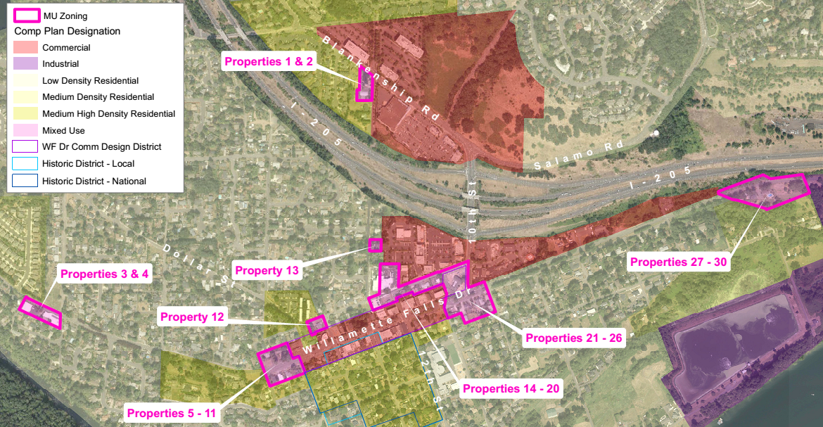
Mixed-Use Working Group: Meeting 1
Meeting 1 – January 4, 2018
  Acclimate to process
  Review materials
  Hear from property owners
  Request 9th member/elect chair

Slide 6
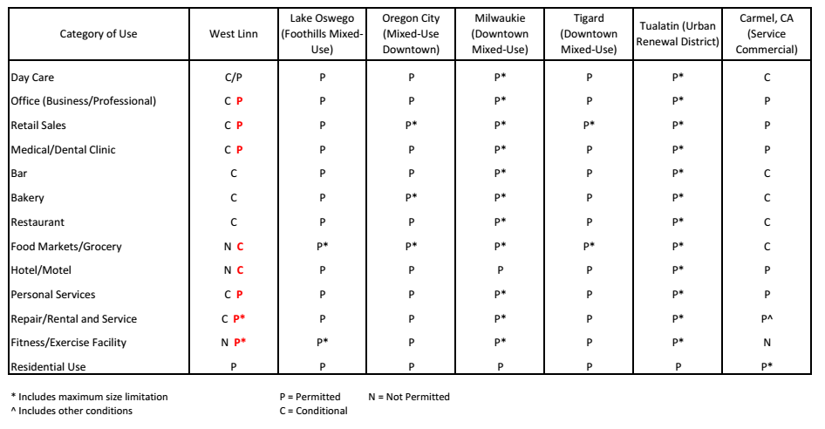
Mixed-Use Working Group: Meeting 2
Meeting 2 – January 25, 2018
  Working definition of mixed-use (Purpose 2)
  Zoning/location discussion
  Permitted/conditional use comparison with other cities

Slide 7
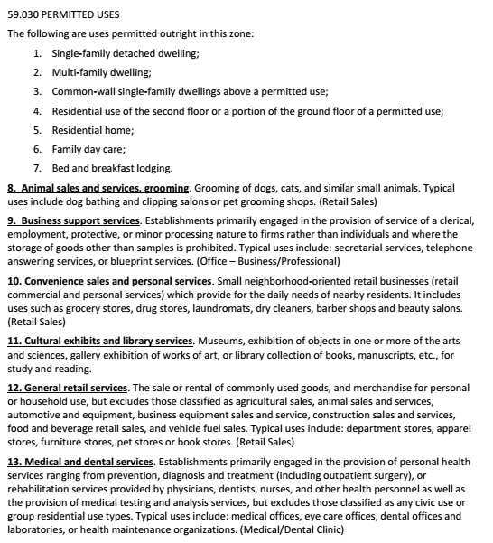
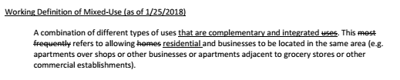
Mixed-Use Working Group: Meeting 3
Meeting 3 – February 22, 2018
  Staff research/options
    Day care, small hotels, repair business, yoga studios
  Proposed updated use list (Purpose 1)
  Definition changes
  Small-scale manufacturing discussion

Slide 8
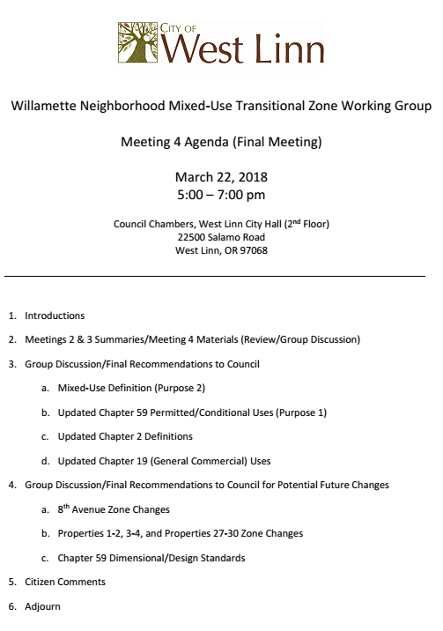
Mixed-Use Working Group: Meeting 4
Meeting 4 – March 22, 2018
  Staff research/options
    Personal service facilities/grocery store
    Small-scale manufacturing
  Final Recommendations
    Mixed-use definition (Purpose 2)
    CDC Chap. 59 updated use list (Purpose 1)
    CDC Chap. 19 additional use
    CDC Chap. 2 definition changes
  Final Recommendations for future consideration

Slide 9
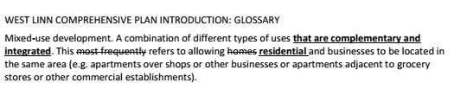
Mixed-Use Working Group: Recommendations
Mixed-use definition (Purpose 2)
  Small amendment to existing Comp Plan Glossary definition
  Add amended definition to CDC Chapter 2

Slide 10

Mixed-Use Working Group: Recommendations
CDC Chapter 59 updated use lists (Purpose 1)
  Permitted Uses
    Added 9 more
  Accessory Uses
    Added 1 more
    Manufacture or repackaging of goods for on-site sale
  Uses and Development Permitted Under Prescribed Conditions
    Added 5 more
  Conditional Uses
    Added 4 more
    Removed 5 for no definition
    Moved 3 to P and 2 to PC

Slide 11
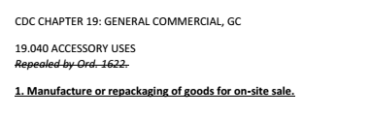

Mixed-Use Working Group: Recommendations
CDC Chapter 19 – add an accessory use to be consistent with Chapter 59

Slide 12

Mixed-Use Working Group: Recommendations
CDC Chapter 2 – Definition amendments
  Business support services
    Added “including instructional”
  Convenience sales and personal services
    Moved “barber shops and beauty salons” for better fit
  Personal service facilities
    Added “barber shops, salons, and fitness studios”
    Removed some out-of-date language
  Hotel/motel
    Bed and breakfast defined separately
  Manufacturing or repackaging of goods for on-site sale
  Mixed-use development

Slide 13

Mixed-Use Working Group: Recommendations

Slide 14
Mixed-Use Working Group: Future Considerations
Consider rezoning properties along 8th Avenue
  10th to 13th Street from MU to GC
    7 of 8 property owners in favor
  13th to 14th Street from R-10 to MU/GC
    4 of 6 property owners on south side in favor
    1 in favor, 1 not out of 5 on north side
Evaluate more appropriate zoning for separated properties
  Properties 1-2, 3-4, and 27-30 on map in packet
CDC Chapter 59 dimensional/design standard changes
  Reuse vs. Redevelopment
  Zero lot lines, remove max building size, remove residential style standards
Evaluate parking management in Willamette Main Street area

Slide 15

CDC-18-02 Legislative Process
June 6: Planning Commission Public Hearing
  Recommendation to City Council
June 18: City Council Worksession
  Staff briefing and question/answer session
July 9: City Council Public Hearing
  Final Decision on proposal

Slide 16
CDC-18-02
QUESTIONS OF STAFF?

