Slide 1
Planning Commission/ PRAB Meeting
April 18, 2018

Slide 2
Agenda
Draft Plan Presentation and Discussion
Overview of Planning Process
Park & Recreation System
Community Priorities
Goals for the Future
Recommendations
Action Plan

Slide 3
OVERVIEW OF PLANNING PROCESS

Slide 4
Dec. 2016
March 2018

Slide 5
PARK & RECREATION SYSTEM

Slide 6
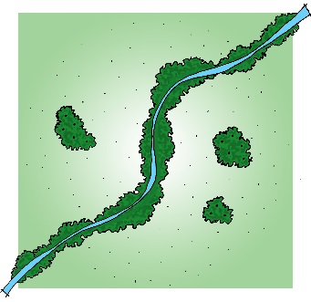
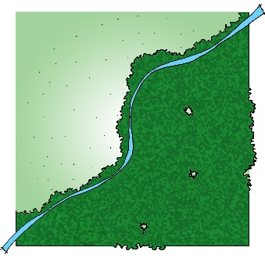
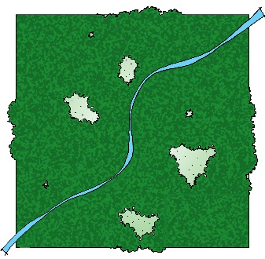
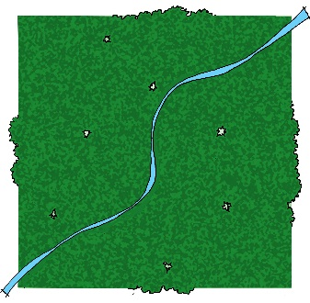
Spectrum of Parks & Open Spaces
More than 548 acres of park land
Developed parks with some natural elements
Natural resource areas with little or no developed uses

Slide 7
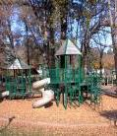
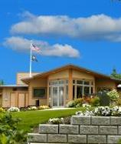
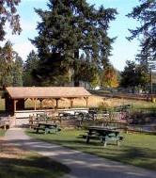
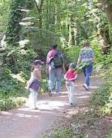
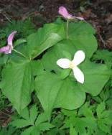
Types of Parks & Open Spaces
City provides 5 different types of parks and open spaces
Active-Oriented Parks
Special Use Areas
Multi-use Parks
Passive-Oriented Parks
Natural Resource Areas
12 existing sites
45.1 acres
7 existing sites
38.7 acres
6 existing sites
207.5 acres
41 existing sites
213.9 acres
25 existing sites
43.1 acres

Slide 8
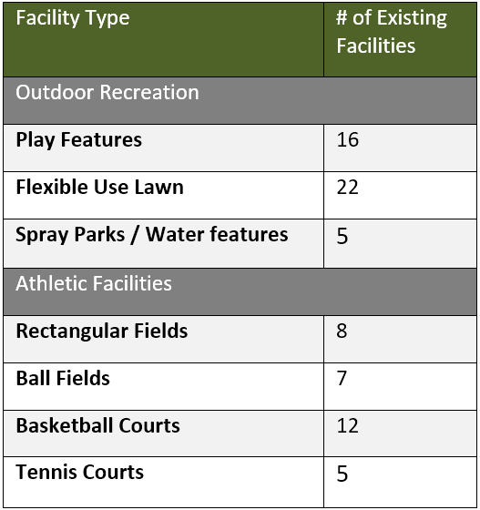
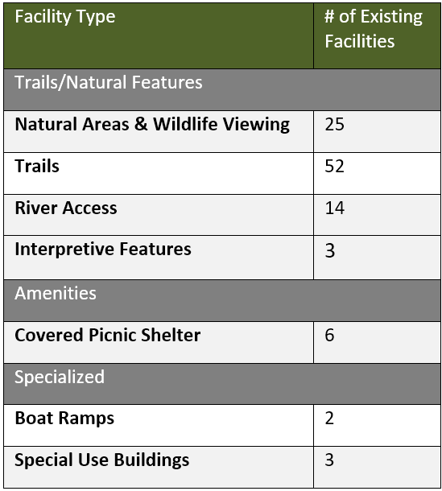
Types of Recreation Facilities

Slide 9
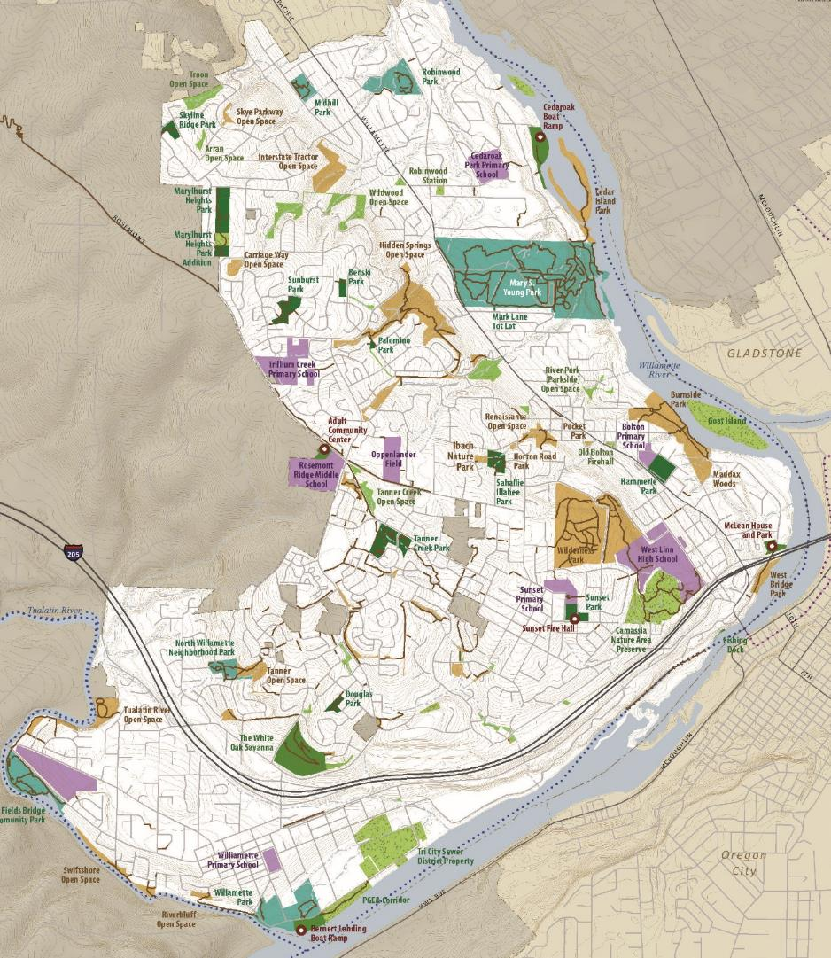
Map of Existing Parks & Facilities

Slide 10
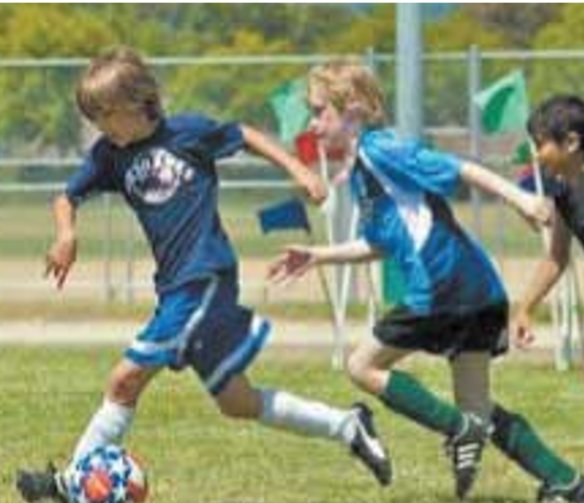
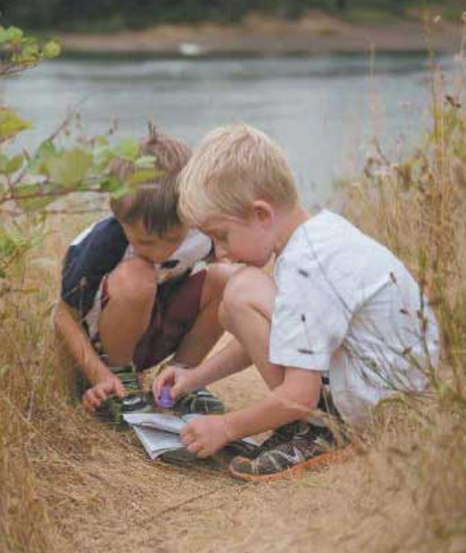
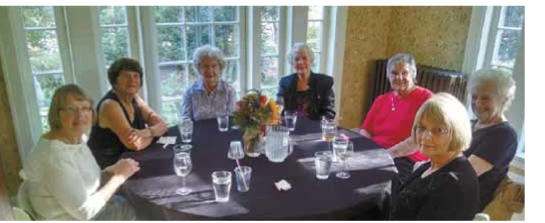
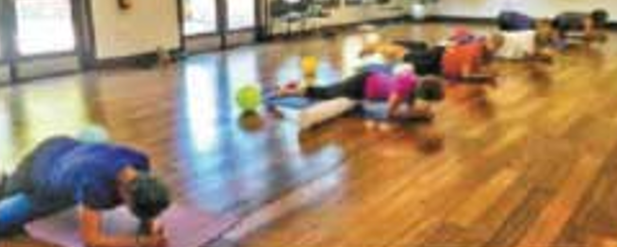
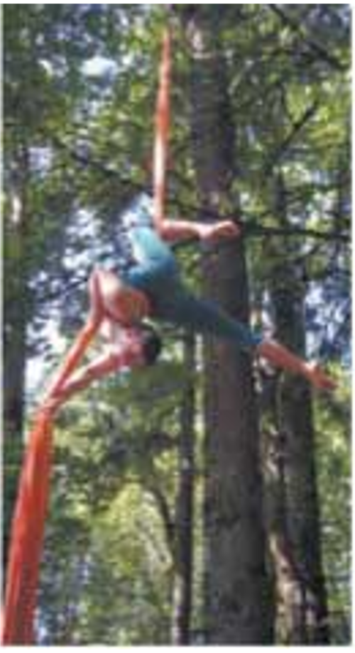
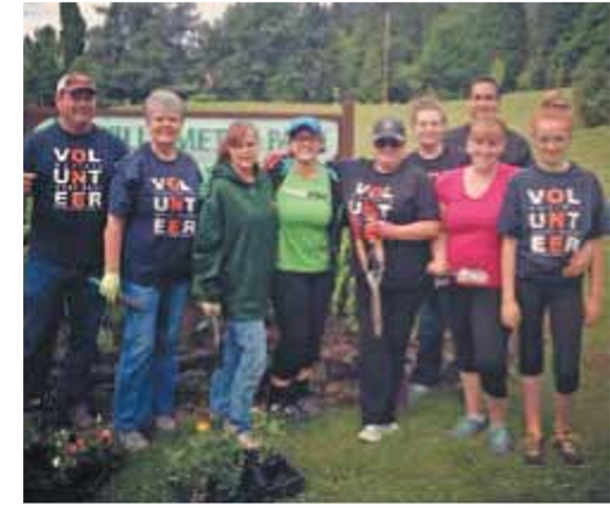
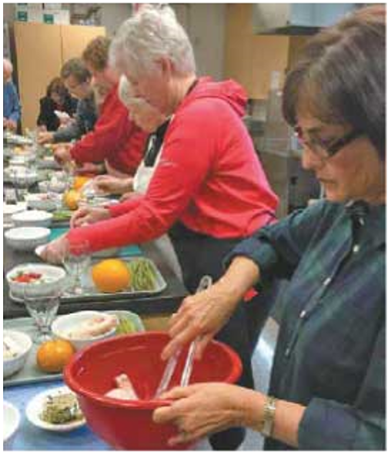
Recreation Programs & Events

Slide 11
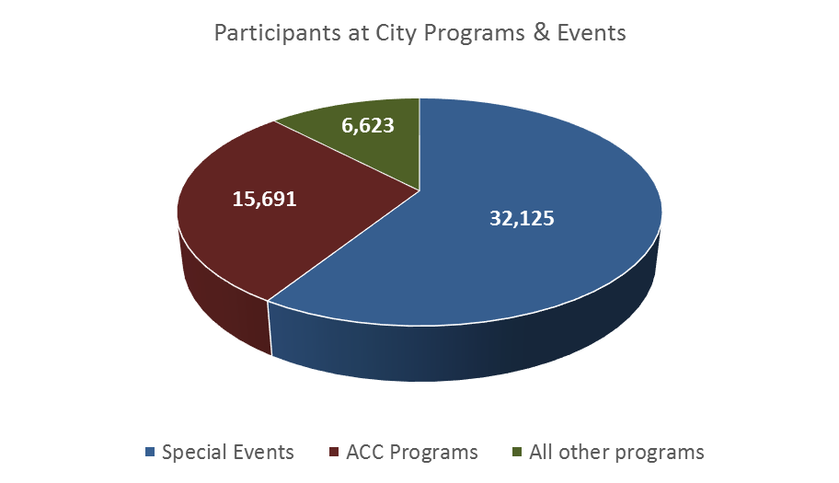
Program Participation

Slide 12
Program Assessment
Special Events
Seniors/Older Adults
Youth Sports
Fitness/Wellness
Cultural Arts
Youth / Childcare
General Interest
Education
Outdoor Recreation/Nature Programs
Teens
Adult Sports
Aquatics
Special Needs
Self-Directed/Drop-In
CORE
Primary responsibility of the Parks & Recreation Department to provide
SECONDARY
Lower priority to be provided by the Parks & Recreation Department
SUPPORT
Not provided directly by the Parks & Recreation Department
NO ROLE

Slide 13
COMMUNITY PRIORITIES

Slide 14
Neighborhoods
Future growth estimated to occur most significantly in the communities of Willamette, Savanna Oaks, Robinwood and Parker Crest

Slide 15
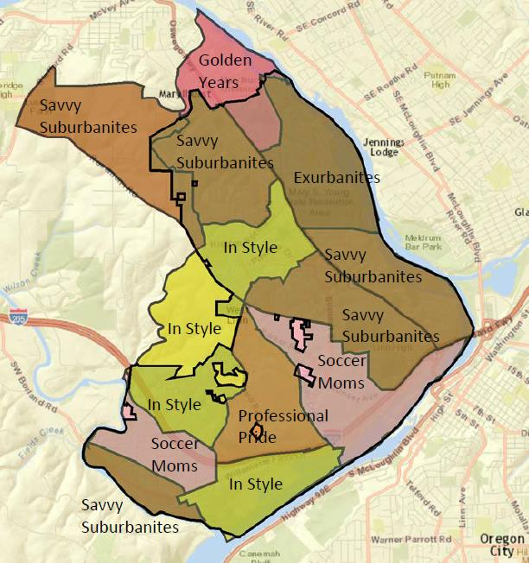
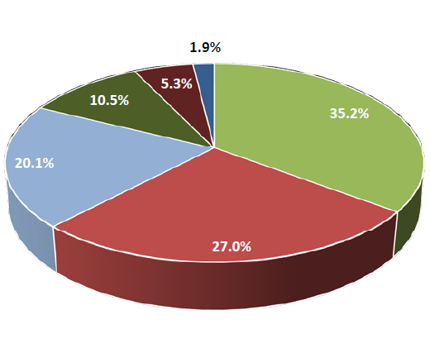
Market Tapestry Segments
Professional Pride
Savvy Suburbanites
Soccer Moms
In Style

Slide 16
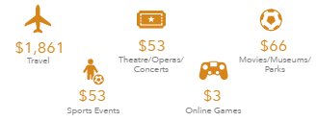
National Average

Slide 17
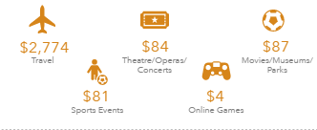
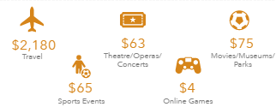
Tapestry Segments
Savvy Suburbanites
(35%)
Families with older kids/empty nests.
Active lifestyles, sports, exercise, arts.
Expenditures on entertainment and rec are 84% above national average.
In Style
(27%)
Professional couples without children.
Arts, travel, gardening, charitable causes.
Expenditures on entertainment and rec are 25% above national average.

Slide 18
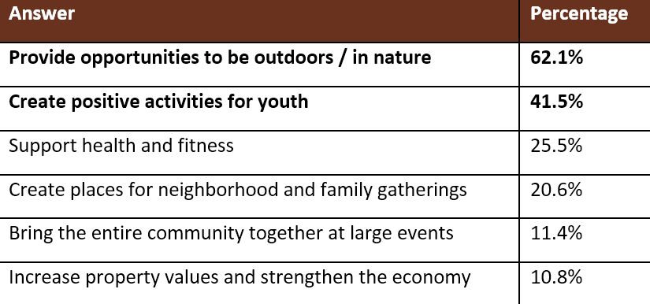
Most important benefits of the parks & recreation system
1,898 total respondents (6% of residents + others)

Slide 19
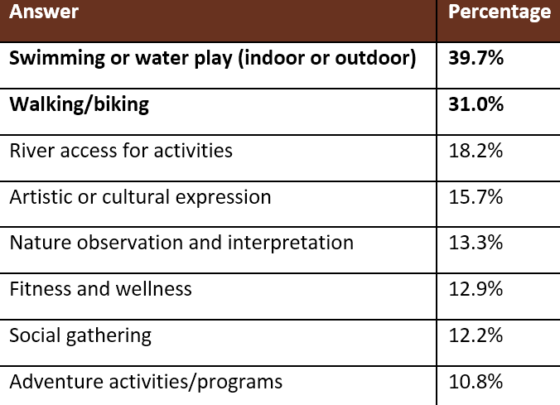
Desired activities in West Linn

Slide 20
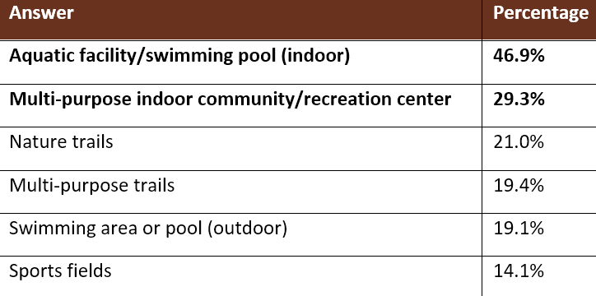
Highest priorities for development or improvement if funding were available

Slide 21
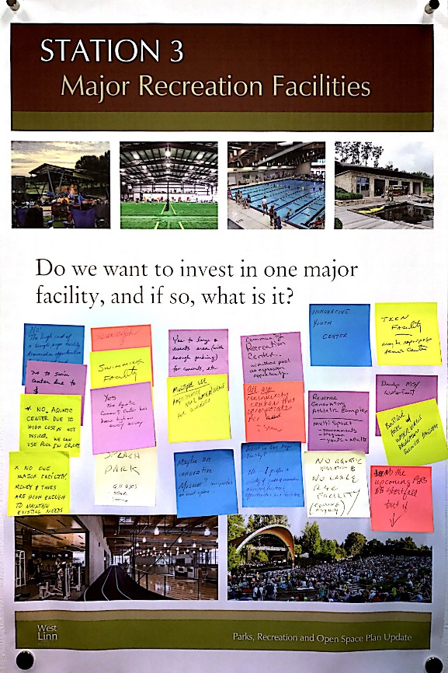
Vision Workshop Priorities
Activating waterfront
Increasing recreation for all ages
Providing greater variety of recreation options
Supporting economic benefits
Investing in West Linn’s identity
Sustain/steward system

Slide 22
Priority if pursue future tax measure
Probably oppose
No answer
New aquatic facility
47%
13%
13%
7%
11%
9%
Definitely support
Probably support
Not sure
Definitely oppose
60% of respondents show some level of support; 40% do not support; 11% oppose.

Slide 23
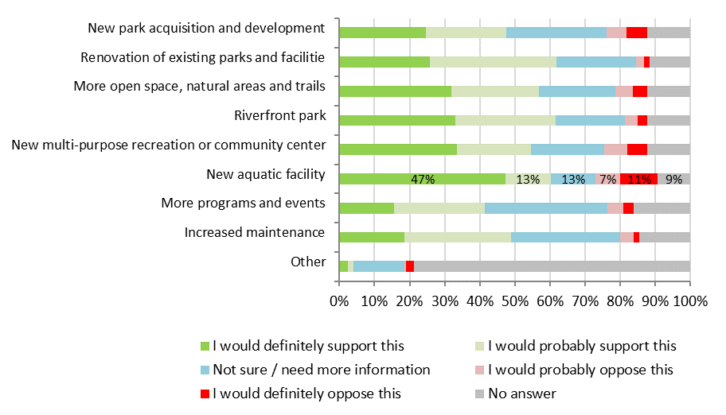
Priority if pursue future tax measure

Slide 24
GOALS FOR THE FUTURE

Slide 25
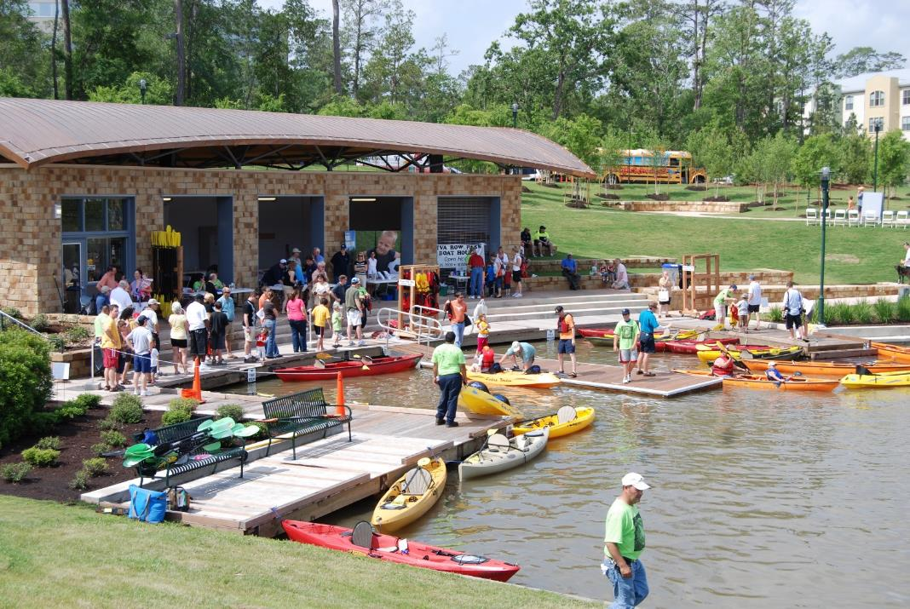
Goal 1: Re-envision West Linn’s water experience

Slide 26
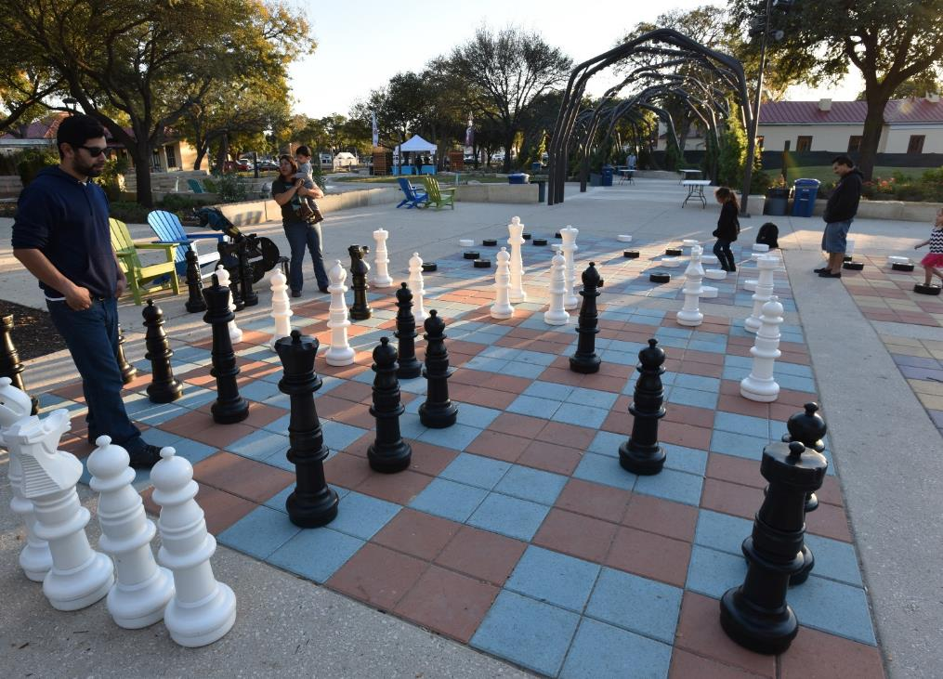
Goal 2: Create social hubs that provide year-round gathering places for all West Linn residents

Slide 27
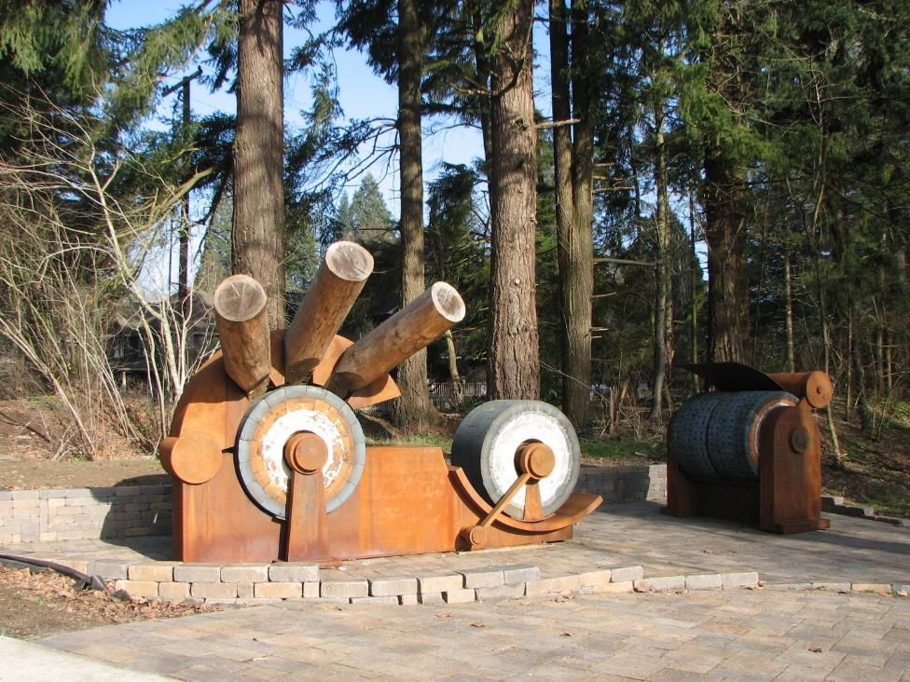
Goal 3: Create parks and open spaces that showcase West Linn’s unique qualities

Slide 28
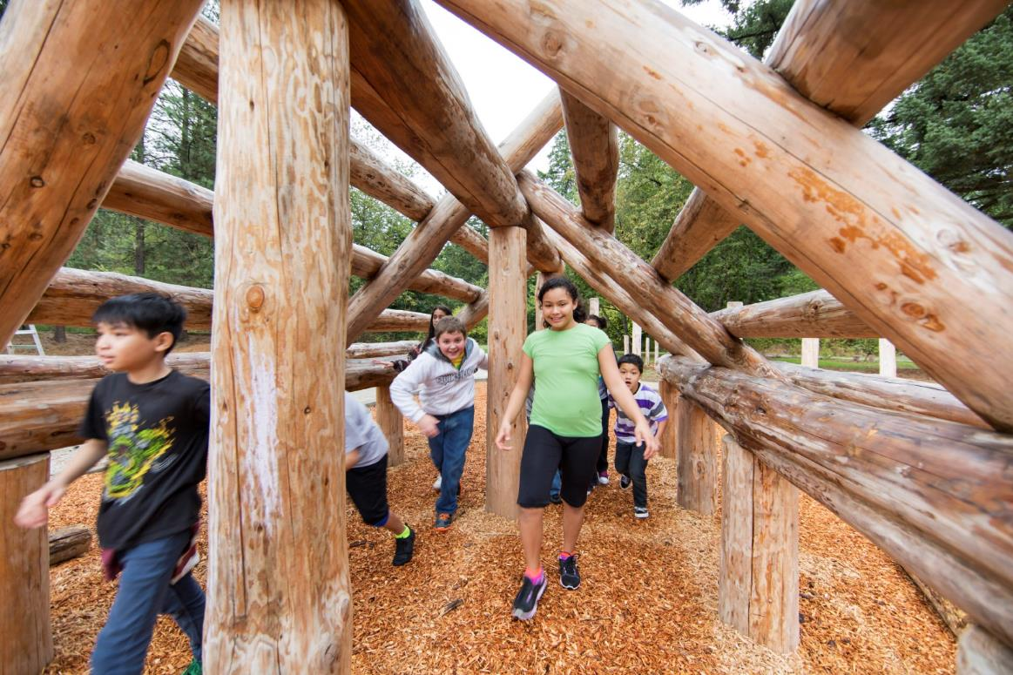
Goal 4: Provide new and extraordinary experiences in West Linn’s parks

Slide 29
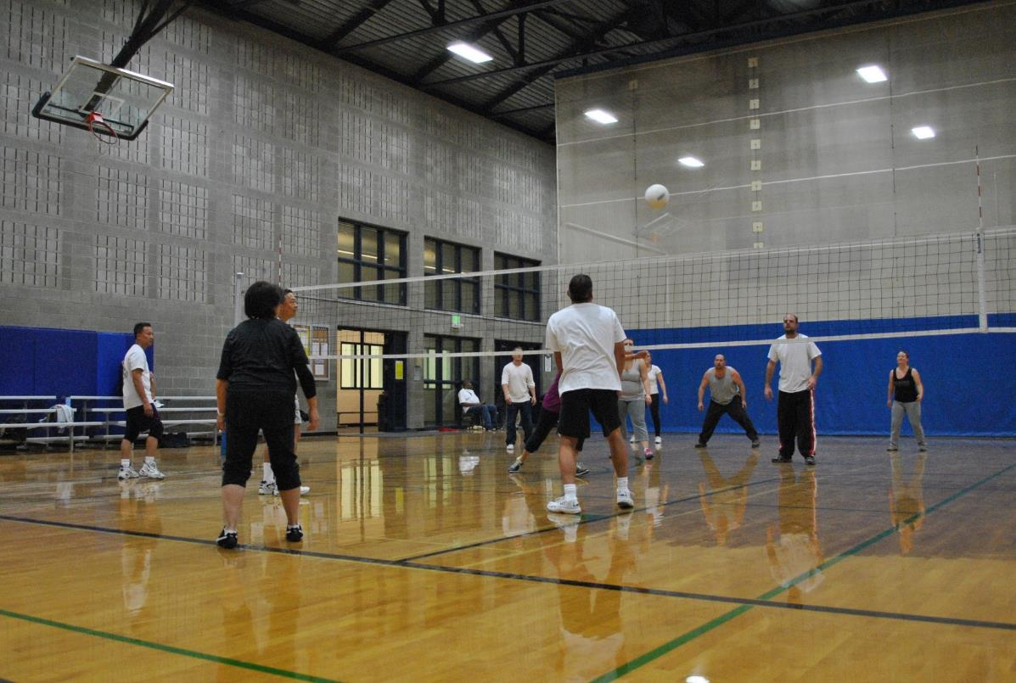
Goal 5: Re-imagine West Linn’s future indoor recreation opportunities

Slide 30
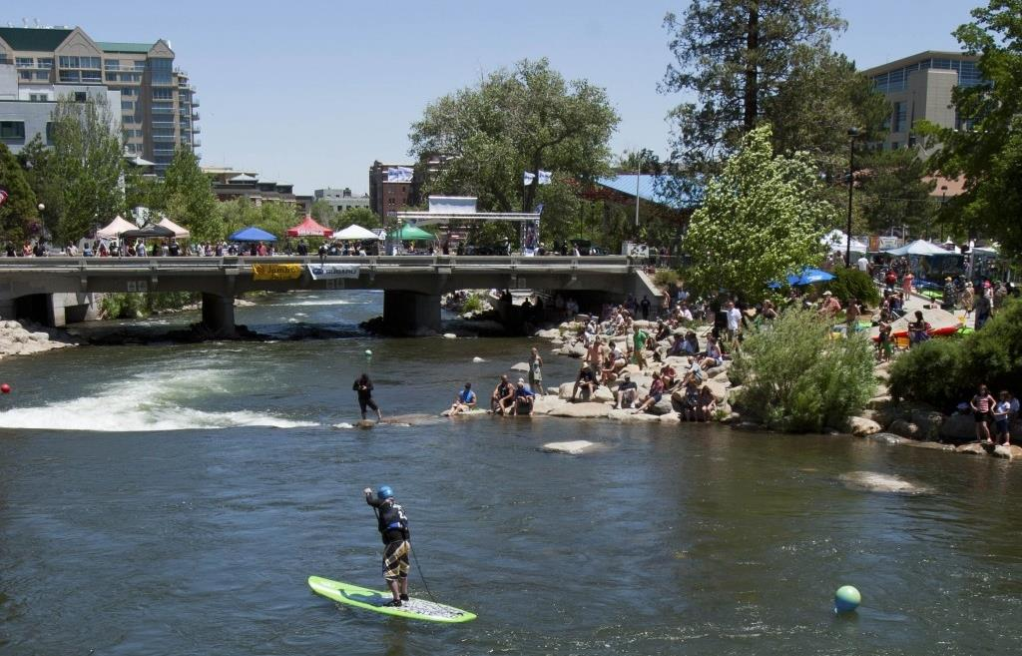
Goal 6: Activate parks with recreation programs and events that encourage social interaction and a sense of community

Slide 31
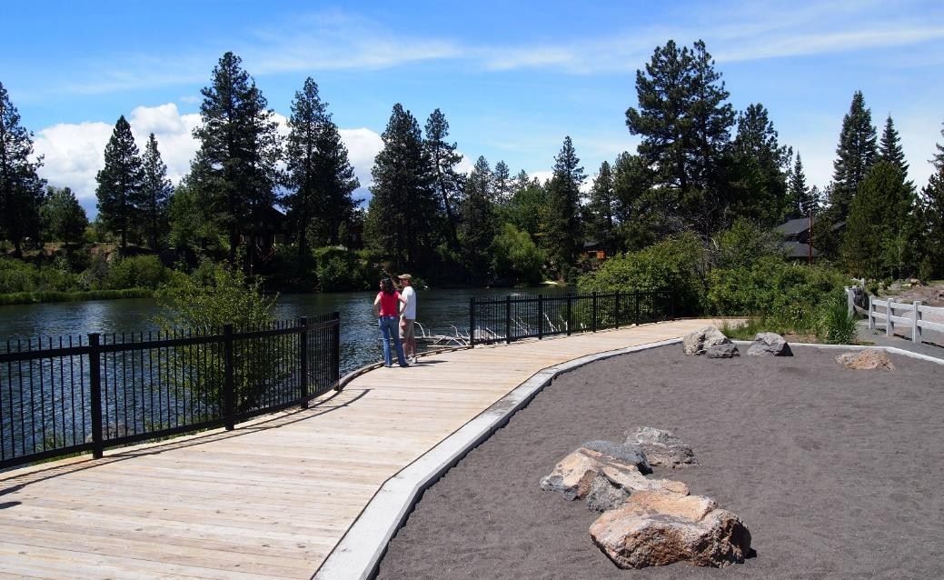
Goal 7: Create a more connected and accessible environment for pedestrians, bicyclists and other recreation uses

Slide 32
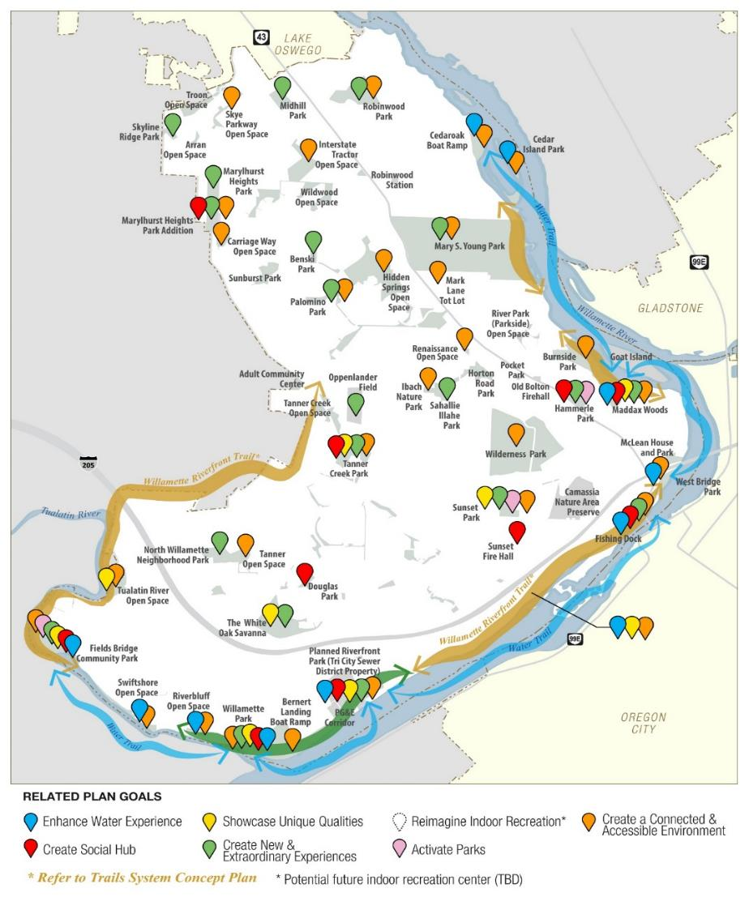

Slide 33
RECOMMENDATIONS

Slide 34
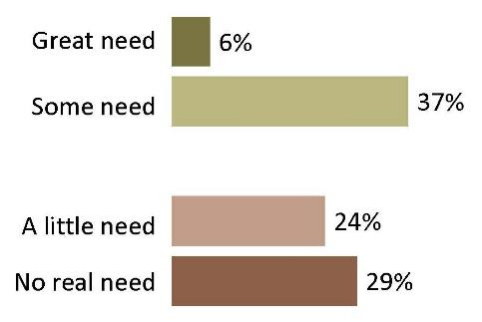
Bond Feasibility Study
The Parks & Recreation Department has a stronger approval rating (85%) than the Streets Department, City Council, Neighborhood Associations and City management overall.
The Department does such a good job of maintaining sites that only 39% of respondents think that deteriorating and run-down parks are a serious problem. Parks issues overall are perceived to be less serious than other city issues.
Fewer than half see a need for funding for neighborhood parks, trails, natural areas, and recreation facilities.
FM3: West Linn Bond Measure Feasibility Study

Slide 35
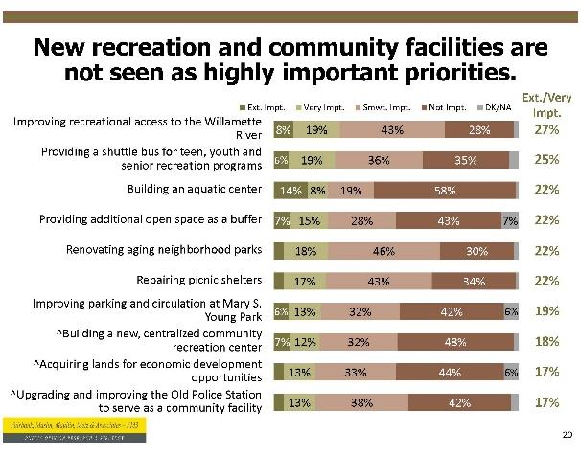
Bond Measure Study Findings on Facility Priorities

Slide 36
Increase in Developed Acres and Maintained Acres per Staff Person Since 1995

Slide 37
Numbers of Sites Needing Improved Maintenance and Reinvestment
Maintenance Classification | Definition | # of Existing Sites | # of Proposed Sites | Examples
Basic Maintenance | A basic level of maintenance includes routine monitoring, inspection and care of recreation facilities, natural areas and landscaping. At this level, the City provides routine maintenance for health and safety, but not specialized care for asset protection. All sites need at least basic maintenance. | 50 | 8 | All parks and natural areas
Standard Maintenance | More heavily or frequently- used sites require a higher standard of maintenance. These sites receive the types of maintenance provided at “basic” maintenance sites on a more frequent basis. | 7 | 1 | All boat ramps, Tanner Creek Park, White Oak Savannah. Mary S. Young, Midhill Park
Enhanced Maintenance | Enhanced maintenance is needed at sites that include specialized assets and are highly visible and heavily used. These sites are maintained at the highest level and receive priority during peak use times. | 10 | 6 | All indoor facilities, Fields Bridge Park, Willamette, planned Riverfront Trail and Riverfront Park
Reinvestment/Replacement | An allowance should be set aside annually to offset the costs of replacing facilities at the end of their lifecycles. In the timeframe of this plan, this applies to all sites. | 41 | 9 | All developed park sites

Slide 38
Highlights of Recommendations for Existing Sites (# of sites needing improvements)
 | Major Enhancement | Minor Enhancement | Added Facility | Deferred Maintenance | Natural Resource Restoration
Active-Oriented | 2 | 5 | 4 | 2 | 0
Special Use | 1 | 2 | 1 | 1 | 0
Multi-Use | 2 | 4 | 0 | 5 | 1
Passive-Oriented | 1 | 6 | 0 | 1 | 14
Natural Resource Areas | 0 | 0 | 0 | 0 | 0
TOTAL Existing Parks | 6 | 17 | 5 | 9 | 15

Slide 39
Highlights of Recommendations for Proposed Sites (# of sites needing improvements)
 | Acquire | Plan | Develop | Enhance | Sustain
Proposed park sites | 6 | 6 | 6 | 3 | 1
Potential Partner Sites | 0 | 0 | 0 | 1 | 0
Other Sites | 0 | 0 | 0 | 1 | 0
TOTAL | 6 | 6 | 6 | 5 | 1

Slide 40
Top Community Projects
Key park improvements
Fields Bridge
Maddox Woods
Sunset Park
Marylhurst Park
Sports, activity and play
User comfort and accessibility
Riverfront park and trail
Trailheads

Slide 41
Programming Recommendations
Cost recovery/ revenue reinvestment
Fee adjustments/facility use fees/concessions
Program expansion:
Outdoor recreation/nature
Cultural arts
Fitness wellness
Continued focus on events and senior programs
Equity partner to phase in indoor rec facility / aquatic facility and programs

Slide 42
ACTION PLAN

Slide 43
Cost Summary
 | Total Capital Costs (10 Years) | Total Reinvest./ Replace. Costs (annual) | Total Maint. Costs (annual)
Active-Oriented | $3,424,100 | $192,400 | $412,000
Special Use | $2,186,400 | $93,200 | $348,300
Multi-Use | $16,609,200 | $891,600 | $1,957,800
Passive-Oriented | $3,084,000 | $124,000 | $340,600
Natural Resource Areas | $0 | $0 | $66,400
Subtotal Existing Parks | $25,303,600 | $1,301,100 | $3,125,200
Proposed Parks | $47,990,000 | $328,800 | $606,500
Partner Sites/Other | $4,500,000 | $0 | $120,500
TOTAL | $77,793,700 | $1,630,000 | $3,852,100

Slide 44
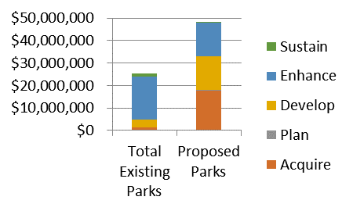
Cost Distribution for Existing and Proposed Parks

Slide 45
Prioritization
Multiple Benefits
Community-Wide Value
City priority
Completing Connections
Replacement and Revitalization
Programming Options
New or Unique Opportunity
All Ages, Abilities and Users
Community Heritage and/or Natural Resources
Sense of Community and Social Cohesiveness

Slide 46
Going Forward
Revise revenue and reinvestment policies
Increase maintenance funding
Avoid commitments to new/small facilities that add to current workload with narrow benefits
Maintain dedicated staff and Department

Slide 47
Going Forward
Include parks project to pass bond measure
Create “Support the Parks” campaign
Pursue operations levy/utility fee
Acquire riverfront property
Prioritize projects

Slide 48
Planning Commission/ PRAB Meeting
4/18/18

