Slide 1
Planning Commission
Public Hearing: PLN-18-01
Parks, Recreation, and Open Space Plan update
May 16, 2018

Slide 2
Decision Before the Planning Commission
Legislative Public Hearing for Recommendation to Council
Adopt the West Linn Parks, Recreation, and Open Space Plan update
Adopt Amendments to Comp Plan
Adopt Amendments to CDC
Recommend Adoption
Recommend Adoption w/Changes
Recommend Not Adopting

Slide 3
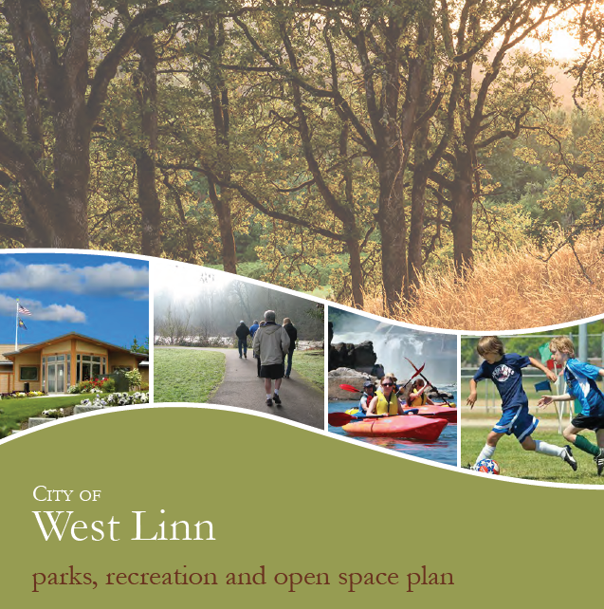
Parks, Recreation, and Open Space Plan
Update to 2007 Plan
Plan is a supporting document to the Comprehensive Plan
Establishes a 10 year outlook of the West Linn Parks System
Planning Process
In 2017, the City hired project consultants, MIG, Inc. to draft the update to the Plan
A survey was conducted in 2017, and received 1,898 total responses.
Information was made available on the City’s website, open houses, and discussions at the Parks Advisory Board meetings
Content Presentations
MIG (consultant) presented on April 18, 2018

Slide 4
Parks, Recreation, and Open Space Plan Goals
Goal 1: Re-envision West Linn’s water experience
Goal 2: Create social hubs that provide year-round gathering places for all West Linn Residents
Goal 3: Create parks and open spaces that show off West Linn’s unique qualities
Goal 4: Provide new and extraordinary experiences in West Linn’s Parks
Goal 5: Re-imagine West Linn’s future indoor recreation opportunities
Goal 6: Activate parks with recreation programs and events that encourage social interaction and a sense of community
Goal 7: Create a more connected and accessible environment for pedestrians, bicyclists and other recreation uses

Slide 5
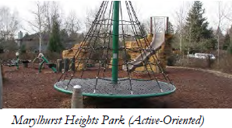
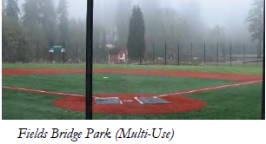
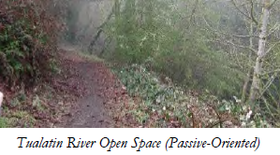
Comp Plan Amendments
Goal 2: Land Use Planning
Comprehensive Plan Exhibit: Figure 2-1 does not show the most up to date park land parcels and needs to be replaced with an updated version.
Goal 5: Intergovernmental coordination
Comprehensive Plan Exhibit; Figure 5-3 does not show the most up to date park land parcels and needs to be replaced with an updated version.
Goal 8: Parks and Recreation
Update Background and Findings
Update Policies
Update Recommended Action Measures
Comprehensive Plan Exhibit: Figure 8-1 does not show the most up to date park land parcels and needs to be replaced with an updated version.

Slide 6
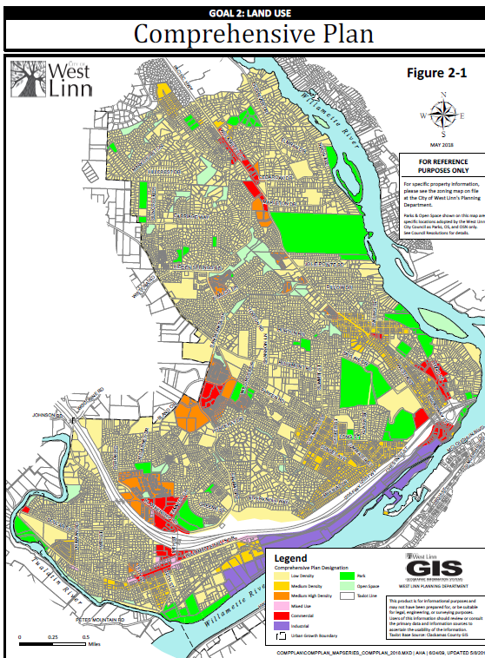
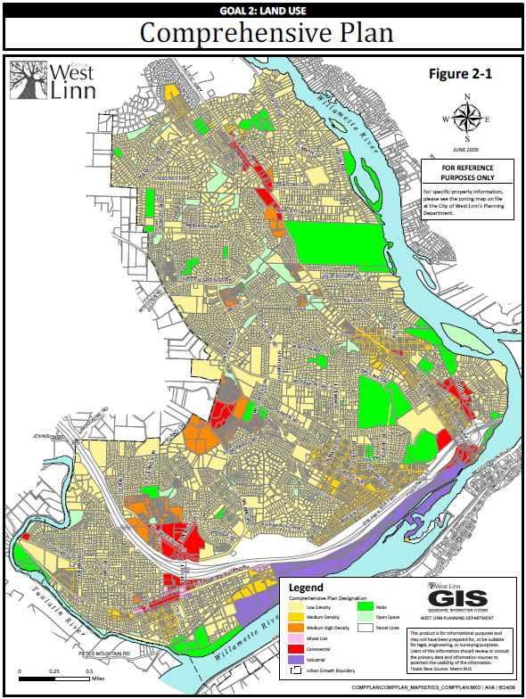
FIGURE 2-1 NEW
FIGURE 2-1 OLD

Slide 7
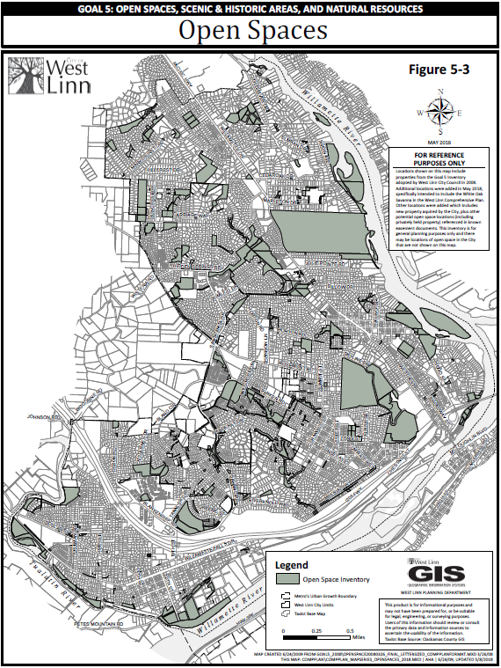
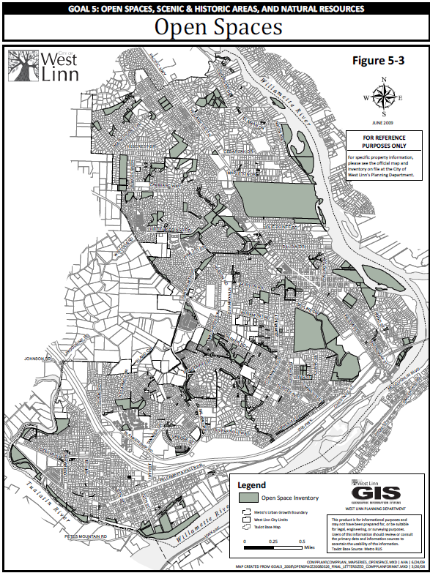
FIGURE 5-3 NEW
FIGURE 5-3 OLD

Slide 8
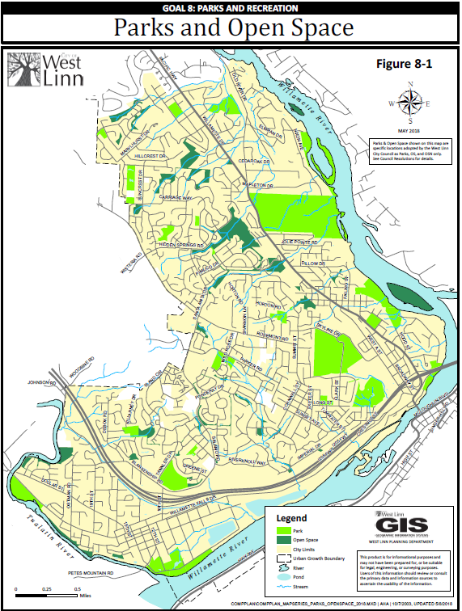
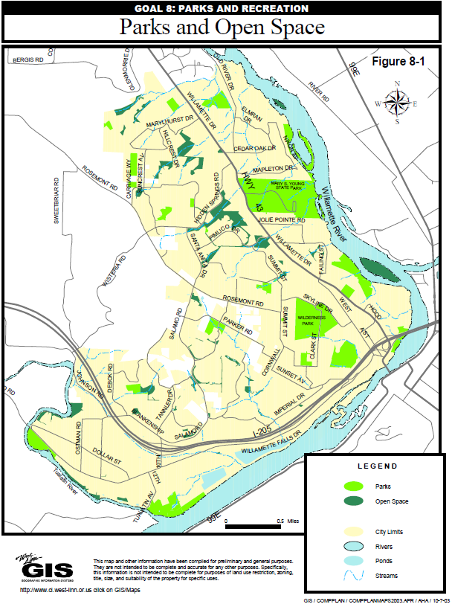
FIGURE 8-1 NEW
FIGURE 8-1 OLD

Slide 9
Community Development Code Amendments
Chapter 2 – Definitions
02.030 Specific Words and Terms
Update definition of Passive-Oriented Parks
Chapter 56 – Parks and Natural Area Design Review
56.015 Categories of Parks and Natural Resource Facilities
Purpose Language Cleanup for park categories and definitions

Slide 10
Parks, Recreation, and Open Space Plan
QUESTIONS OF STAFF?

