Slide 1
City Council
PLN-18-01
Parks, Recreation, and Open Space Plan update
June 18, 2018

Slide 2
Parks, Recreation, and Open Space Plan Goals
Goal 1: Re-envision West Linn’s water experience
Goal 2: Create social hubs that provide year-round gathering places for all West Linn Residents
Goal 3: Create parks and open spaces that show off West Linn’s unique qualities
Goal 4: Provide new and extraordinary experiences in West Linn’s Parks
Goal 5: Re-imagine West Linn’s future indoor recreation opportunities
Goal 6: Activate parks with recreation programs and events that encourage social interaction and a sense of community
Goal 7: Create a more connected and accessible environment for pedestrians, bicyclists and other recreation uses

Slide 3
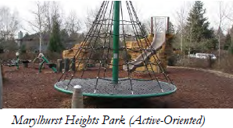
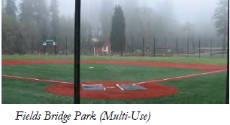
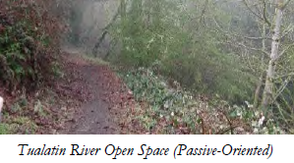
Comp Plan Amendments
Goal 2: Land Use Planning
Comprehensive Plan Exhibit: Figure 2-1 does not show the most up to date park land parcels and needs to be replaced with an updated version.
Goal 5: Intergovernmental coordination
Comprehensive Plan Exhibit; Figure 5-3 does not show the most up to date park land parcels and needs to be replaced with an updated version.
Goal 8: Parks and Recreation
Update Background and Findings
Update Policies
Update Recommended Action Measures
Comprehensive Plan Exhibit: Figure 8-1 does not show the most up to date park land parcels and needs to be replaced with an updated version.

Slide 4
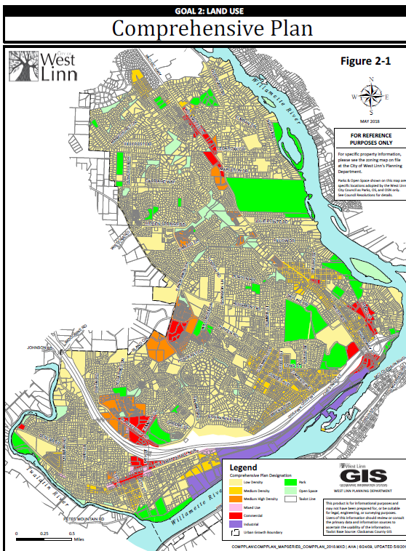
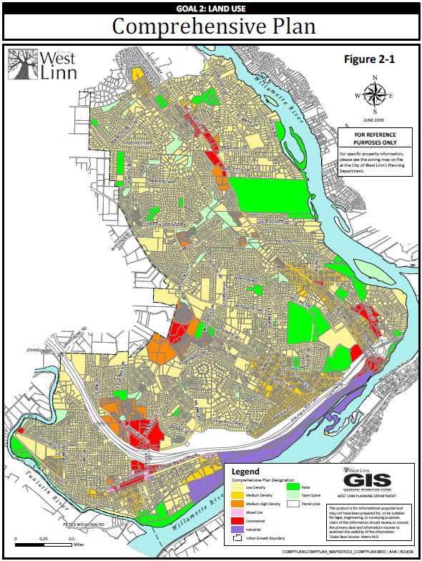
FIGURE 2-1 NEW
FIGURE 2-1 OLD

Slide 5
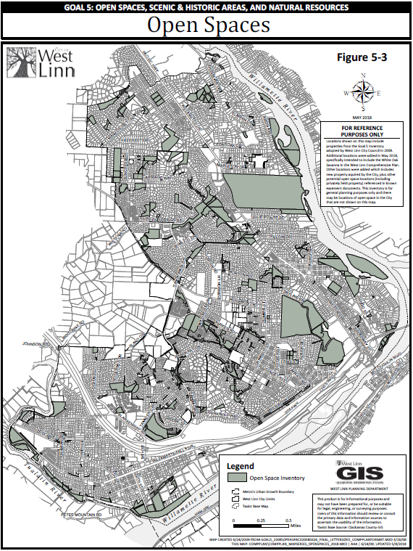
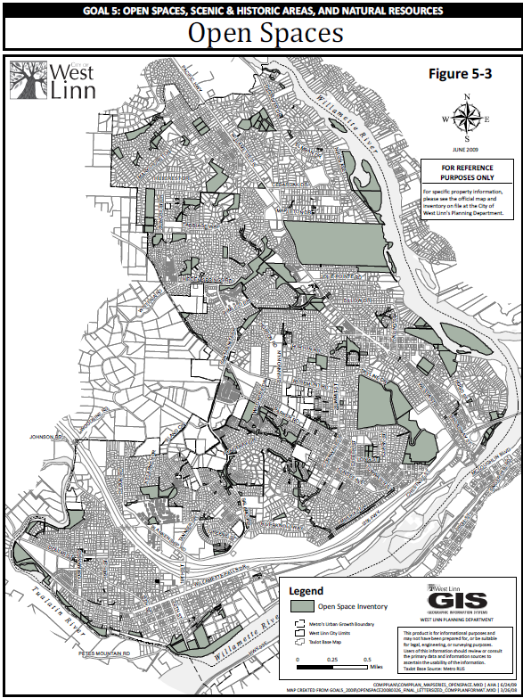
FIGURE 5-3 NEW
FIGURE 5-3 OLD

Slide 6
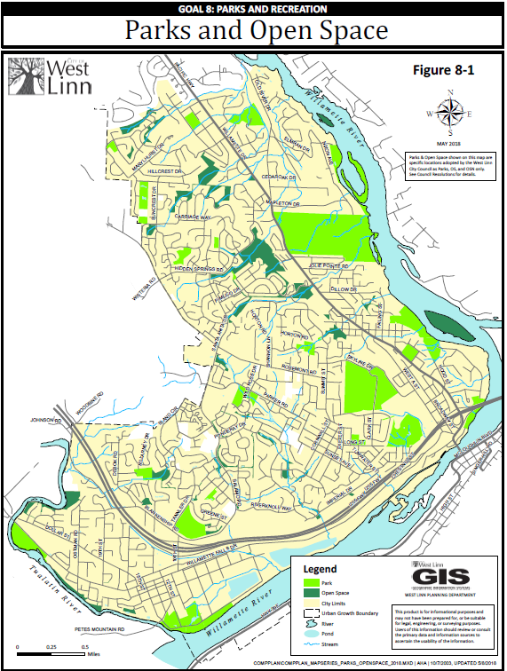
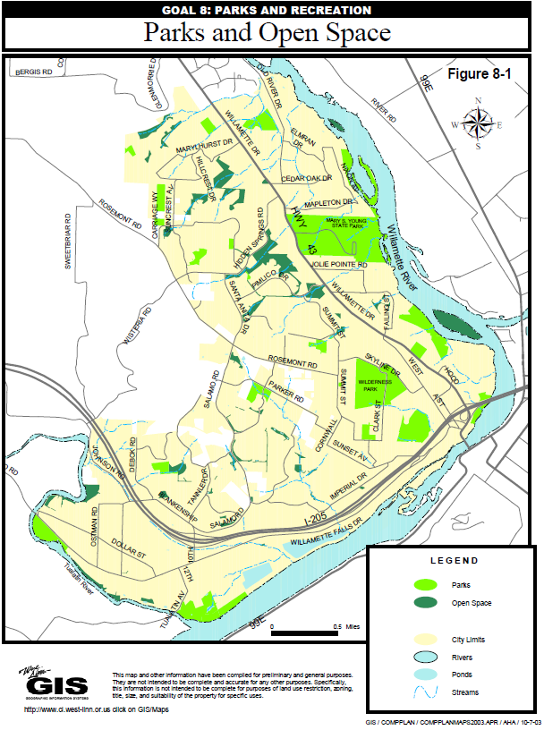
FIGURE 8-1 NEW
FIGURE 8-1 OLD

Slide 7
Community Development Code Amendments
Chapter 2 – Definitions
02.030 Specific Words and Terms
Update definition of Passive-Oriented Parks
Chapter 56 – Parks and Natural Area Design Review
56.015 Categories of Parks and Natural Resource Facilities
Purpose Language Cleanup for park categories and definitions
Developed parks with some natural elements
Natural resource areas with little or no developed uses

Slide 8
Planning Commission Recommendation
May 16, 2018 Planning Commission Hearing on PLN-18-01
“Chair Gary Walvatne moved to recommend approval of the City of West Linn’s Parks, Recreation and Open Space Master Plan Update to City Council with the condition that the plan recognize the importance to the city of the local community centers as exemplified by the Sunset, Robinwood and Bolton community centers, which would include budgetary consideration“ (Approved Meeting Notes)
Seconded by Bill Relyea and the motion passed 7-0

Slide 9
Parks, Recreation, and Open Space Plan
QUESTIONS OF STAFF?

