Slide 1
City Council
Right-of-Way Vacation (Falls View Ave. & Canemah St.)
Public Hearing: MIS-17-12
January 8, 2018

Slide 2
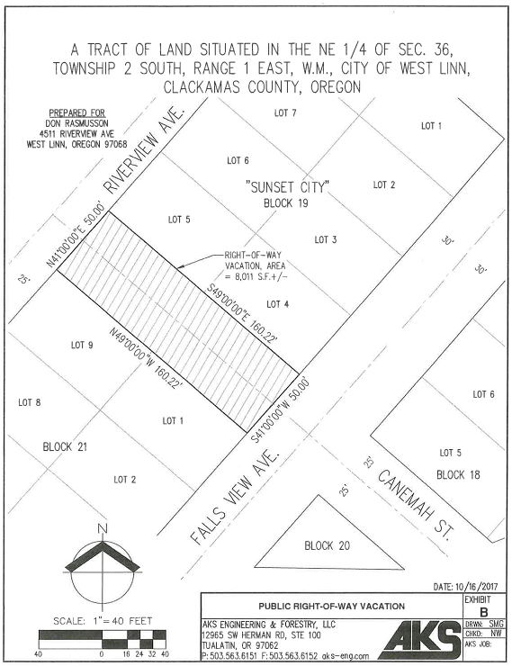
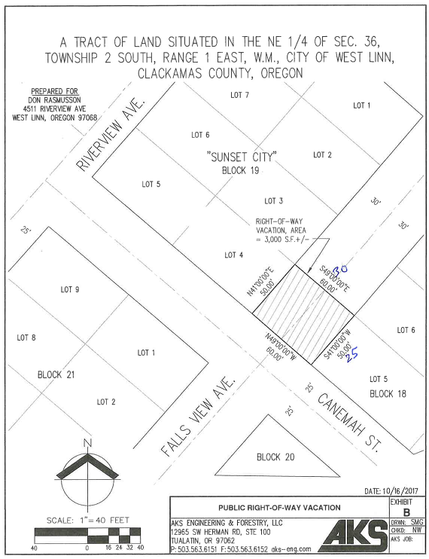
Decision Before the City Council
Two-step process
Accept applicant’s petition for right-of-way vacation
100% consent of abutting property owners
Minimum 66.7% of real property within affected area consent
Hold quasi-judicial public hearing on Ordinance 1670
Approve
Deny

Slide 3
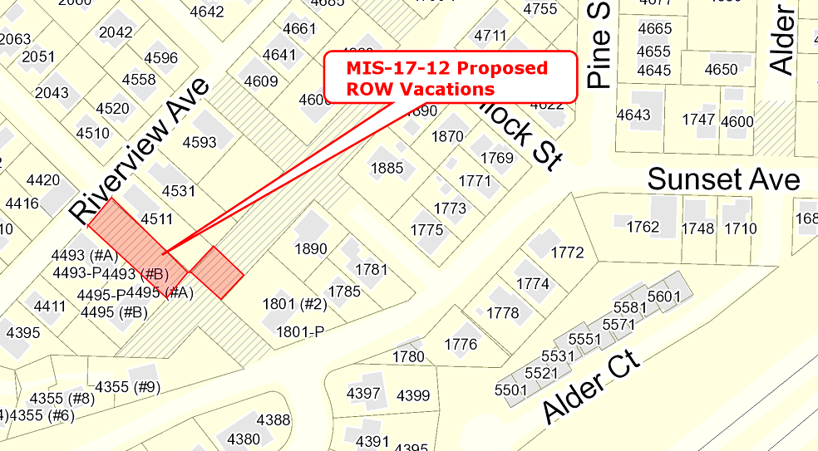
Petition for Right-of-Way Vacation
Petitioners: Don Rasmusson & Laurel Jamtgaard
8,011 sq. ft. of unimproved Canemah St. ROW
3,000 sq. ft. of unimproved Falls View Ave. ROW

Slide 4
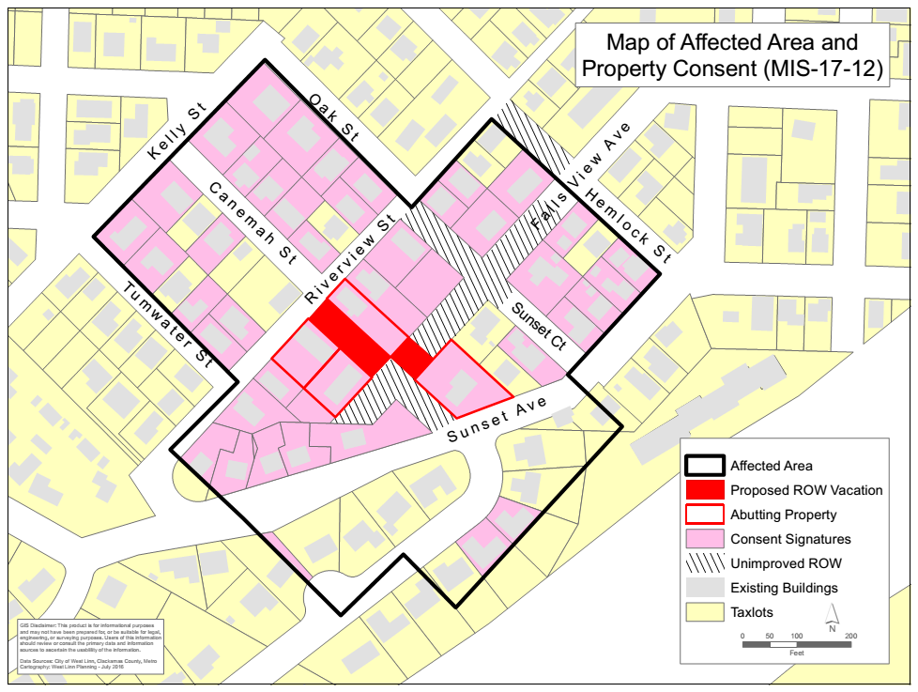
Approval Criteria: Property Owner Consent
100% of abutting property owners
69.8% of real property within affected area

Slide 5
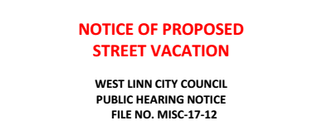
Approval Criteria: Public Notice
Published in West Linn Tidings in consecutive weeks
December 21, 2017
December 28, 2017
Signs posted at each end of proposed vacation at least 14 days in advance of public hearing
Four signs posted on December 21, 2017

Slide 6
Approval Criteria: Public Interest Not Prejudiced
No objection from City staff
No TSP or Trails Plan projects located in proposed vacation
Existing pedestrian pathway 450 feet to the east
Canemah Street slope is 22%
Falls View Avenue cross-slope is 33%
No private property is dependent upon the unimproved ROW for access
Public Utility Easement over the public sanitary sewer line in the unimproved Canemah Street ROW
Public Utility Easements will be placed over entirety of the vacated ROWs

Slide 7
MIS-17-12
QUESTIONS OF STAFF?

Slide 8
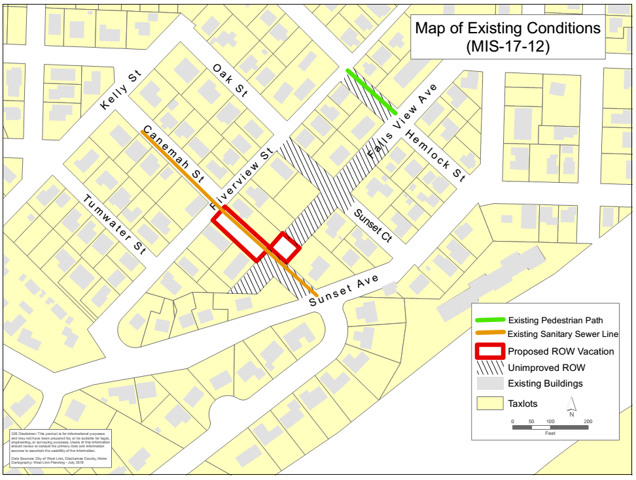
MIS-17-12

