Slide 1
Historic Review Board
Public Hearing: MISC-17-11 – 1744 4th Ave.
November 14, 2017

Slide 2
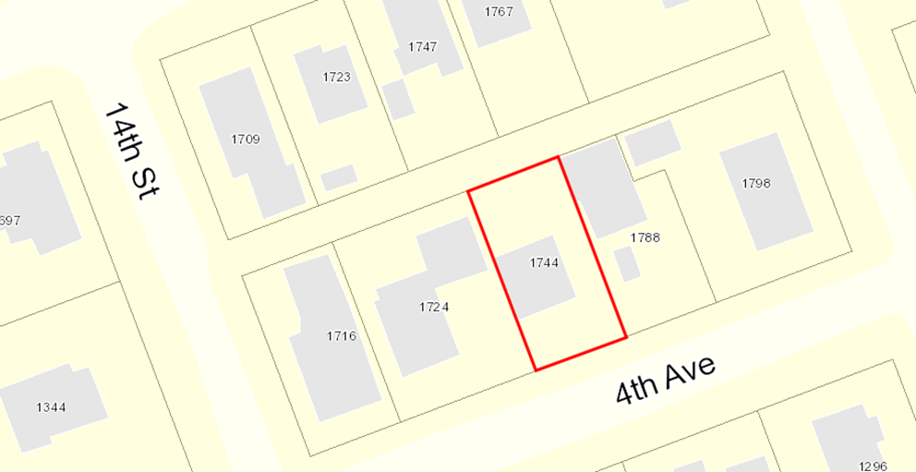

Decision Before the Historic Review Board
Public Hearing for Modification of Design Review
  Replace existing exterior walls
    Removed original materials
  Increase roof height 18 inches
Approve
Approve with Conditions
Deny

Slide 3
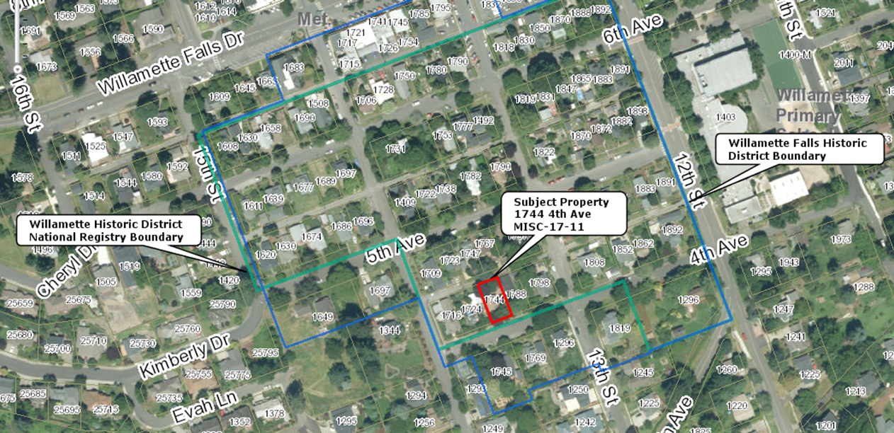

Property Characteristics
Willamette Historic District Overlay &Willamette Historic District National Register
Existing Home
Area: approx. 5,000 sq. ft. lot
Applicant/Owner:
The Scheuerells
Zoning:
R-5
Comp. Plan:
Medium Density Residential

Slide 4
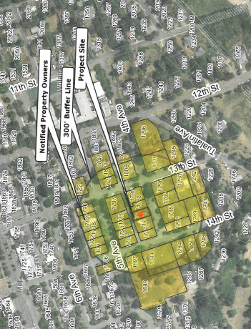
Proposal Background
Application Submitted and Deemed Complete November 1, 2017
Notice Requirements Met (Exhibit HRB-1 & HRB-2)

Slide 5
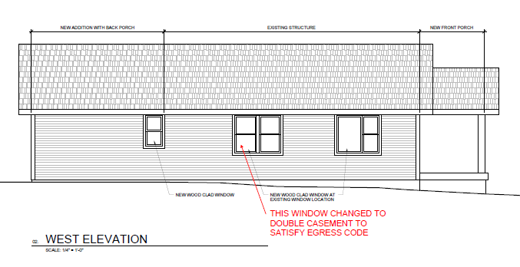
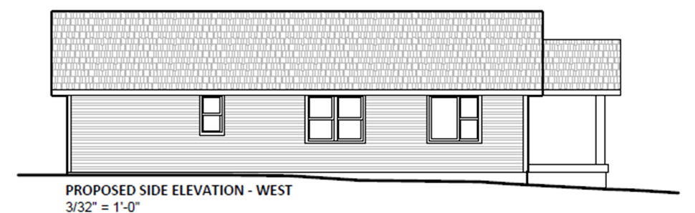
Modifications

Slide 6
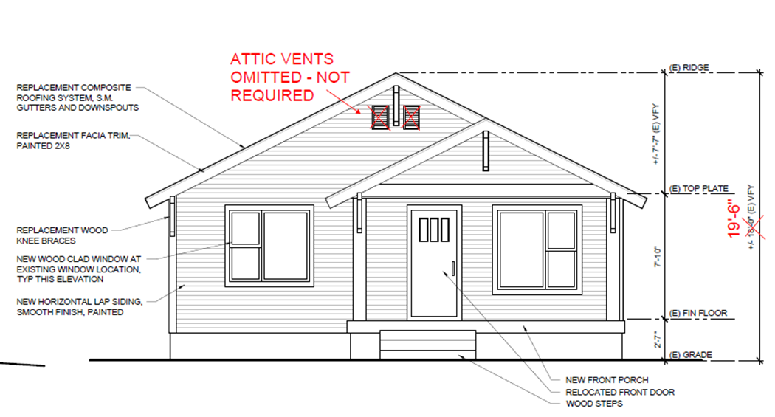
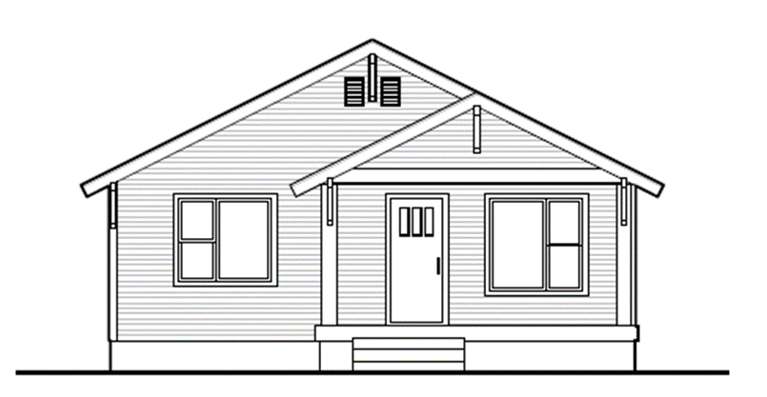
Modifications

Slide 7
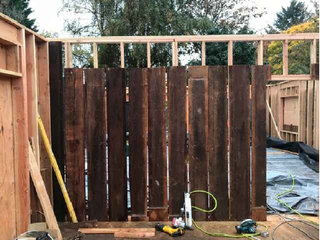
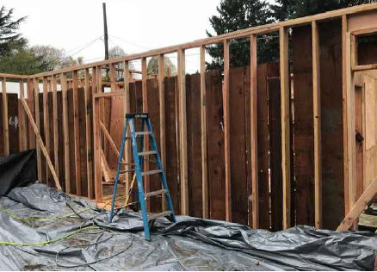
Criteria
CDC 13 R-5 Zoning
CDC 25 Historic Design Review Processes/Standards
CDC 99 Quasi-Judicial Decision Making
CDC 99.120 Amendments

Slide 8
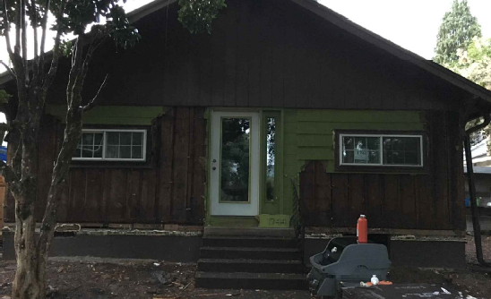
Staff Analysis
Staff recommends approval of the application subject to the following condition:
  Site Plan, Elevations, and Narrative. The project shall conform to the plans, elevations, and narrative submitted in Exhibit HRB-4.

Slide 9
Historic Review Board – DR-17-06
QUESTIONS OF STAFF?

