Slide 1
Planning Commission
Public Hearing: SUB-17-03 Proposed 12-lot Subdivision at 3015/3001 Parker Road
November 15, 2017

Slide 2
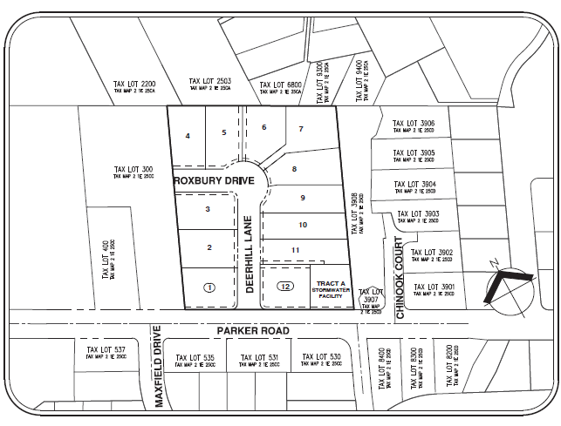
Decision Before the Planning Commission
Public Hearing for 6-Lot Subdivision
3.55 acres
R-10 Zoning
Existing Home- Proposed Removal
ROW Improvements for Parker Road, Deerhill Lane and Roxbury Drive
All Access from Deerhill Lane and Roxbury Drive
Approve Staff Recommendation
Approve with Modified Conditions
Deny

Slide 3
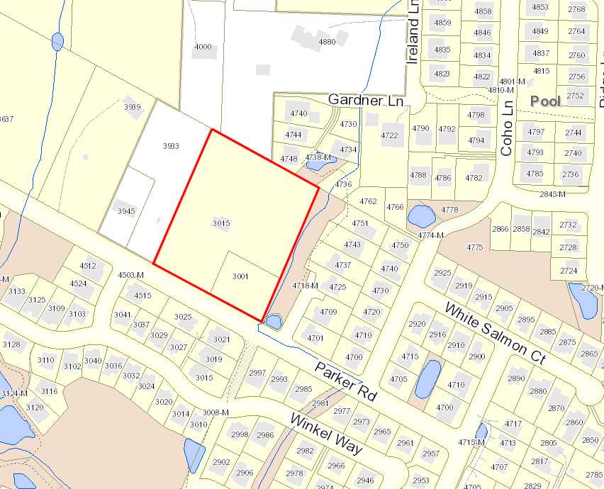
Vicinity Map

Slide 4
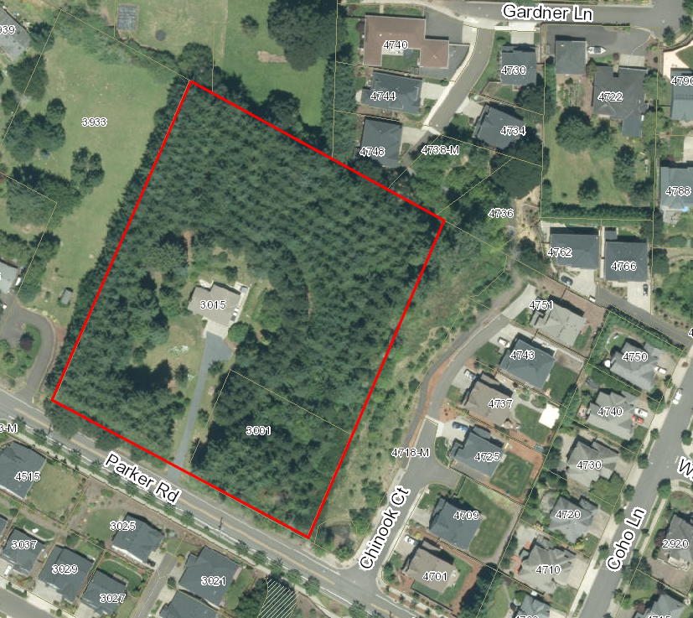
Aerial Photograph

Slide 5
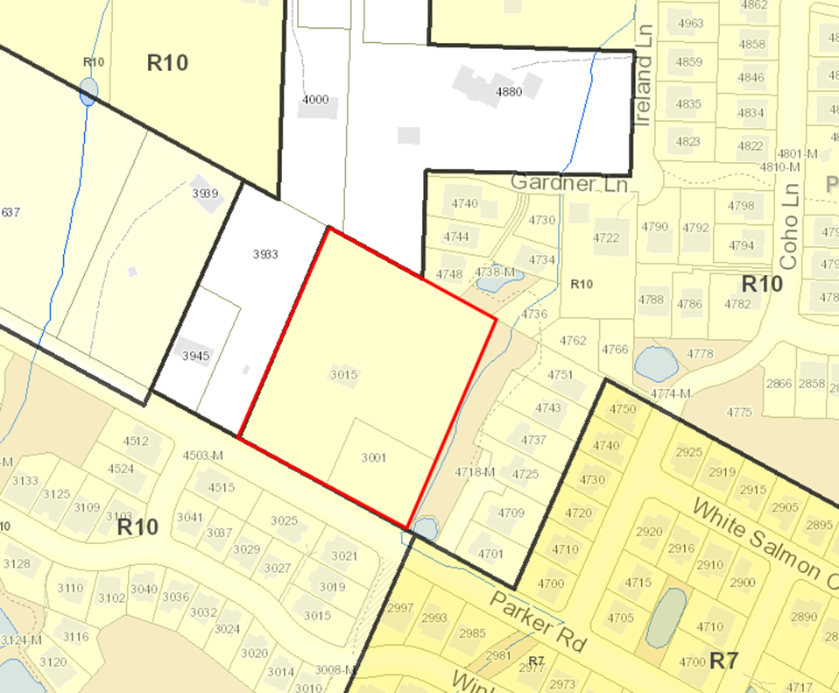
Neighborhood Zoning

Slide 6
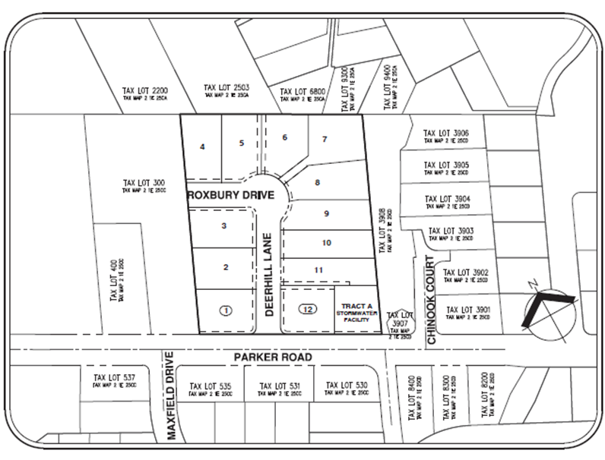
Site Plan

Slide 7
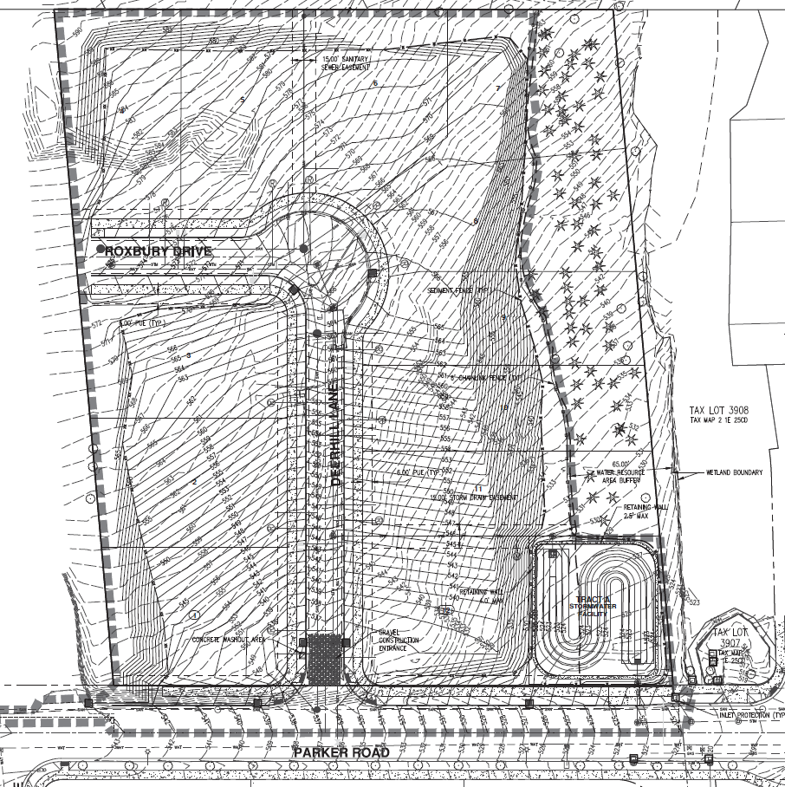
Grading Plan

Slide 8
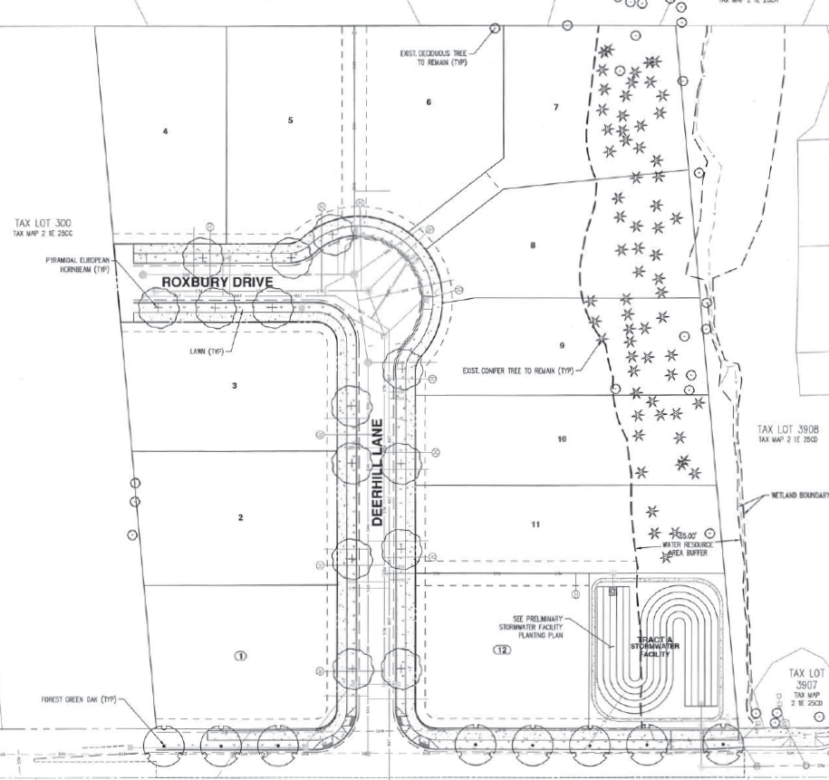
Tree Protection and Removal Plan

Slide 9
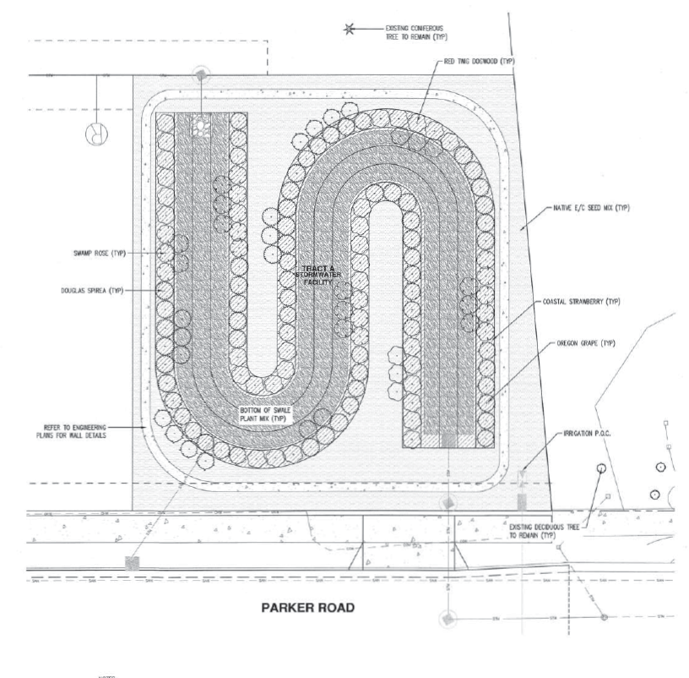
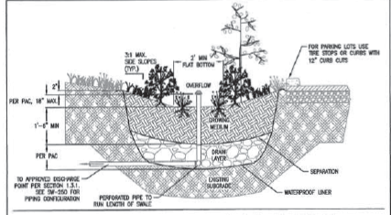
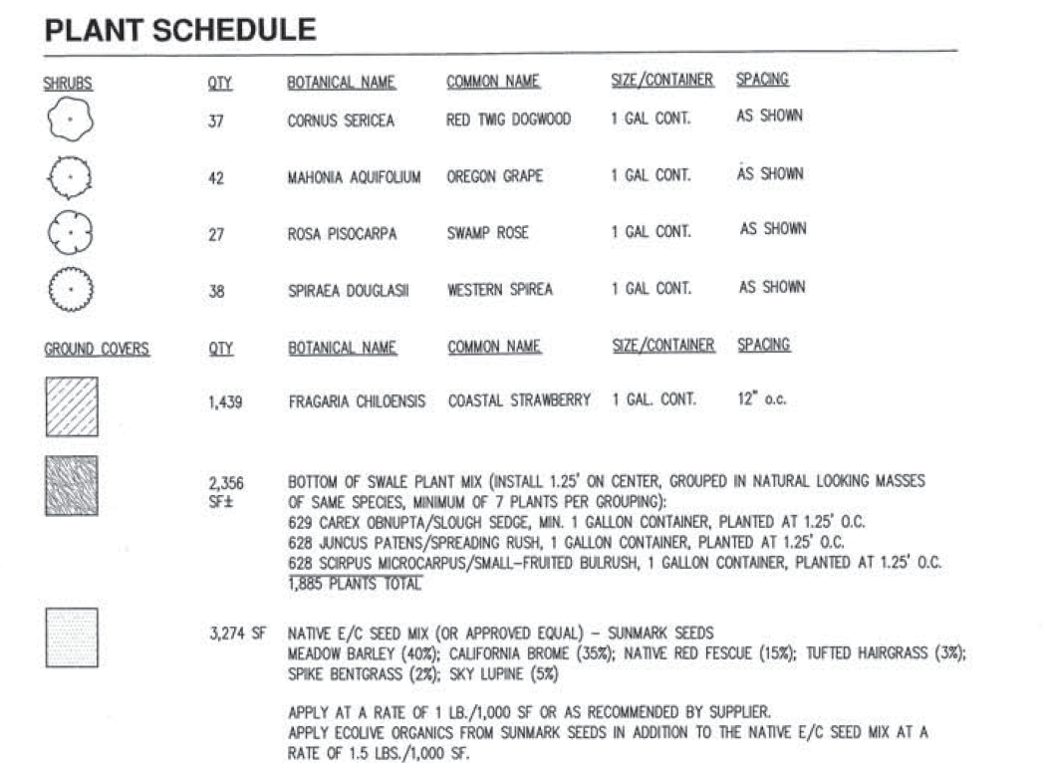
Stormwater Facility Planting Plan

Slide 10
Staff Recommended Conditions of Approval
Site Plan. With the exception of modifications required by these conditions, the project shall conform to the Tentative Subdivision Plat dated August 23, 2017.
Engineering Standards. All public improvements and facilities associated with public improvements including street improvements, utilities, grading, onsite stormwater design, street lighting, easements, and easement locations are subject to the City Engineer’s review, modification, and approval. These must be designed, constructed, and completed prior to final plat approval. (See Staff Findings 22-25, 29, 33, 46, 48, 51, 55, 72, 73, & 75)
Street Improvements. The applicant shall construct full street improvements along Deerhill Lane/Roxbury Drive including curb, planter strip and sidewalks, and street trees. Dedication of this right-of-way is required on the face of the plat. In addition, the applicant shall dedicate on the face of the plat additional ROW and complete half street improvements including curb, planter strip and sidewalks, and street trees for the portion of Parker Road abutting the subject property. All improvements must be installed prior to the approval of the final plat. (See Staff Findings 33, 48, 50, 51, 55, & 72)

Slide 11
Staff Recommended Conditions of Approval
No Parking Signs. The applicant shall install signs reading “No Parking – Fire Lane” on both sides of Deerhill Lane/Roxbury Drive. The signs shall be 12 inches wide by 18 inches high and shall have red letters on a white reflective background. The signs shall be installed with a clear space above grade level of 7 feet.
Fire Flow. The applicant shall perform a fire flow test and submit a letter from Tualatin Valley Fire and Rescue showing adequate fire flow is present.
Tree Protection. The applicant shall provide written confirmation from the City’s Arborist that the required tree protection measures are correctly in place prior to the issuance of a site development permit.
Public Utilities. The applicant shall underground all utilities serving this subdivision per Engineering Standards. Paving mitigation along Parker Road for utility extensions shall be approved by the City Engineer. (See Staff Finding 68)

Slide 12
Staff Recommended Conditions of Approval
Street Lights. The applicant shall install street lights on Deerhill Lane/Roxbury Drive according to City of West Linn Public Works Standards and Portland General Electric Standards. (See Staff Finding 66)
Access. All access points for the proposed subdivision shall be via the new proposed public street Deerhill Lane/Roxbury Drive. (See Staff Finding 11)
Mitigation and Re-Vegetation. Prior to approval of the final subdivision plat, all on-site mitigation and revegetation shall be completed per the AKS “Mitigation Plan” Exhibit C: Natural Resources Assessment and Mitigation Plan. (See Staff finding 8)
Public Utility Easement. The applicant shall record, on the face of the plat, an 8’ wide Public Utility Easement per Engineering Standards on each proposed lot frontage along Deerhill Lane/Roxbury Drive. (See Staff Finding 63)

Slide 13
Planning Commission SUB-17-03
QUESTIONS OF STAFF?

