Slide 1
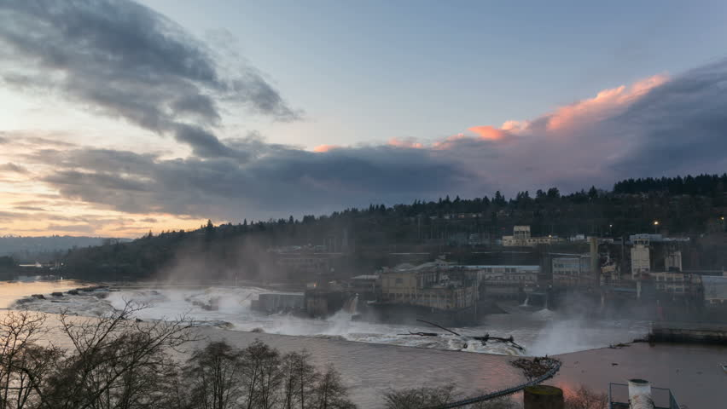
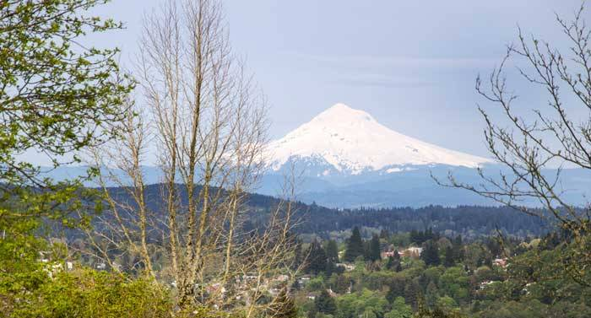
CDC 17-02 Overview
Proposed amendments to West Linn’s Community Development Code to address grading, geotechnical and storm water issues
City Council Public Hearing October 9, 2017

Slide 2
CDC 17-02 Background
2014: Chapters 31 (Erosion Control) and 33 (Stormwater Management) repealed from Community Development Code via Ordinance 1622
These code sections were found to be duplicative or in conflict with City’s Public Works Design Standards and State Building Code requirements
2015-2017: Challenges during land use applications
Planning Commission, City Council identified shortfalls in code authority when reviewing land use applications with respect to geotechnical issues and surface water management.

Slide 3
CDC 17-02 Background
April 2017 - Code work prioritized at City Council and Planning Commission joint meeting
Project goal defined: ensure that applicants submit thorough information on geotechnical and surface water issues and that decision-makers have adequate code authority to approve, approve with conditions, or deny applications based on these issues and conformance with City standards.
May 2017 - Planning Commission discussion on initial draft, direction to staff, including:
Ensure scale of submittal is appropriate for scope of site challenges
Strengthen geotechnical elements
Ensure small applications not unduly burdened
Reference State of Oregon licensing standards

Slide 4
CDC 17-02 Background
September 6, 2017 - Planning Commission hearing on revised draft:
1 written testimony, 1 person testified in person
PC continued discussion of key questions, balance of regulation
Five areas of revisions made to draft (shown in red in later slides)
Unanimous recommendation of approval, with amendments, to Council
September 18, 2017 – City Council Work Session:
Discussion of balance of regulation
Discussion of several changes to text (shown in blue in later slides)
Requested information about other jurisdictions’ approaches
Continue discussion to October 9 following hearing

Slide 5
CDC 17-02 Adoption Process
Council determined that working group was not required, Planning Commission to lead work
Public notice: West Linn Tidings, City web site, City Hall
Planning Commission work session, public hearing, recommendation to City Council
City Council work session, public hearing, Ordinance adoption

Slide 6
CDC 17-02 Approval Criteria (CDC 98.100)
Conformance with:
Statewide Planning Goals and rules, other applicable state statutes
Federal statutes
Metro plans and rules
West Linn Comprehensive Plan policies and map
West Linn implementing ordinances
Detailed analysis provided in staff report

Slide 7
CDC 17-02 Overview
Adds new submittal requirements and approval criteria for grading, storm drainage, and geotechnical issues to all development application types in CDC:
Planned Unit Developments
Willamette/Tualatin River Protection Areas and Water Resource Protection areas
Design Review and Parks Design Review
Conditional Use Permits
Subdivisions and Partitions
General Improvement Standards

Slide 8
CDC 17-02 Proposed Requirements/Approval Criteria
Grading, Storm Drainage and Treatment
Requires plans prepared by Civil Engineer demonstrating:
Location and extent to which grading will take place indicating general contour lines, slope ratios, slope stabilization proposals, and location and height of retaining walls, if proposed.
All proposed storm detention and treatment facilities comply with the standards for the improvement of public and private drainage systems located in the West Linn Public Works Design Standards.
There will be no adverse off-site impacts, including impacts from increased intensity of runoff downstream or constrictions causing ponding upstream.
Sufficient factual data to support the conclusions of the plan.
Type IV lands require affirmative decision from Planning Director to require reports.

Slide 9
CDC 17-02 Proposed Requirements/Approval Criteria
Geotechnical submittal requirements:
Sites where more than half of site by area has slopes over 10% will require geotechnical report meeting industry standards including:
Site characteristics, geologic descriptions and a summary of the site investigation conducted;
Assessment of engineering geological conditions and factors;
Review of the City of West Linn’s Natural Hazards Mitigation Plan and applicability to the site; and
Conclusions and recommendations focused on geologic constraints for the proposed land use or development activity, limitations and potential risks of development, recommendations for mitigation approaches and additional work needed at future development stages including further testing and monitoring.

Slide 10
CDC 17-02 Proposed Requirements/Approval Criteria
Geotechnical approval standards:
The applicant must demonstrate that the proposed methods of rendering known or potential hazard sites for development, including proposed geotechnical remediation, are feasible and adequate to prevent landslides or other damage to property and safety.
The review authority may impose conditions, including limits on type or intensity of land use, which it determines are necessary to eliminate mitigate known risks of landslides or property damage.

Slide 11
CDC 17-02 Land Type Definitions
Revised/corrected slope definitions in Land Types:
Type I: 35% or more slope on more than 50% of site*
Type II: over 25% slope on more than 50% of site**
Type III: over 10% slope on more than 50% of site
Type IV: 10% or under slope on more than 50% of site
Sites assigned to steepest category for which they qualify
Corrects former loophole: a steeply sloped site in which no single slope category makes up more than 50% of a site would not have fallen into any of the Land Types.
*Type I also includes floodways and mapped landslide areas
**Type II also includes drainage courses, wetlands, 100-yr floodplain)

Slide 12
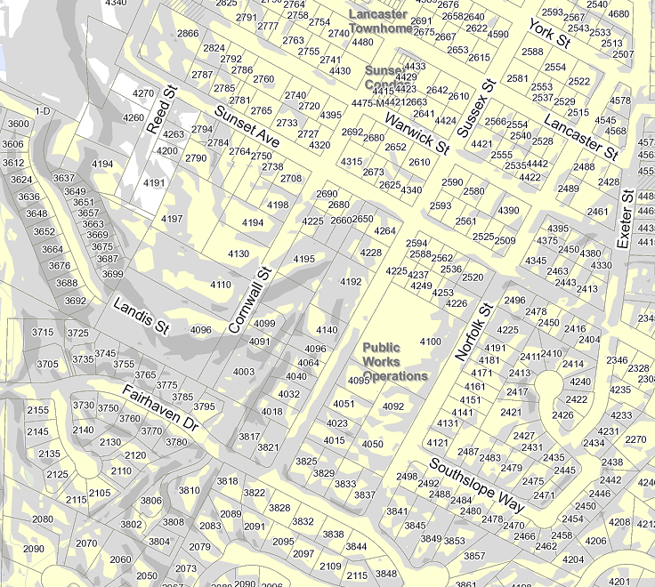
CDC 17-02 Land Type – Example of West Linn topography
Light gray = over 10% slope
Dark gray = over 25% slope

Slide 13
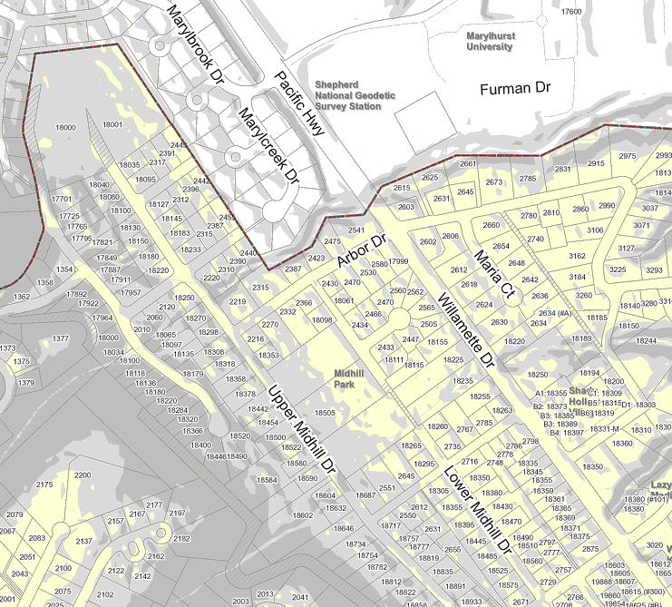
CDC 17-02 Land Type – Example of West Linn topography
Light gray = over 10% slope
Dark gray = over 25% slope

Slide 14
CDC 17-02 Existing Code: exemptions/additions
99.035 ADDITIONAL INFORMATION REQUIRED, WAIVER OF REQUIREMENTS AND REPORT REQUIRED
A. The Planning Director may require information in addition to that required by a specific chapter in the Community Development Code; provided, that:
1. The chapter expressly authorizes that additional information may be required;
2. The information is needed to properly evaluate the proposed site plan or proposal; and
3. The need can be justified on the basis of a special or unforeseen circumstance.
B. The Planning Director may waive a specific requirement for information or a requirement to address a certain approval standard subject to the provisions of subsection C of this section provided:
1. The Planning Director finds that specific information is not necessary to properly evaluate the application; or
2. The Planning Director finds that a specific approval standard is not applicable to the application.
C. Where a requirement is waived, the Planning Director shall cite in the staff report on the application the specific requirements waived and the reasons for the waiver. The decision of the Planning Director to waive the requirement is subject to review and denial by the approval authority or the appeal authority. (Ord. 1568, 2008)

Slide 15
CDC 17-02 Planning Commission discussion points
Are requirements appropriate and will they accomplish Commission/Council goals?
Should all application types be covered by proposed requirements?
Overall: is balance of regulation appropriate to meet community needs?

Slide 16
CDC 17-02 Other jurisdictions’ approaches
Oregon City: Geologic Hazards Overlay Zone
Requires geologic report prepared by professional in:
Areas with slope of 25% or greater and areas within 50’ of crest or toe of 25% slope
Areas within 200’ of crest or toe of landslide geologic units
Areas defined by State of Oregon as geologic hazards due to historic landslide/debris fan
Any other area identified by geotechnical professional as subject to soil instability, slumping, earth flow, high groundwater, or landslides
Trigger: almost any development, tree removal, excavations

Slide 17
CDC 17-02 Other jurisdictions’ approaches
Lake Oswego: Hillside Protection
Requires geologic report prepared by professional certifying that development can be made safe in:
Areas mapped as Slide Area, Slide Hazard Area by City
Parcels with undisturbed slopes over 12%
Trigger: all development

Slide 18
CDC 17-02 Other jurisdictions’ approaches
Portland: Potential Landslide Hazard Areas
Requires Landslide Hazard Study prepared by both a Certified Engineering Geologist and Geotechnical Engineer in areas shown as “Potential Landslide Hazard Areas.” These include:
Areas mapped as Earthquake Hazard Areas by Metro
Almost 700 historic landslide sites mapped by PSU
All land with slope over 15%
Trigger: land division

Slide 19
CDC 17-02 Other jurisdictions’ approaches
Happy Valley: Steep Slopes Development Overlay Zone
Studies may be required in:
Areas with over 1,000 square feet of 15% or more slope
Landslide hazard areas identified by State of Oregon (DOGAMI)
Hazardous areas identified by a certified geotechnical engineer
Trigger: activities and uses that require a building, grading, tree removal or land use permit

