Slide 1
Planning Commission
Public Hearing: SUB-15-02 Proposed 6-lot Subdivision at 23128 Bland Circle
December 2, 2015

Slide 2
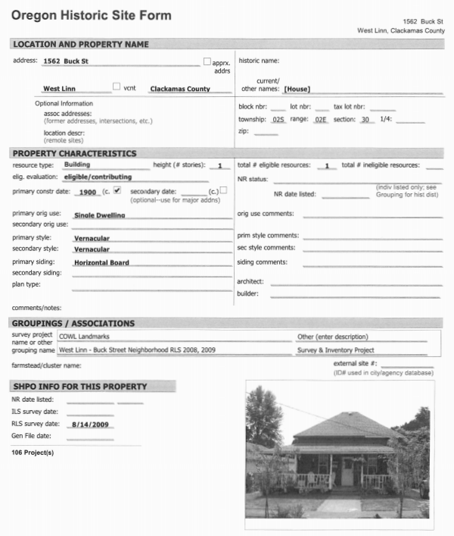
Decision Before the Planning Commission
Public Hearing for 6-Lot Subdivision
2.11 acres
R-7 Zoning
Existing Home Retained
Remove Detached Garage & Basketball Court
ROW Improvements to Bland Circle and Tannler Drive
All Access from Tannler Drive
Approve Staff Recommendation
Approve with Modified Conditions
Deny

Slide 3
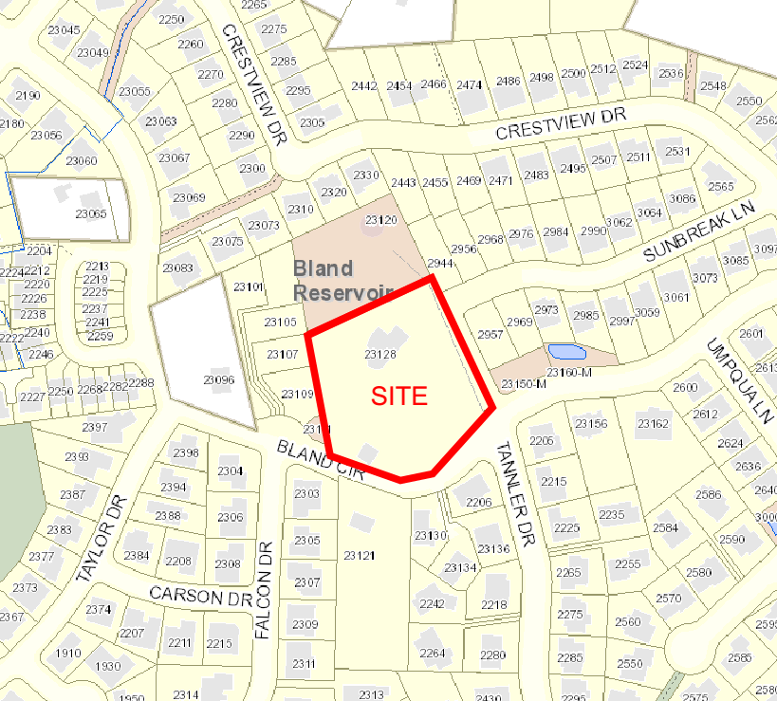
Vicinity Map

Slide 4
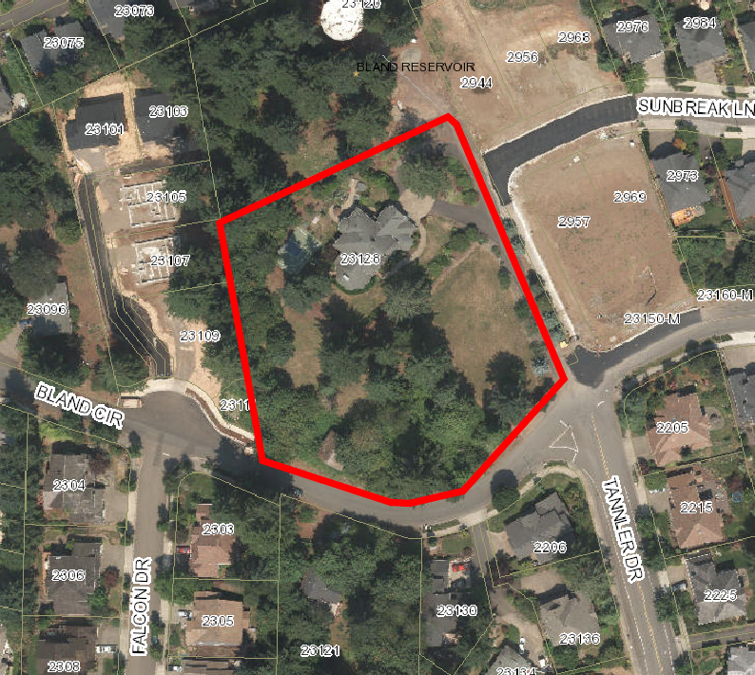
Aerial Photograph

Slide 5
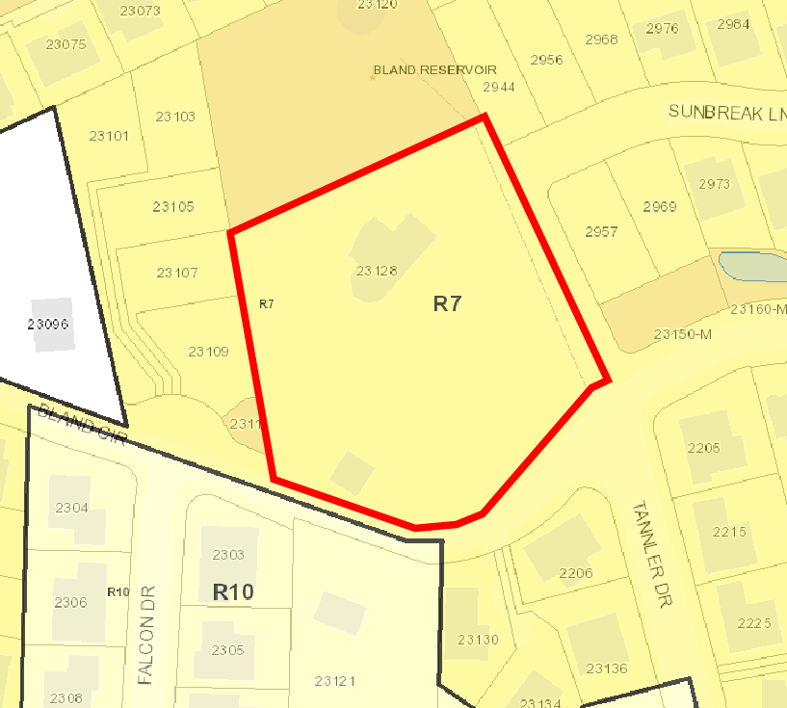
Neighborhood Zoning

Slide 6
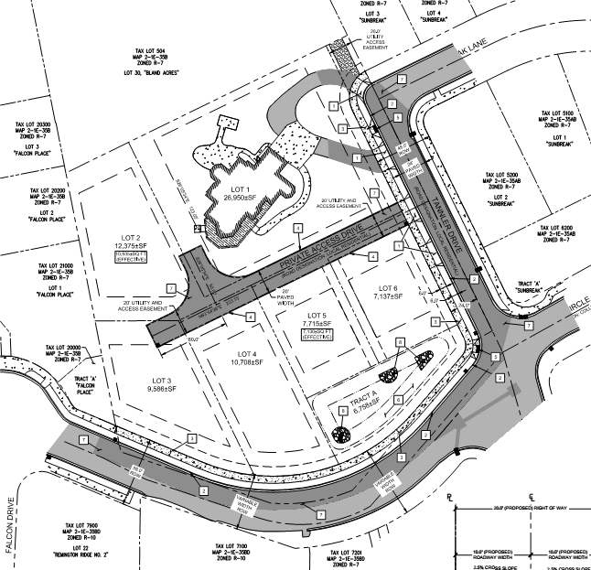
Site Plan

Slide 7
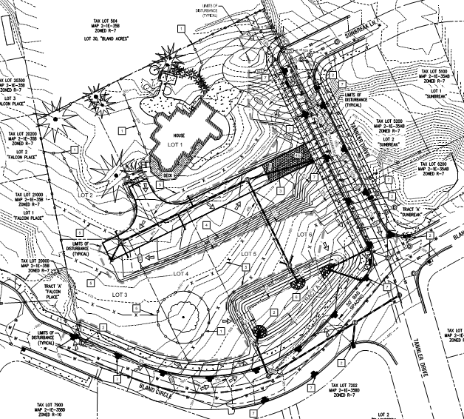
Grading Plan

Slide 8
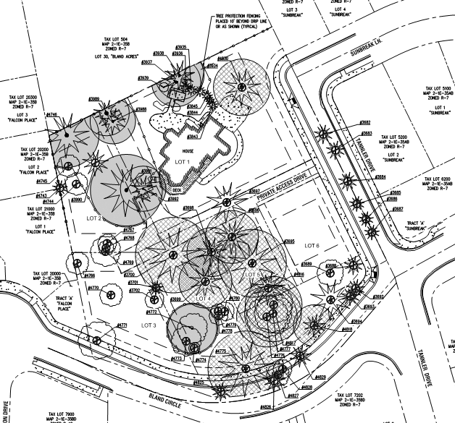
Tree Protection and Removal Plan

Slide 9
Approval Criteria – Partial Checklist
Community Development Code (CDC) Chapter 85 Land Division includes the approval criteria for subdivisions:
Do all lots achieve the minimum lot size of 7,000 square feet in this R-7 zone? YES
Does the density achieve the minimum 70% as required? YES
Do all lots meet the dimensional or shape standards of the R-7 zone? YES
Are sewer, water and storm water facilities available and adequately sized? YES
Do the street improvements and dedications meet code? YES
Are the connectivity requirements satisfied? YES
Are the significant trees protected per code? YES

Slide 10
Staff Recommended Conditions of Approval
Site Plan. With the exception of modifications required by these conditions, the project shall conform to the Tentative Subdivision Plat dated 9/14/2015.
Engineering Standards. All public improvements and facilities associated with public improvements including street improvements, utilities, grading, onsite stormwater design, street lighting, easements, and easement locations are subject to the City Engineer’s review, modification, and approval. These must be designed, constructed, and completed prior to final plat approval.
Street Improvements. The applicant shall dedicate on the face of the plat additional ROW and complete half street improvements including curb, planter strip and sidewalks, and street trees for the portion of Bland Circle abutting the subject property. In addition, the applicant shall dedicate on the face of the plat additional ROW and complete half street improvements including curb, planter strip and sidewalks, and street trees for the portion of Tannler Drive, from Bland Circle to Sunbreak Lane, abutting the subject property. The applicant shall also pave Tannler Drive, from Bland Circle to Sunbreak Lane, from curb-to-curb and be reimbursed by the City of West Linn for the half street pavement layer not immediately adjacent to the subject property. The applicant shall also complete the private road access to Lots 2-5 prior to Certificate of Occupancy.

Slide 11
Staff Recommended Conditions of Approval
Stormwater Tract A. The applicant shall dedicate Stormwater Tract A to the City of West Linn.
Mutual Maintenance and Easements. The applicant shall provide the City of West Linn, along with the final plat, a Mutual Maintenance and Reciprocal Access and Public Utility Easement for platted Lots 2-5 to ensure continued access and necessary maintenance of the shared drive in perpetuity.
No Parking Sign. The applicant shall install signs reading “No Parking – Fire Lane” on both sides of the shared access drive. The signs shall be 12 inches wide by 18 inches high and shall have red letters on a white reflective background. The signs shall be installed with a clear space above grade level of 7 feet.
Fire Flow. The applicant shall perform a fire flow test and submit a letter from Tualatin Valley Fire and Rescue showing adequate fire flow is present.
Tree Conservation Easement. The applicant shall provide a tree conservation easement for trees 3991, 3992, and 4772. The easement shall extend outwards to the tree dripline plus 10 feet. The easement shall include a legal description and a map of the area. The easement shall be recorded with the County and a copy of the recorded easement shall be provided to the City of West Linn.

Slide 12
Staff Recommended Conditions of Approval
Significant Tree Mitigation. The applicant shall mitigate for the loss of 70 caliper inches of significant trees, not including street trees which are a requirement of the subdivision approval, before recording of the final plat. The mitigation shall either occur on the subject property or through fee-in-lieu payment to the City of West Linn.
Access During Construction. Approved fire apparatus access roadways shall be installed and operational prior to any combustible construction or storage of combustible materials on the site. Temporary address signage shall also be provided during construction.
Public Utility and Access Easement. The applicant shall vacate the portion of the existing public utility and access easement on the eastern edge of the property that is no longer needed, but retain the section on Lot 1 that provides access to the City of West Linn Property to the north.
Street Lights. The applicant shall install street lights on Bland Circle and Tannler Drive according to City of West Linn Public Works Standards and Portland General Electric Standards.
Lot Access. Access to Lots 1 and 6 shall be from Tannler Drive.

Slide 13
Planning Commission SUB-15-02
QUESTIONS OF STAFF?

