Slide 1
Application by ConAm Properties, LLC for a Comprehensive Plan Map Amendment from “Commercial” to “Medium-High Density Residential” and Zoning Map Amendment from “OBC” to “R-2.1” on Approximately 11.3 Acres.

Slide 2
1. CONAM PROPERTIES, LLC
REPRESENTATIVES.
Rob Morgan and Mike Mahoney of ConAm
Brenden Buckley, economist, of Johnson Economics
Brent Ahrend, traffic engineer, of MacKenzie
Michael Robinson of Perkins Coie
We are here to answer your questions.

Slide 3
2. REASON FOR APPLICATION SUBMITTAL.
ConAm made this request because it wants to develop the property for multi-family uses. The evidence in the application shows that the site is unsuitable for office, hotel or retail development but is well-suited for multi-family development.
The OBC zone allows multi-family units with first floor commercial uses but because of the site’s lack of visibility and topography, and because of limited demand for additional commercial development in this area, commercial development on this site is highly unlikely. Moreover, the OBC zone is ambiguous about what kind of and how much commercial use is required in order to develop multi-family units.

Slide 4
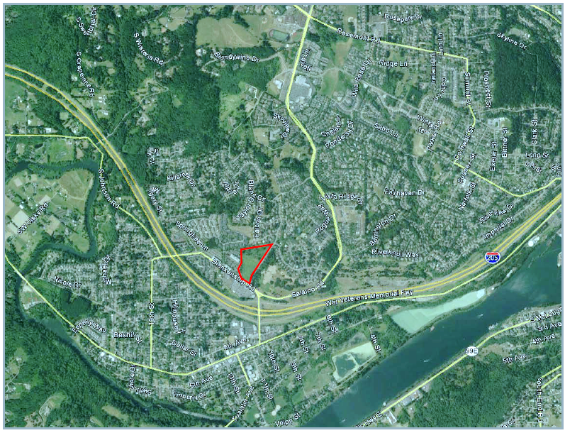
3. AREA MAP.

Slide 5
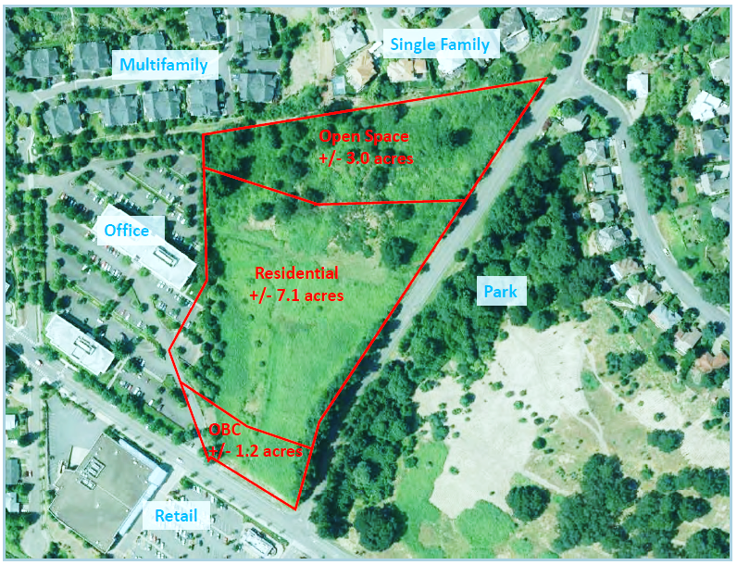
4. SITE MAP.

Slide 6
5. SITE INFORMATION.
The approximately 11.3 acre site consists of three (3) areas:
Approximately 7.1 acres in the center of the site to be developed for multi-family housing. The development could contain about 210 dwelling units.
Retention of 1.2 acres of OBC zoning on the north side of Blankenship Road.
Retention of approximately 3.0 acres for open space retained on the north end of the site. This part of the site contains most of the significant trees on the site.
The West Linn Parks and Recreation Advisory Board unanimously adopted a motion on January 9, 2014 to support setting aside this open space.

Slide 7
6. LAND USES AROUND THE SITE.
Six (6) single-family dwellings are located on the south side of Falcon Drive adjacent to the north portion of the site.
The northwest corner of the site abuts apartments south of Summerlinn Way.
The west side of the site abuts offices.
The east side of the site abuts Tannler Drive. Across Tannler Drive is property zoned OBC. A portion of that property has been purchased for the development of the White Oak Savanna Park.
The property across Blankenship Road is developed as the River Falls Shopping Center.

Slide 8
7. APPROVAL CRITERIA FOR THE AMENDMENT.
West Linn Community Development Code (“CDC”) 105.050 “Quasi-judicial Amendment and Standards for Making Decisions”:
“A. The standards set forth in CDC 99.110(A), which provide the decision shall be based on consideration of the following factors:
    The applicable Comprehensive Plan Policies as identified in subsection C of this section and map designation.
    The applicable standards of any provisions of this code or other applicable implementing ordinance.”

Slide 9
8. RESPONSE TO CDC 105.050.A.
The application at pages 24-27 addresses the applicable West Linn Comprehensive Plan policies.
The application also addresses relevant provisions of the CDC.

Slide 10
9. CDC 105.050.B.
“The standards set forth in CDC 99.110(B), which provide that, in making the decision, consideration may also be given to the following:
  Proof of change in the neighborhood or community or a mistake or inconsistency in the Comprehensive Plan or Zoning Map as it relates to the property which is the subject of the development application.
  Factual oral testimony or written statements from the parties, other persons and other governmental agencies relevant to the existing conditions, other applicable standards and criteria, possible negative or positive attributes of the proposal or factors in sub-section A or B(1) of this section.”

Slide 11
10. RESPONSE TO CDC 105.050.B.
The Planning Commission can find there is a proof of change in the neighborhood or community, or a mistake in the comprehensive plan and zoning map as it relates to this property.
The site is highly unlikely to be developed for office or retail use. George Diamond’s August 24, 2014 letter and the Johnson Economics study dated June 27, 2014 support this finding.
There is significant land available for office and retail development elsewhere in the city. The Johnson Economics study concludes that there is more than a 20-year supply of land available for office development and a 47-year supply of land available for commercial development.

Slide 12
11. RESPONSE TO CDC 105.050.B (continued).
The office buildings to the west of the site have a combined vacancy rate in excess of 27%. A recent Economic Services found 80,000 square feet of available office space in West Linn and a 31% vacancy rate for office buildings.
The evidence shows that suburban “live/work” developments, like that allowed by the OBC zone, are unsuccessful.

Slide 13
12. RESPONSE TO CDC 105.050.B (continued).
Positive benefits of the Application include economic benefits in the form of approximately $4.1 million in System Development Charge fees and building permit fees to the city; approximately $572,500 in annual additional general property tax revenues to the city and special districts, including the school district; construction excise taxes from the development of this property to the school district; the creation of 170 jobs for construction of and operation of the multi-family project; and $12.3 million added through wages and related economic activities.
Additional land is needed for multi-family development.

Slide 14
13. RESPONSE TO CDC 105.050.B (continued).
The evidence shows limited land is available for multi-family development in the city.
Developing this site for multi-family dwellings benefits three nearby shopping areas by providing additional customers that will shop at River Falls shopping center, the shopping center on 8th Avenue, and the Willamette Falls Drive commercial area. These new residents will add up to $9.3 million in household spending.
9. CONCLUSION. The Planning Commission can find that the property is not correctly planned and zoned and that the evidence supports a finding that planning and zoning of the property for a combination of R-2.1 and OBC zones will benefit the community.

Slide 15
14. CDC 105.050.C.
“The Comprehensive Plan and Ordinance Revision Process and Specific Policy No. 4, which provides that the decision shall be based on consideration of the following criteria:
  Conformance with the Comprehensive Plan policies and criteria.
  There is a public need for the change or the change can be demonstrated in the interest of the present and future community.
  The changes will not adversely affect the health, safety, and welfare of the community.”

Slide 16
15. RESPONSE TO CDC 105.050.C.
There is a public need for the change and the change is demonstrated to be in the interest of present and future communities.
Development of the site for multi-family use will benefit the community for the reasons previously discussed, whereas leaving the site vacant in the OBC zone will not.
The City will still be in compliance with State and Metro Policies requiring sufficient land for economic development.

Slide 17
16. RESPONSE TO CDC 105.05.D (continued).
  4. The Planning Commission can find that the changes will not adversely affect the health, safety, and welfare of the community.
  a. Development of the site for multi-family use will generate 50% fewer vehicle trips than development of the property in the OBC zone.
  b. Retention of the north end of the site as open space will provide a buffer to the adjacent single family homes on Falcon Drive and will preserve most of the site’s significant trees.

Slide 18
17. CDC 105.05.D, TRANSPORTATION PLANNING RULE (“TPR”) COMPLIANCE.
The Transportation Planning Rule is satisfied. Development of this site in the R-2.1 zone will generate less than half of the vehicle trips during peak hours than would development in the OBC zone (page 4 of July 11, 2014 letter by Brent Ahrend).
ODOT told the City on March 27, 2014 that it agreed with the applicant’s TPR analysis.

Slide 19
18. APPLICABLE STATEWIDE PLANNING GOALS, ADMINISTRATIVE RULES, AND METRO FUNCTIONAL PLAN POLICIES ARE SATISFIED.
Statewide Planning Goals 1, 2, 9, 10, 11, 12, and 13 are satisfied.
The Administrative Rules implementing Goal 9, “Economic Development”, Goal 10, “Housing”, and Goal 12, “Transportation”, are satisfied.
Applicable Metro Functional Plan Policies are satisfied.

Slide 20
19. CONCLUSION.
The Planning Commission can find that this Application benefits the community, represents an appropriate change to the City’s Comprehensive Plan map and Zoning map and meets the applicable approval criteria for the change.

