Slide 1
Planning Commission and Transportation Advisory Board
Joint Work Session on Transportation - December 5, 2018

Slide 2
Joint Work Session Agenda
Call to Order and Introductions
Public Comment for items not related to agenda
Joint Work Session on Transportation
Overview of Transportation Related Roles & Responsibilities
City Council
Planning Commission
Transportation Advisory Board
Traffic Safety Committee
City Staff
Other Agencies roles in City Transportation
Transportation System Plan Review - Kittleson & Associates
Transportation Related Items of Interest from Planning Commission, Transportation Advisory Board, and others for Discussion
Adjourn Joint Work Session

Slide 3
Role of the City Council
The City Council is an elected body with five members that serve for four year terms.
The City Council oversees all city transportation related activity within the city while following federal, state, and regional laws for transportation. Through the Municipal Code and Community Development Code, the City Council has delegated specific authority for various items to appointed bodies of the city as well as to city staff.

Slide 4
Role of the Planning Commission
The Planning Commission has seven members that serve for four year terms.
The Planning Commission is responsible to review certain types of private development (example: subdivisions) for consistency with the comprehensive plan and development code.
Other roles of the Planning Commission include providing recommendations to Council for adoption of plans such as the Transportation System Plan as well as proposed changes to the zoning map or Community Development Code.

Slide 5
Role of the Transportation Advisory Board
The Transportation Advisory Board has seven members that serve for four year terms.
The Transportation Advisory Board provides advice to the City Council regarding: the Transportation System Plan, Capital Improvement Plan transportation projects, Transportation Demand Management improvements, general transportation issues, and encouraging alternative transportation systems along with other duties as assigned by the City Council.
© Morgan PS Group

Slide 6
Role of the Traffic Safety Committee
The Traffic Safety Committee is a joint staff committee made up of representatives from the City of West Linn Police, Planning, and Public Works Departments along with staff representatives from the Tualatin Valley Fire and Rescue District and West Linn/Wilsonville School District.
The role of the Traffic Safety Committee is to provide a multi-jurisdictional opportunity to address resident and business concerns for a safe transportation network through education, law enforcement, engineering, and emergency response. In addition, the Traffic Safety Committee oversees the city’s neighborhood traffic management program to address individual resident local traffic concerns.

Slide 7
Role of the City Staff
City staff (under the direction of the City Manager) has a number of transportation related roles as delegated by City Council. These roles include;
Liaison to Council Appointed Boards
Municipal Code Chapter 2 – Liaison is determined by the City Manager. The staff liaison provides professional guidance, continuity, insight into City policy, and coordinates with the chair to set the agenda. Staff participates in all citizen advisory group discussion, but staff shall not vote on matters. Staff will ensure that minutes are produced for each meeting that staff attends.
Traffic Enforcement
Municipal Code Chapter 6 – Uniform Traffic Ordinance
Includes Oregon Vehicle Code adoption, Parking Restrictions delegated to City Manager, and Enforcement delegated to Police.
Public Protection (nuisance code)
Municipal Code Chapter 5 – Nuisance Code
Includes traffic related items like noise/construction work hour regulation, blocking public streets/right of way, clear vision requirements (landscaping), etc. with Enforcement delegated to Police.

Slide 8
Role of the City Staff (cont.)
City staff (under the direction of the City Manager) has a number of transportation related roles as delegate by City Council. These roles include;
Public Transportation Standards
Municipal Code Chapter 3.3 – Public Works Standards for design and construction including city owned transportation facilities delegated to City Engineer.
Work in Public Right of Way
Municipal Code Chapter 3 – All transportation related work in the public right of way and city streets requires conformance to approved standards as delegated to City Engineer for city work, franchisee work, and/or private work in the right of way including temporary traffic control.
Transportation Maintenance
Municipal Code Chapter 2 – Maintenance of City public right of way assets including the roads are delegated to Public Works (through the City Manager).

Slide 9
Role of other Agencies in City Transportation
A number of other agencies have a legal or agency interest in City Transportation. These agencies include;
ODOT
ODOT owns Highway 43 and I-205 in West Linn. They control all aspects of these facilities. In addition, ODOT has legal authority related to land use and transportation around the interchanges of I-205. ODOT also controls speed limits on all public streets including local city roadways.
Metro
As part of the Metro area, the City of West Linn is legally required to follow Metro Code including transportation system design and development requirements.
TriMet
The City is located within the TriMet transit district. TriMet provides all transit services within the city.
Tualatin Valley Fire and Rescue – Interested party with direct support to West Linn residents.
West Linn Wilsonville School District – Interested party with direct support to West Linn residents.

Slide 10
Transportation System Plan
Notes:
Regulatory Compliance
A TSP must be consistent with other TSPs and planning documents governing the region it serves and with the Oregon Transportation Plan and its modal and topic plans. TSPs are required by the Transportation Planning Rule documented in the Oregon Administrative Rule 660-012-0015.

Slide 11
Transportation System Plan
City of West Linn 2016 Transportation System Plan Update
Required to meet Transportation Planning Rule requirements for comprehensive transportation planning in Oregon cities.
Created in 2000, updated in 2008, and updated again in 2016 to address regulatory changes and update 20-year projects for transportation planning.
Provides City with guidance for improving multimodal transportation system.
Focuses on priority projects, policies, and programs for the next 20 years.
Provides a vision for longer term projects that could be implemented, should funding become available.
Guides development review decisions, capital programming, and efforts to obtain grant funding.
Intended to provide guidance but be flexible enough to respond to changing needs and revenue sources over the next 20 years and with regular updates.

Slide 12
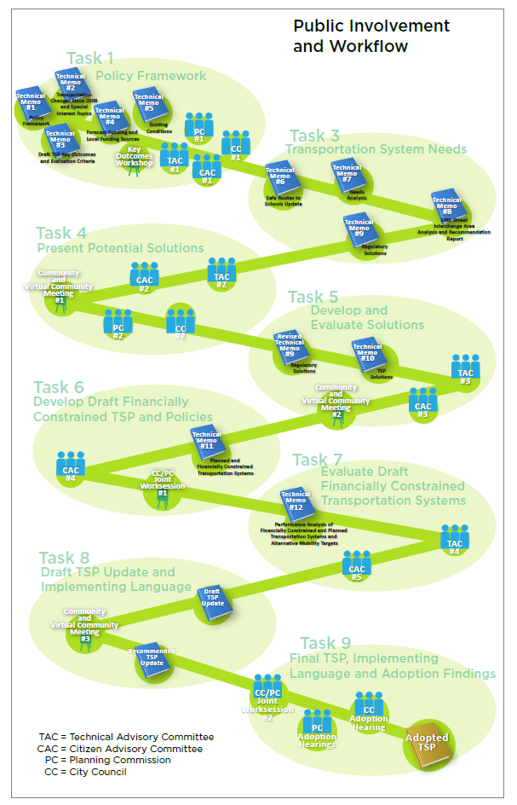
2016 Transportation System Plan
2016 West Linn TSP Process
Process
(16 months)
Nov. 2014 to March 2016
5 monthly meetings with Transportation Advisory Board (January 2015– June 2015)
4 meetings with Technical Advisory Committee
3 public workshops and on-line workshops
3 briefings with Planning Commission and/or City Council
Started adoption process in October 2015 – Multiple Planning Commission work sessions
Planning Commission Recommendation – February 2016
City Council Adoption – March 2016

Slide 13
Transportation System Plan
Transportation Advisory Board (acting as Citizen Advisory Committee)
Provided guidance and direction on:
Goals for the transportation system – based on Comprehensive Plan
Targets and evaluation criteria to prioritize projects
Transportation Needs and Solutions
Draft Plan and Priorities
Planning Commission and City Council
3 Briefings plus Adoption Hearings
Provided guidance and approved plan

Slide 14
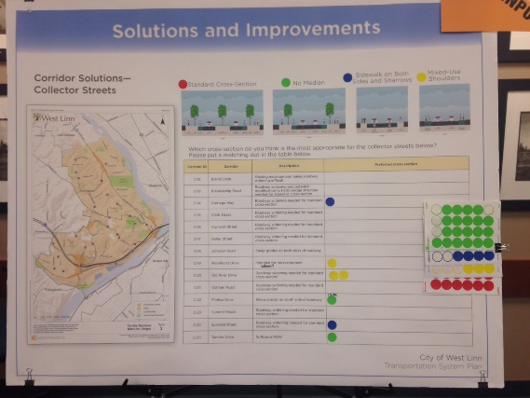
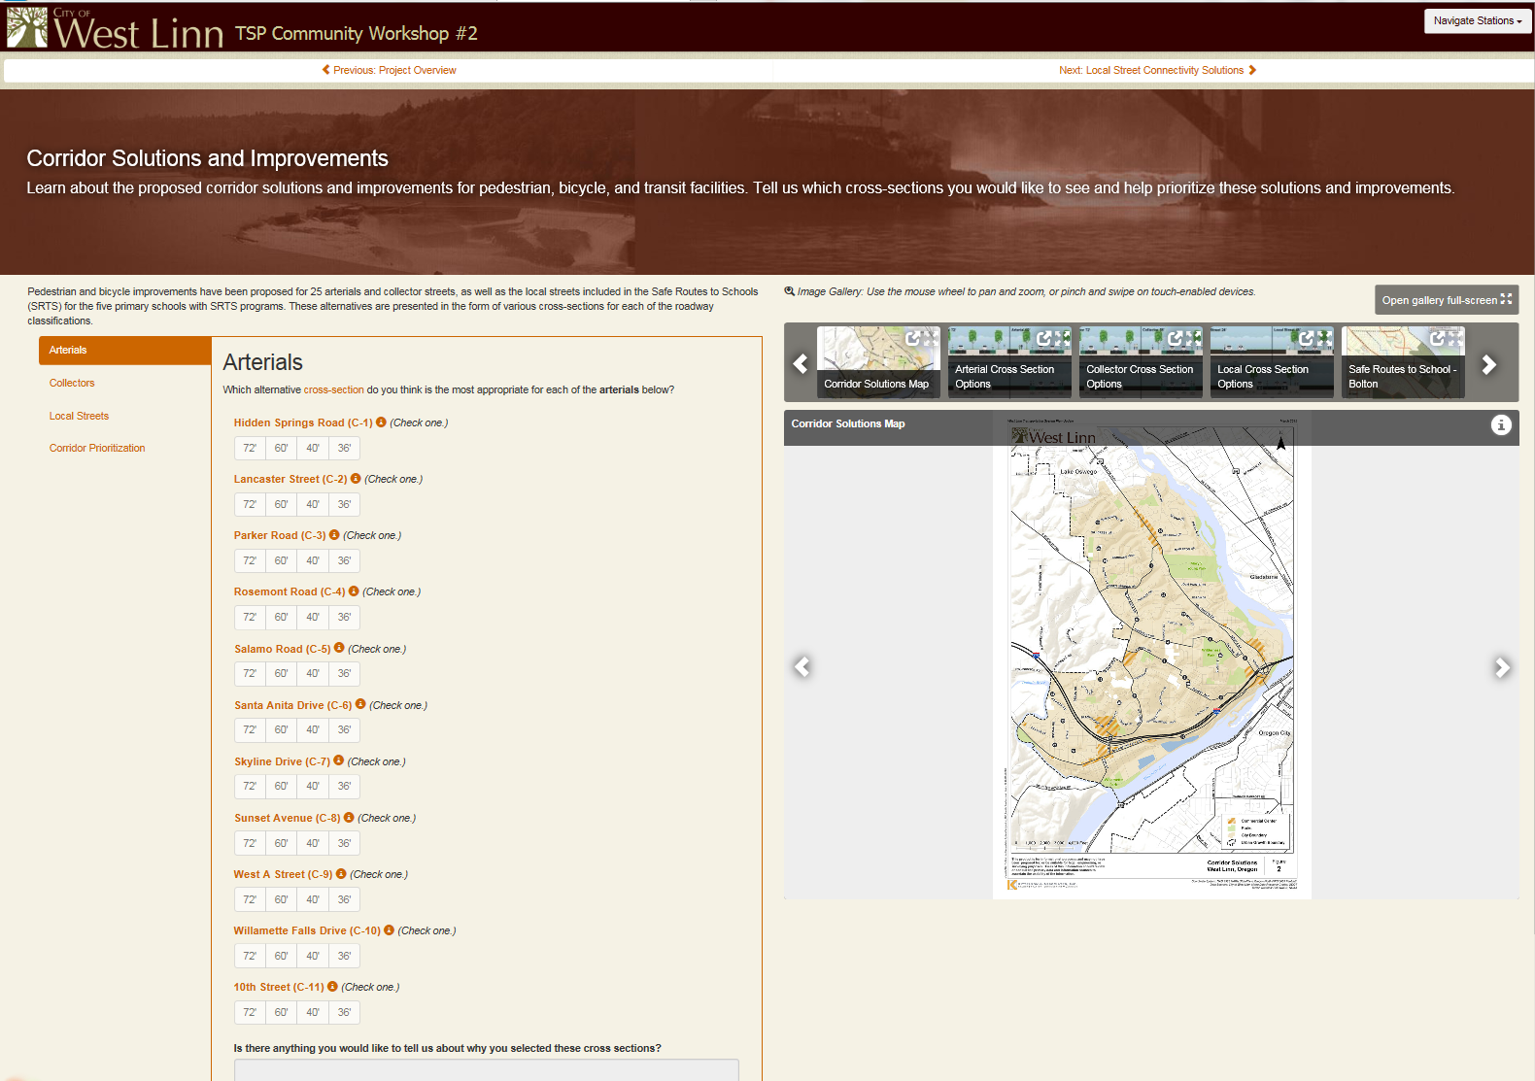
Transportation System Plan
Public Comments from multiple sources
Public comments were received from a variety of sources, including:
Three open houses & Virtual Open House
Resulted in projects, programs, policies, and priorities being added and modified throughout the TSP update as deemed appropriate by the PMT, TAC, and CAC.
Direct phone calls between citizens and City staff/consultants
Direct e-mails between citizens and City staff/consultants
Staff outreach to Neighborhood Associations & direct presentation to interested citizen groups
Published and posted notice public hearings of Plan Commission and City Council.
Posted notice TAB meetings open to public comment/input

Slide 15
Transportation System Plan
Transportation System Plan Chapters
Introduction (includes Organization and Methodology)
Goals, Targets, and Evaluation Criteria
Pedestrian Plan (existing/proposed and future projects)
Bicycle Plan (existing/proposed and future projects)
Transit Plan (existing/future and investment priorities)
Transportation System Management and Operations (TSMO)
Motor Vehicle Plan (existing/future and future projects)
Other Travel Modes (includes Locks, Freight, other modes)
Funding (existing/future funding and meeting Chapter 2 goals/targets
Appendices (Technical & Process Details)
Attachments - Highway 43 Concept Plan

Slide 16
Transportation System Plan - Goals
Goal 1. Safety
Reduce transportation related fatalities and injuries for all transportation modes.
Goal 2. Mobility, Access, and the Environment
Improve peoples’ access to jobs, schools, health care and other regular needs in ways that improve health, reduce pollution and retain money in the local economy.
Goal 3. Equity
Develop transportation facilities that are accessible to all members of the community.
Goal 4. Maintenance
Maintain, protect and improve the existing transportation system.

Slide 17
Transportation System Plan - Safety
Goal 1. Safety
Reduce transportation related fatalities and injuries for all transportation modes.
Vision Zero – No fatal injury collisions by mode and reduce the total number of severe injury collisions by mode.
Reduce the total number of high collision locations by 2040.
Strategies to reduce the severity of collisions include managing vehicle speeds, reducing speed differentials or separating modes, safe intersections and crossings, enforcement, and education.
Targets

Slide 18
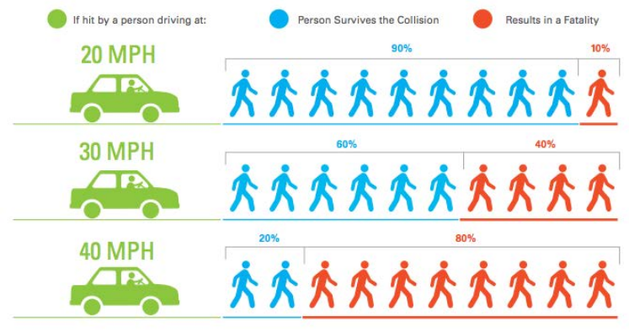
Transportation System Plan - Safety

Slide 19
Transportation System Plan – Mobility, Access, Environment
Goal 2. Mobility, Access, and the Environment
Improve peoples’ access to jobs, schools, health care and other regular needs in ways that improve health, reduce pollution and retain money in the local economy.
Targets
Reduce single-occupant vehicle miles traveled (VMT) per capita.
Achieve forty to forty-five percent non-single-occupant vehicle (SOV) trip mode share in 2040.
Increase the percentage of people that can access key destinations via a 20-minute walk, bike or public transit ride by forty percent by 2040.
Active Safe Routes to School (SRTS) Programs in place in all West Linn elementary and middle schools.
A good quality pedestrian network and low stress bicycle network connecting all residents to key destinations.
Increase the number of green street facilities by 2040 (helps with storm water management).

Slide 20
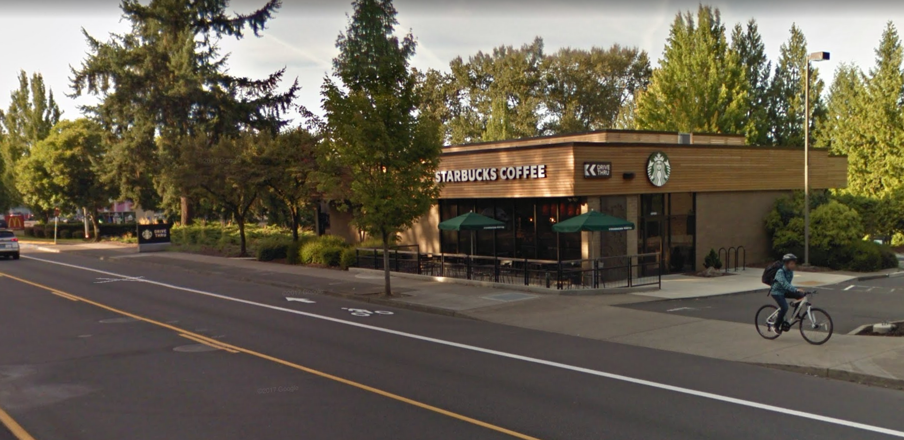
Transportation System Plan - Access
Four Types of Cyclist
Level of Traffic Stress
(LTS)
4
Source: Roger Geller, City of Portland
3
2
1

Slide 21
TSP - Minimize Bike Level of Stress to Maximize Access

Slide 22
Transportation System Plan – Equity & Maintenance
Goal 3. Equity
Develop transportation facilities that are accessible to all members of the community.
By 2040, increase walking, bicycle and public transit access, for transportation disadvantaged populations, to key destinations, by forty percent.
Ensure transportation services (and impacts) are equitably distributed to all segments of the population.
Targets
Goal 4. Maintenance
Maintain, protect and improve the existing transportation system.
Targets
Increase the average local road pavement condition index (PCI) to 70 by 2040.
Reduce the number of transportation facilities in “distressed” condition by five percent by 2040.

Slide 23
Transportation System Plan – 2016 update
Significant Changes to the 2008 TSP
Incorporated and reflect current Comprehensive Plan Goals
Identified pedestrian and bicycle projects
Incorporated Elementary School SRTS routes
Incorporated performance targets and evaluation criteria to prioritize projects for all modes
Removed I-205/10th Street Interchange reconstruction project and replace with 10th Street improvements
Updated roadway functional classifications and future street connectivity map
Concurrent Activities (adopted or incorporated into the TSP at a later date):
Code revisions
Hwy 43 Concept Plan
Hwy 43/I-205 Waterfront Concept Plan (Future)

Slide 24
Transportation System Plan – Funding
Proposed Transportation System Cost Summary (TSP p. 117)
Project Type | High Priority | Medium Priority | Low Priority | Total
Proposed Transportation System Plan
TSM |  | $250,000 |  | $250,000
TDM |  |  | $620,000 | $620,000
Land Use |  | $185,000 |  | $185,000
Access Management |  |  | $55,000 | $55,000
Bike/Ped | $17,605,000 | $11,215,000 | $1,695,000 | $30,515,000
Transit |  | $485,000 |  | $485,000
Motor Vehicle | $5,690,000 | $4,845,000 | $7,735,000 | $18,270,000
Total | $23,295,000 | $16,980,000 | $10,105,000 | $50,380,000
Total Available Local Funding |  |  |  | $20,000,000

Slide 25
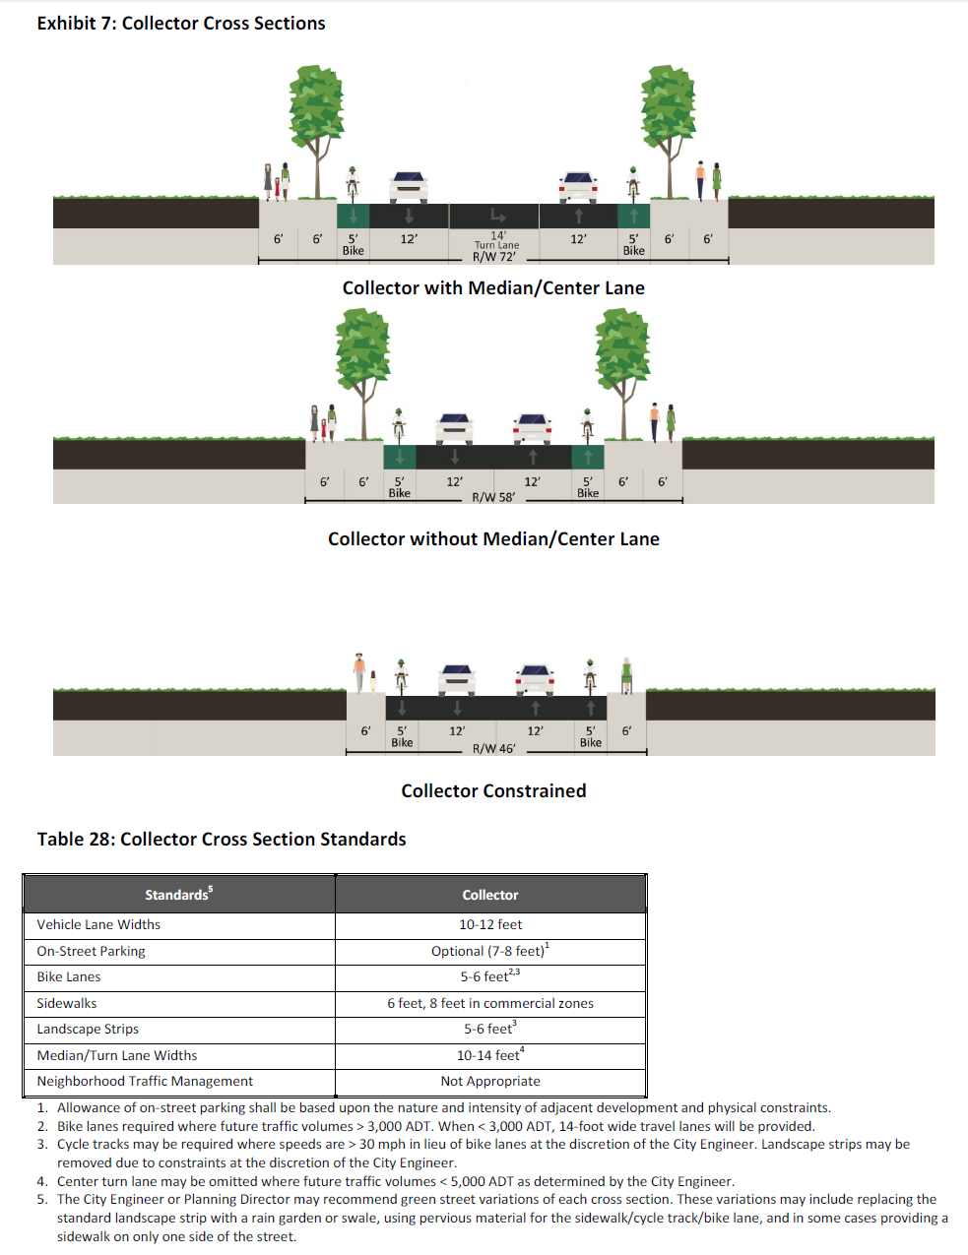
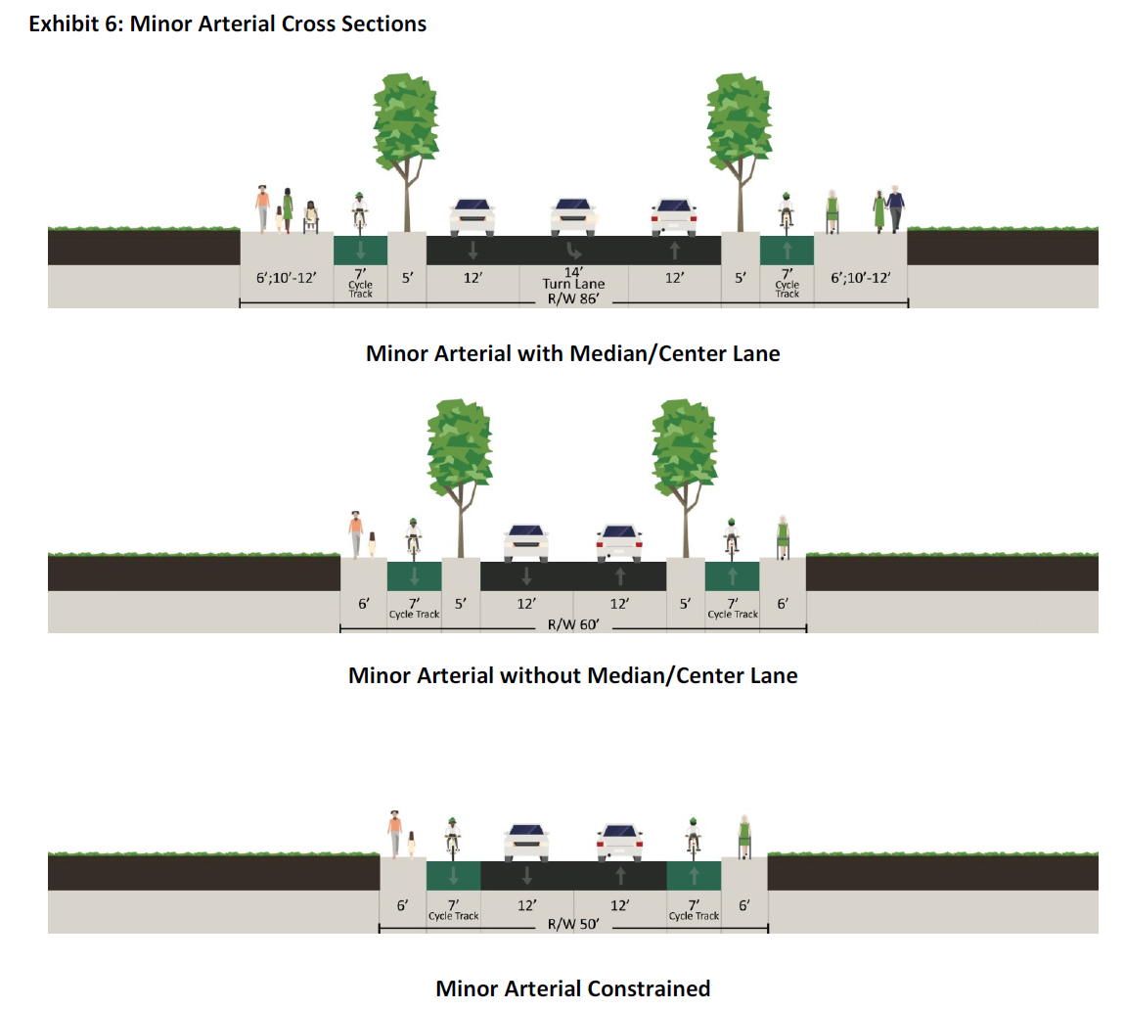
Transportation Items of Interest – Road Sections
Arterial/Collector Street Cross Sections updates from 2008 TSP.
Major shift in design with elimination of wide medians and focus on separated bike lanes for higher volume/higher speed street sections.
On-street parking largely removed/limited to specially designated areas.
Focus on bike/pedestrian safety.

Slide 26
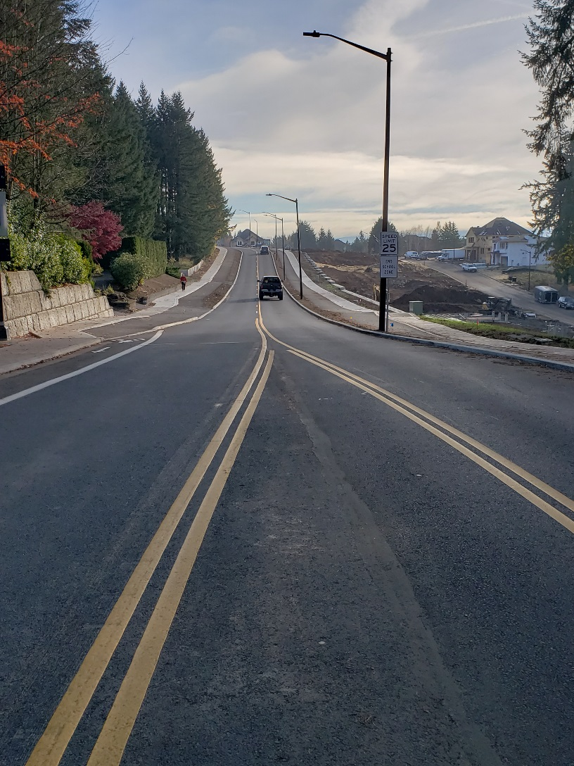
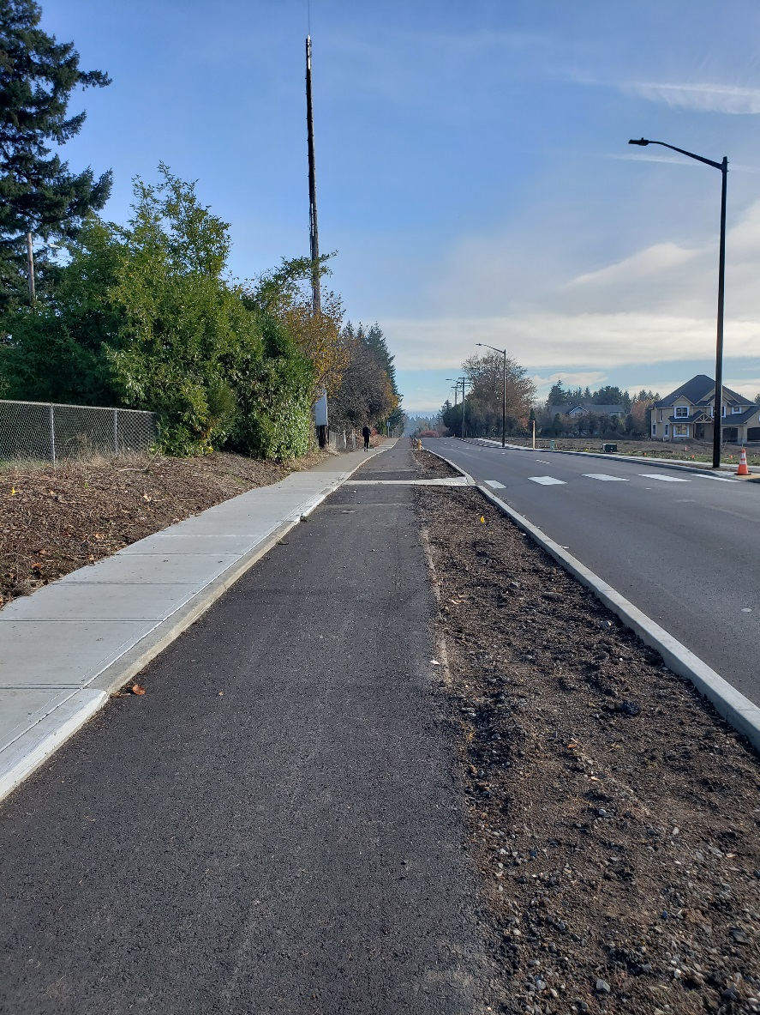
Rosement Road – Cycle Track / Separated Bike Lane

Slide 27
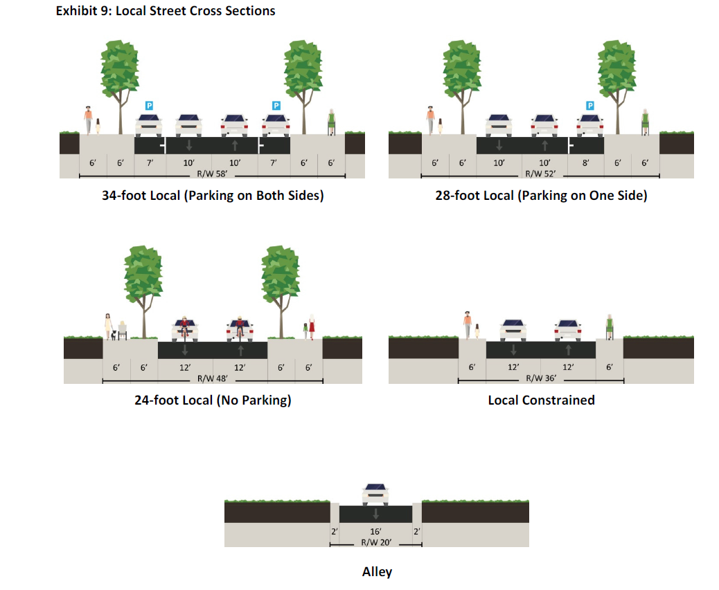
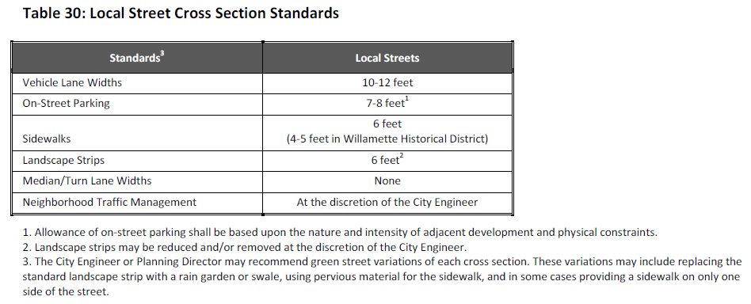
Transportation Items of Interest – Road Sections
Local Street Cross Sections updates from 2008 TSP.
24’ & 28’ sections same.
Parking identified in TSP for credit relative to CDC Section 46 “Off-street” parking requirements and as general notation.
34’ section widened from 32’.
Alley widened/revised to 20’ hard surface standard width.
Constrained section created for
Credit
Credit
Credit
(No Parking Credit)
(No Parking Credit)

Slide 28
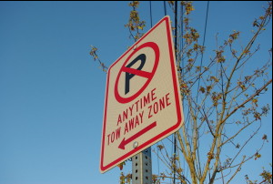
Transp. Items of Interest – Parking Restrictions/Signage
Temporary on-street parking restrictions can also be put into effect for special events.
Temporary on-street parking restrictions delegated to City Engineer during construction.
On-street parking restrictions requests are typically directed to the Traffic Safety Committee for review by all impacted agencies before a final determination is made by the City Manager. Once determined, Public Works will install appropriate signage with enforcement by Police.
On-street parking restrictions are delegated to the City Manager to determine and Police to Enforce.
On-street residential parking zones are directly set by Council.
On-street parking is governed directly by the City Council through city staff and is not delegated to the Planning Commission or other board.
On-street parking restrictions and signage are regulated by the Municipal Code.
Off-street parking restrictions and regulated by the Community Development Code (Ch. 46).
Off-street parking requirements vary by land use.
Credit can be provided to off-street requirements for available on-street parking and by shared use.
Typically only calculated in multi-family and commercial development but applies to single family residential as well.
Single family residential only requires 1 off-street parking space per unit. Note the code requires more off-street parking for a 600 sf one bedroom condo/apartment (1.58 spaces required) than a 4000 sf single family home (1 space required).

Slide 29
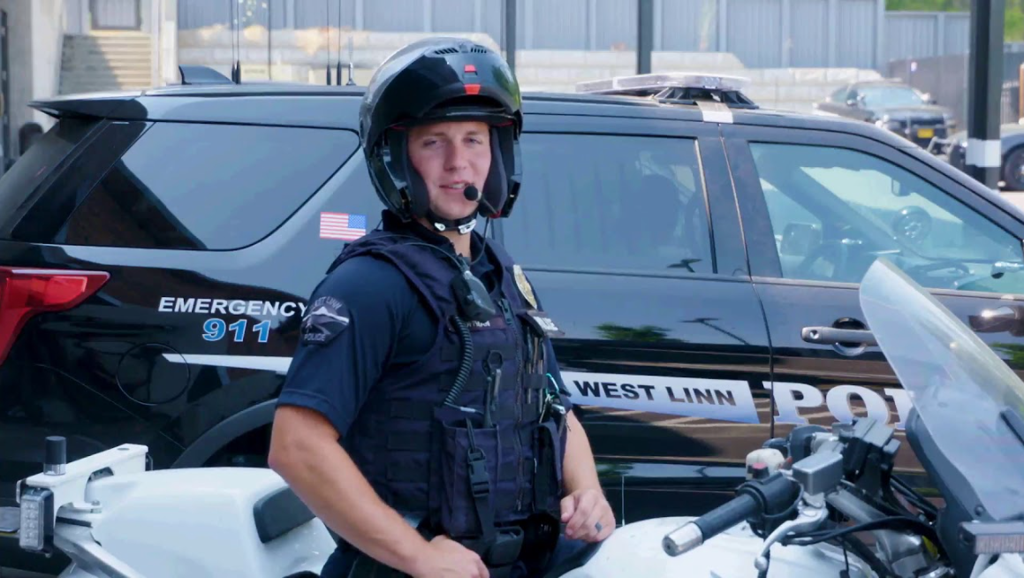
Transp. Items of Interest – Speed Limit / Work Hours
Speed Limit and Work Hours are regulated by the Municipal Code.
Speed Limits are governed by ODOT and state statute. The City has very little oversight of speed limits.
Temporary construction speed limits are governed by state standards and overseen by the City Engineer with enforcement by the Police.
Temporary (or permanent) speed limits are enforceable to all motorized vehicle traffic and cannot be limited to individual groups of traffic.
Work Hours (noise) is governed directly by the City Council through the Municipal Code to city staff and is not delegated to the Planning Commission or other board.
7:00 a.m. to 7:00 p.m. Monday through Friday. 9:00 a.m. to 5:00 p.m. on Saturday, Sunday and Federal holidays for all construction regardless of land use approval or type.
Police enforce work hours as set by Municipal Code Chapter 5. The City Manager is delegated oversight of this code section and can approve exceptions based on criteria outlined in the code.

Slide 30
Transportation Items of Interest – Other
Other items of interest?

Slide 31
Adjourn
Adjourn – the PC and TAB will move to separate work meetings as indicated in the posted meeting agendas.

