Slide 1
Planning Commission
Public Hearing: SUB-18-02 Proposed 4-lot Subdivision at 19310 Suncrest Drive
October 17, 2018
Notes:
Application deemed complete on July 26, 2018
120 day process period ends November 23, 2018 (ask applicant for extension of the 120 days if anyone testifies)
Notice was sent out September 27th posted on the property October 5th and in the Tidings October 4th.

Slide 2
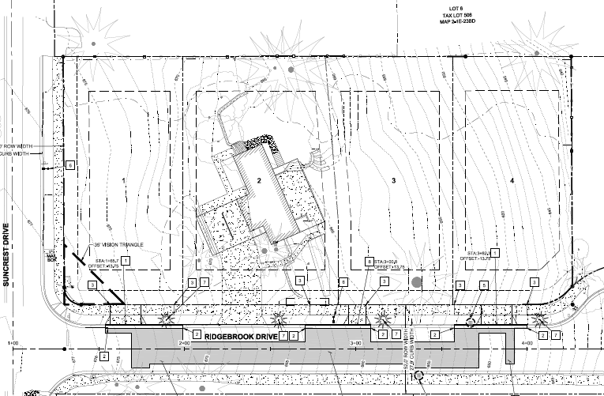
Decision Before the Planning Commission
Public Hearing for 4-Lot Subdivision
0.98 acres
R-10 Zoning
Existing Home- Proposed to Remain
All Access from Ridgebrook Drive
Approve Staff Recommendation
Approve with Modified Conditions
Deny
Notes:
Subject property currently has 1 single family home which will remain on proposed lot 2
The existing driveway will remain as the access to proposed lot 2
All proposed access will be via Ridgebrook Drive

Slide 3
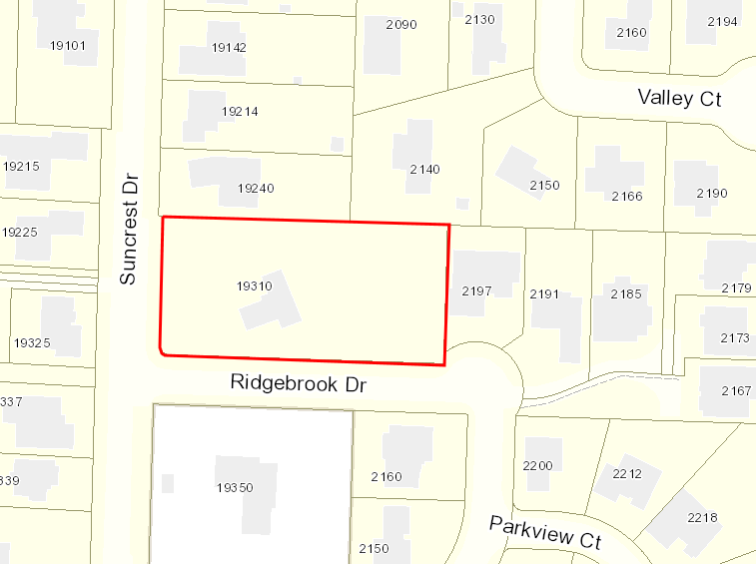
Vicinity Map
Notes:
Subject property is located on the corner of Suncrest Drive and Ridgebrook Drive

Slide 4
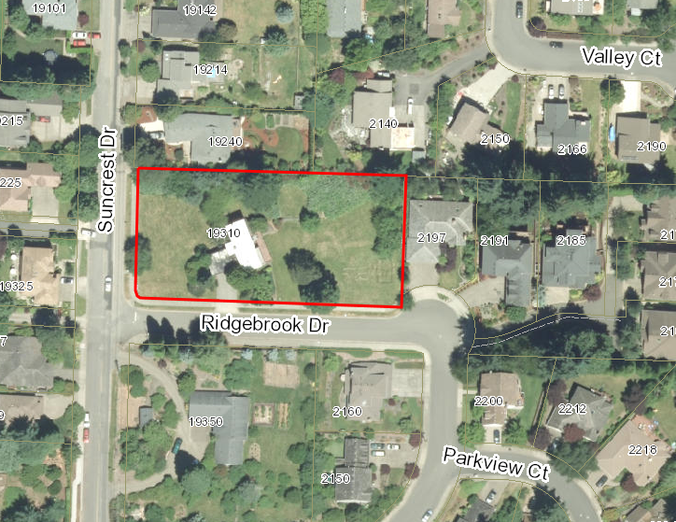
Aerial Photograph
Notes:
The property has sidewalks alone all roadway frontage and both Ridgebrook Drive and Suncrest Drive are built out to Engineering Standards.
No ROW Dedication required with this Subdivision

Slide 5
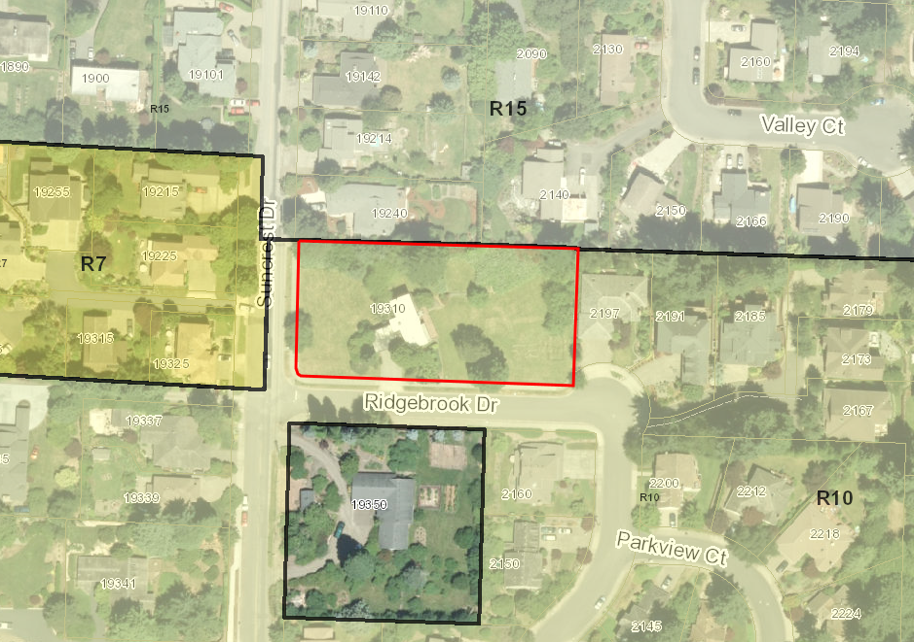
Neighborhood Zoning
Notes:
Subject property is located in the R-10 zone requiring 10,000 sq. ft. lot sizes
Property directly across the street is an island property and not yet annexed
Property to the west is zoned R-7
Property to the North is zoned R-15 requiring 15,000 sq ft lot sizes
Neighborhood is largely built out in an R-10 pattern with the average lot size being 10,000 sq. ft. even in the R-15 zoned section of the neighborhood

Slide 6
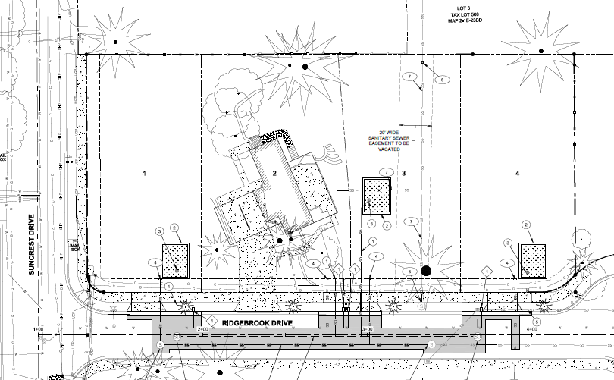
Site Plan
Notes:
On proposed lot 3 there is an existing Sewer Easement proposed to be vacated when the applicant abandons the existing sewer line per condition of approval 3
No changes to proposed lot 2 for stormwater management
Proposed lots 1, 3, and 4 will use rain gardens for stormwater treatment with the overflow going into the City’s stormwater utility line in Ridgebrook Drive
Sewer, stormwater and Water lines are all existing within the Ridgebrook Drive ROW
Sewer and Stormwater lines will be extended along the frontage within the Ridgebrook Drive ROW to serve each lot

Slide 7
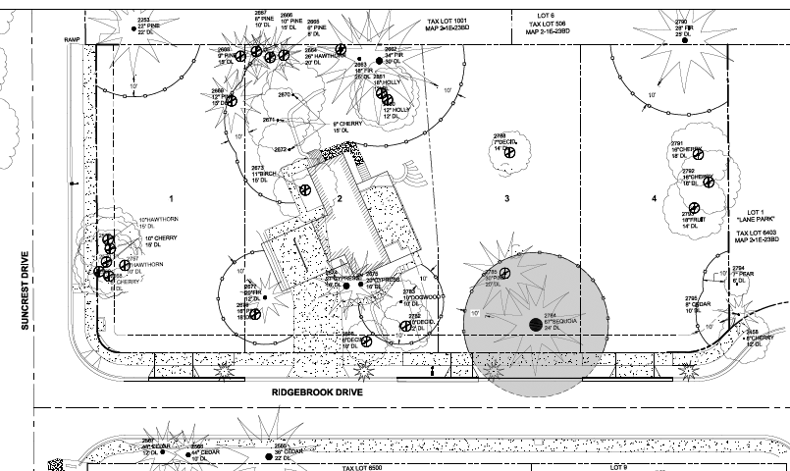
Tree Protection and Removal Plan
Notes:
The subject property has 44 trees and the applicant proposes to retain and protect 10 on-site trees
There are 11 off-site trees to be protected
One tree on the subject property is identified as a significant tree and will be retained as part of the 10 protected trees on-site
510 caliper inches of trees total on the property; 223 inches retained totaling 43% retention
100% of significant trees will be retained exceeding CDC criteria

Slide 8
Staff Recommended Conditions of Approval
Site Plan. With the exception of modifications required by these conditions, the final plat shall conform to the submitted Tentative Plan, (Sheet C200).
Engineering Standards. All public improvements and facilities including street improvements, ADA upgrades to sidewalks, utilities, grading, onsite storm water design, driveway placement and construction, pavement mitigation, street lighting, street trees, easements, and easement locations are subject to the City Engineer’s review, modification, and approval per the City adopted Public Works standards. All improvements must be designed, constructed, and completed prior to final plat approval. The Director of Public Works may allow a waiver of improvements as allowed by Code.
Future Easement Vacation. The applicant shall vacate the existing sewer easement on proposed lot 3 and abandon the existing sewer connection in an upstream location.

Slide 9
Planning Commission SUB-18-02
QUESTIONS OF STAFF?

Slide 10
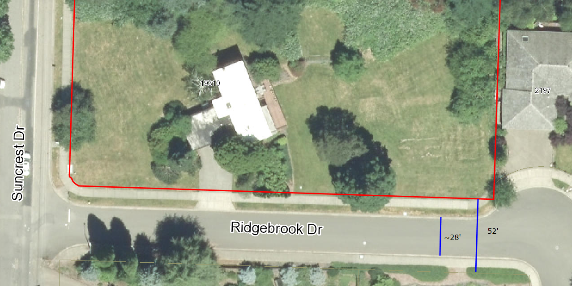
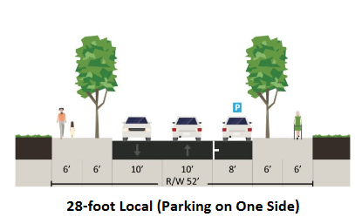
Planning Commission SUB-18-02
Notes:
Ridgebrook Drive has a 52 foot right-of-way which includes a sidewalk on the south side and a sidewalk/planter strip on the north side.
Using the GIS is appears that there is approximately 28 feet of paved driving surface.
Graphic in lower left is from the TSP which shows this ROW can accommodate parking on one side

