Slide 1
Planning Commission
Mixed-Use Working Group Recommendations
Worksession: CDC-18-02
May 2, 2018

Slide 2
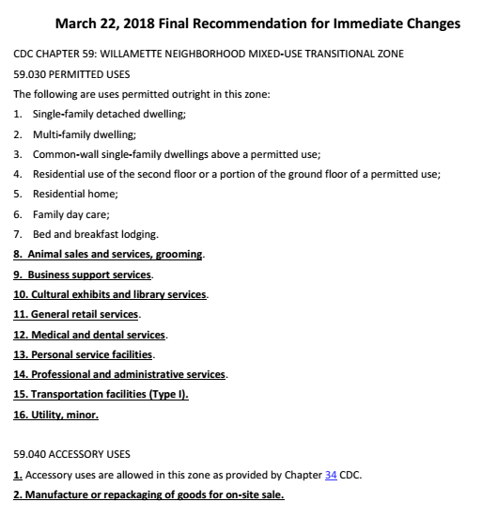
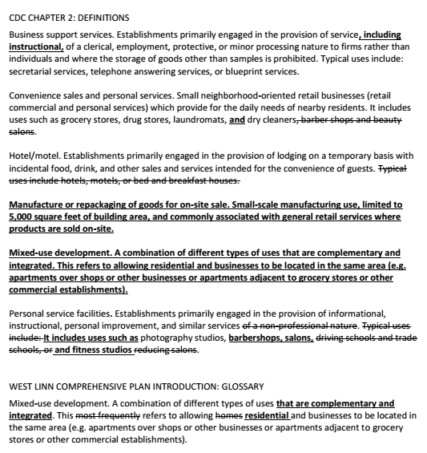
Planning Commission Agenda Packet
Staff Memo
Link to MU Working Group materials
MU Working Group Memo/Recommendation
Immediate legislative changes
CDC Chap. 59 use list
CDC Chap. 19 use addition
CDC definition amendments
Comp Plan mixed-use definition
Planning docket additions
Map, Purpose & Goal, Membership
CDC Chapter 59

Slide 3
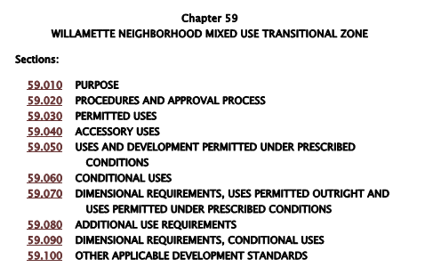
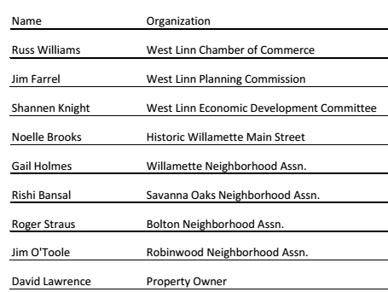
Mixed-Use Working Group: Background
CC/PC/EDC Meeting – Summer 2017
Priority of CC
Directed CCI to propose
Purpose
Goal
Membership
City Council appointed group on 11/13/2017
8 Members
2 Purposes
1 Goal

Slide 4
Mixed-Use Working Group: Purpose & Goal
City Council prescribed purposes for group
First Purpose: To review and update as necessary the list of permitted and conditional uses in the Willamette Neighborhood Mixed-Use Transitional Zone (MU Zone – Chapter 59)
Second Purpose: Consider a definition of mixed-use
City Council prescribed goal for the group
Updated lists are needed to reflect current business culture and categories (terminology or categories of uses) and to facilitate compatible mixed-use, commercial, and residential uses. Updated lists will support community and economic goals and will assure appropriate transition between the Historic Willamette commercial core and surrounding Willamette neighborhood.

Slide 5
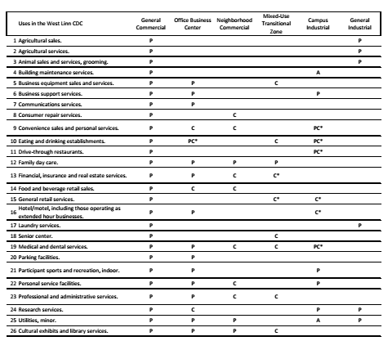
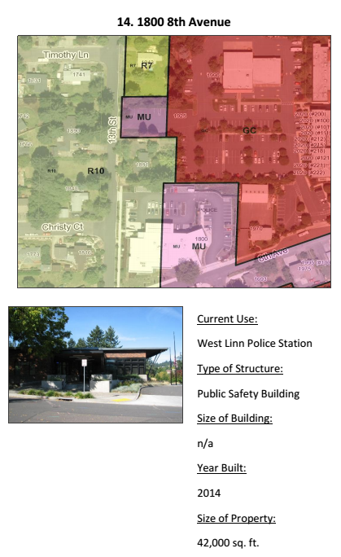
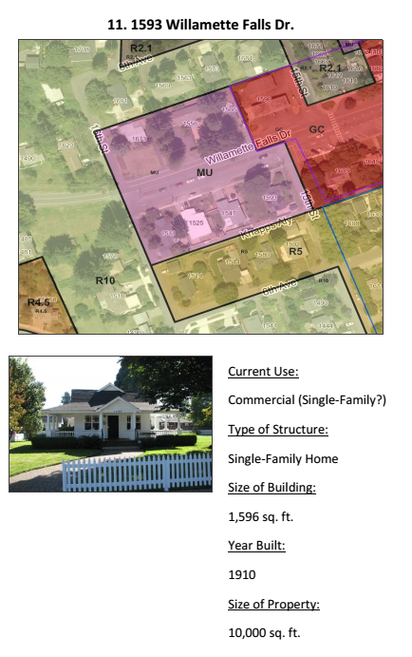
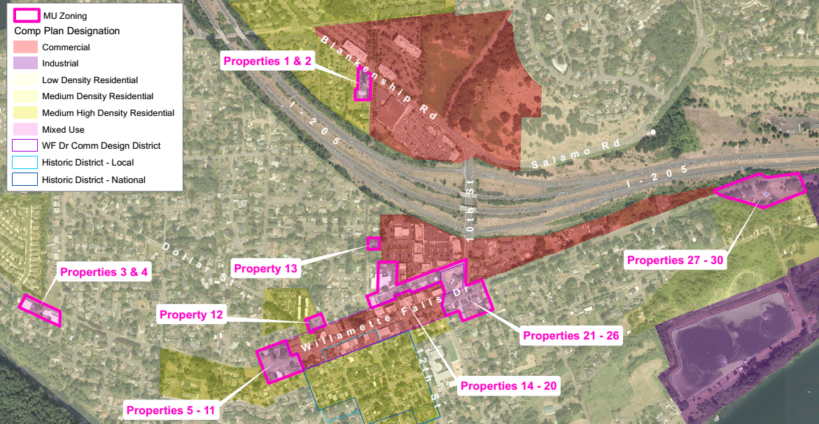
Mixed-Use Working Group: Meeting 1
Meeting 1 – January 4, 2018
Acclimate to process
Review materials
Hear from property owners
Request 9th member/elect chair

Slide 6
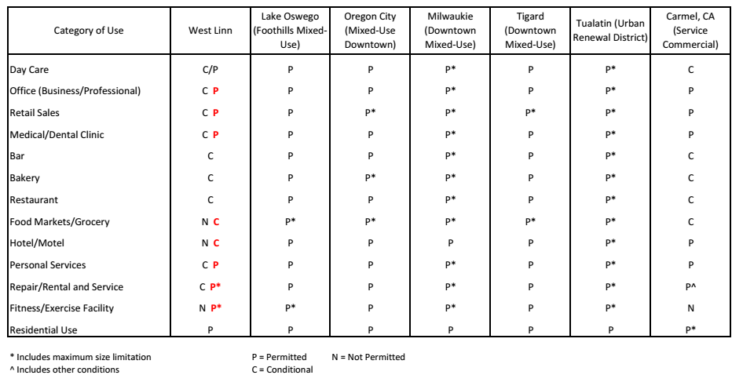
Mixed-Use Working Group: Meeting 2
Meeting 2 – January 25, 2018
Working definition of mixed-use (Purpose 2)
Zoning/location discussion
Permitted/conditional use comparison with other cities

Slide 7
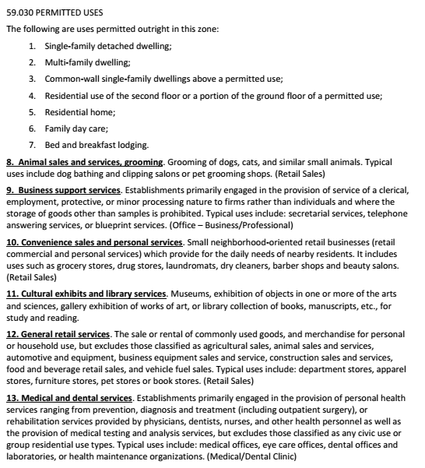
Mixed-Use Working Group: Meeting 3
Meeting 3 – February 22, 2018
Staff research/options
Day care, small hotels, repair business, yoga studios
Proposed updated use list (Purpose 1)
Definition changes
Small-scale manufacturing discussion

Slide 8
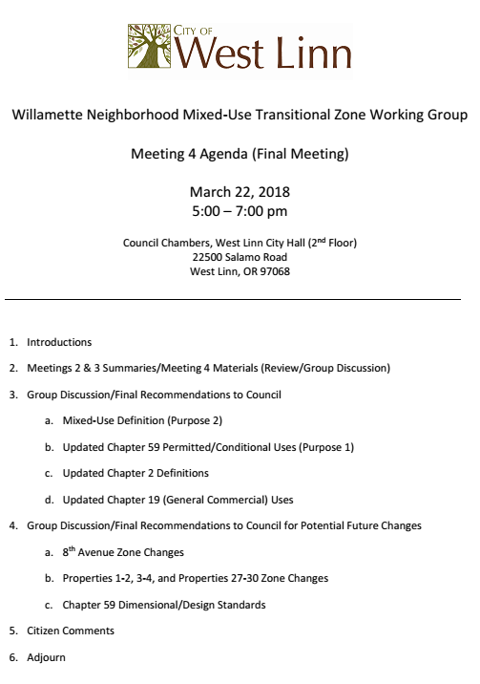
Mixed-Use Working Group: Meeting 4
Meeting 4 – March 22, 2018
Staff research/options
Personal service facilities/grocery store
Small-scale manufacturing
Final Recommendations
Mixed-use definition (Purpose 2)
CDC Chap. 59 updated use list (Purpose 1)
CDC Chap. 19 additional use
CDC Chap. 2 definition changes
Final Recommendations for future consideration

Slide 9
Mixed-Use Working Group: Recommendations
Mixed-use definition (Purpose 2)
Small amendment to existing Comp Plan Glossary definition
Add amended definition to CDC Chapter 2

Slide 10
Mixed-Use Working Group: Recommendations
CDC Chapter 59 updated use lists (Purpose 1)
Permitted Uses
Added 9 more
Accessory Uses
Added 1 more
Manufacture or repackaging of goods for on-site sale
Uses and Development Permitted Under Prescribed Conditions
Added 5 more
Conditional Uses
Added 4 more
Removed 5 for no definition
Moved 3 to P and 2 to PC

Slide 11
Mixed-Use Working Group: Recommendations
CDC Chapter 19 – add an accessory use to be consistent with Chapter 59

Slide 12
Mixed-Use Working Group: Recommendations
CDC Chapter 2 – Definition amendments
Business support services
Added “including instructional”
Convenience sales and personal services
Moved “barber shops and beauty salons” for better fit
Personal service facilities
Added “barber shops, salons, and fitness studios”
Removed some out-of-date language
Hotel/motel
Bed and breakfast defined separately
Manufacturing or repackaging of goods for on-site sale
Mixed-use development

Slide 13
Mixed-Use Working Group: Recommendations

Slide 14
Mixed-Use Working Group: Future Considerations
Consider rezoning properties along 8th Avenue
10th to 13th Street from MU to GC
7 of 8 property owners in favor
13th to 14th Street from R-10 to MU/GC
4 of 6 property owners on south side in favor
1 in favor, 1 not out of 5 on north side
Evaluate more appropriate zoning for separated properties
Properties 1-2, 3-4, and 27-30 on map in packet
CDC Chapter 59 dimensional/design standard changes
Reuse vs. Redevelopment
Zero lot lines, remove max building size, remove residential style standards
Evaluate parking management in Willamette Main Street area

Slide 15
CDC-18-02 Legislative Process
June 6: Planning Commission Public Hearing
Recommendation to City Council
June 18: City Council Worksession
Staff briefing and question/answer session
July 9: City Council Public Hearing
Final Decision on proposal

Slide 16
CDC-18-02
QUESTIONS OF STAFF?

