Slide 1
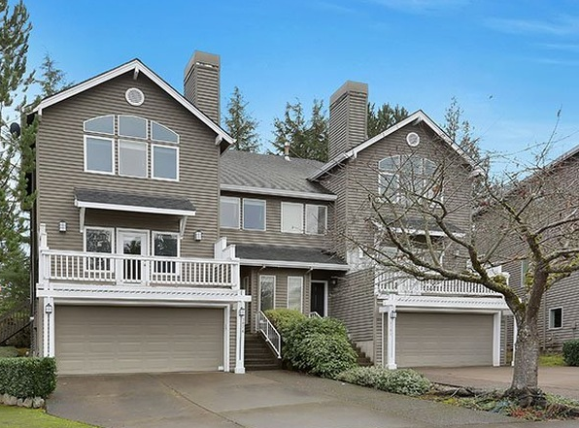
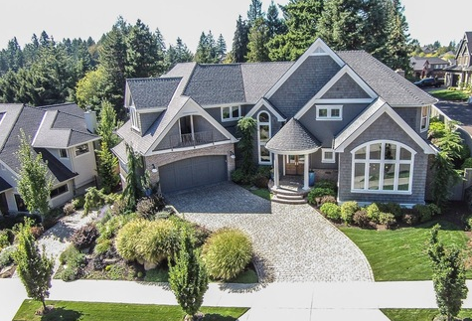
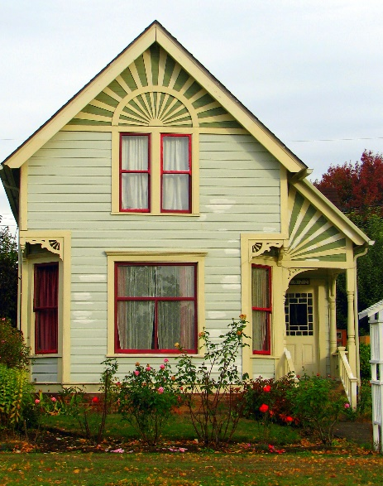
Planning Commission Work Session
November 1, 2017

Slide 2
Tonight’s topics
Affordable Housing
SB 1051 Overview
Clackamas County Housing Needs Assessment
Planning Docket Update

Slide 3
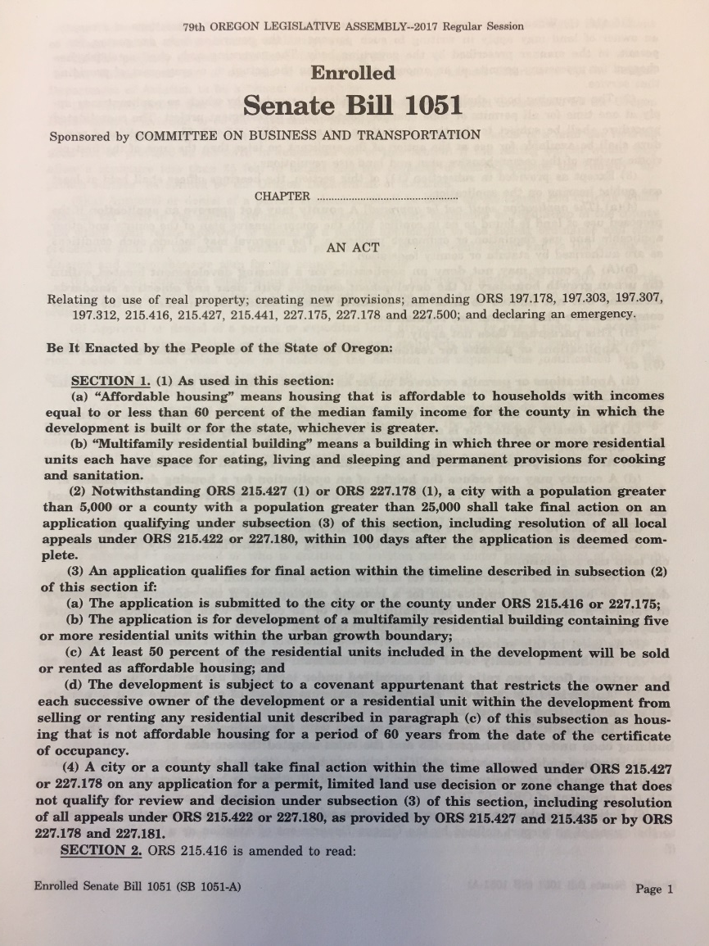
SB 1051 Overview
Creates new requirements for cities and counties related to the planning and permitting of residential development
Effective date: January 1, 2018; varied implementation dates
14 sections

Slide 4
SB 1051 – overview of relevant sections
Section 1: Requires multifamily affordable housing projects to go through entire local land use process in 100 days (currently 120). Analysis: no code changes recommended. May require scheduling of special meetings on rare occasions. Future code changes regarding procedures will need to ensure 100-day review process is possible.
Section 3: Requires city to approve applications for all housing types if they meet clear and objective standards. Prohibits city from lowering the density or height of an application if is at or below the zone’s authorized density or height. Exceptions: health, safety, habitability issues, or to comply with protective measures based on land use goals.
Analysis: no code changes recommended.

Slide 5
SB 1051 – overview of relevant sections
Sections 4,5: Redefines “needed housing” to include housing at all price points, including but not limited to low income. Analysis: may impact housing needs assessments; opens up needed housing requirements to all price points.
Section 6: Requires cities over 2,500 pop. to allow accessory dwelling units (ADUs) in all single-family zones on lots containing a detached dwelling.
Analysis: no impact on West Linn; this standard already exists in Metro area and West Linn code complies.

Slide 6
SB 1051 – overview of relevant sections
Sections 7, 8: Requires counties and cities to allow the placement of housing on lands owned by worship institutions if: (1) at least half of units are affordable to households under 60% median family income; (2) underlying zoning allows residential uses; and (3) land is within Urban Growth Boundary. Analysis: no code changes recommended.
Section 9: Minor changes to annual DLCD reporting requirements.
Analysis: very minor amount of staff work required.

Slide 7
Clackamas County Housing Needs Assessment
Proposal under discussion at C4:
Analysis of current/future needs for housing county-wide
Unincorporated Clackamas County + 12/14 cities (Milwaukie and Wilsonville have recently completed)
To serve as basis of discussions to bridge identified housing gaps
Inventory of housing stock/condition, buildable land supply, more
Document and predict commute trends, demographics, economy
Assess best practices for developing housing at various price points

Slide 8
Planning Docket Update
Review current docket (handout)
Annual update process (CDC 98.030):
Anyone may request a Comprehensive Plan, CDC or zoning map amendment or a related project by submitting a form (available online or at City Hall).
Each year, staff shall present the proposed project list to the Planning Commission to give them the opportunity to review the proposed projects, add projects of interest, and to prioritize the proposed projects within their purview.
The City Council sets the docket each year after considering all proposals. The Council may also initiate amendments at any time, outside of the docketing process.

