Slide 1
Historic Review Board
Public Hearing: DR-17-07 – 1296 12th Street.
July 18, 2017

Slide 2
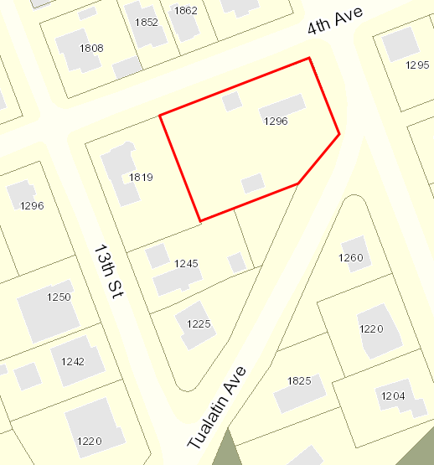
Decision Before the Historic Review Board
Public Hearing for Design Review
Dismantle and rebuild an existing garage on its current footprint and modify the existing roofline in the Historic District.
Approve with Conditions
Deny

Slide 3
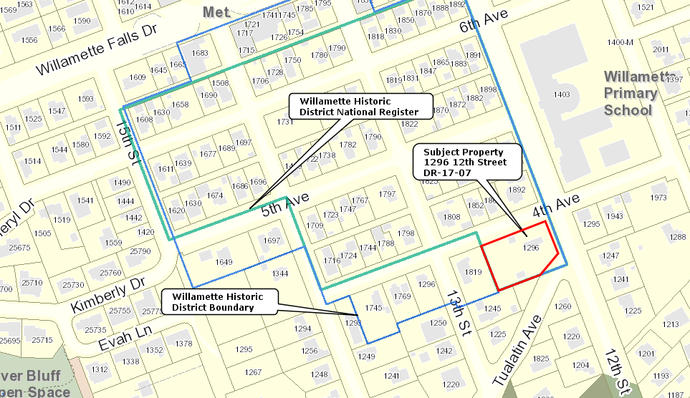
Property Characteristics
Willamette Historic District Overlay &Willamette Historic District National Registe
Area: approx. 26,619 sq. ft. lot
Applicant/Owner:
John Klatt/ Jody Carson
Zoning:
R-10
Comp. Plan:
Low Density Residential

Slide 4
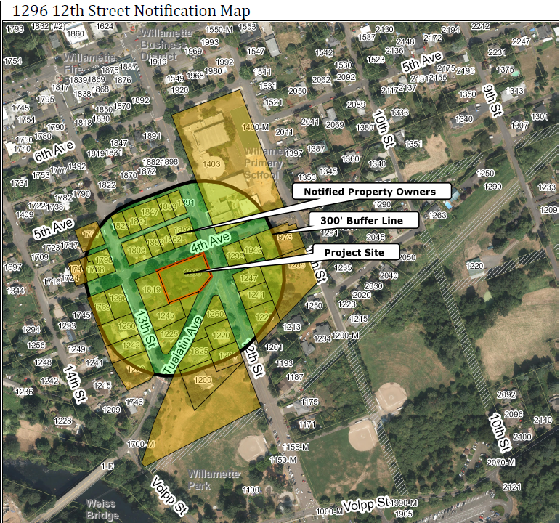
Proposal Background
Application Submitted and Deemed Complete June 28, 2017
Notice Requirements Met (Exhibit HRB-1 & HRB-2)

Slide 5
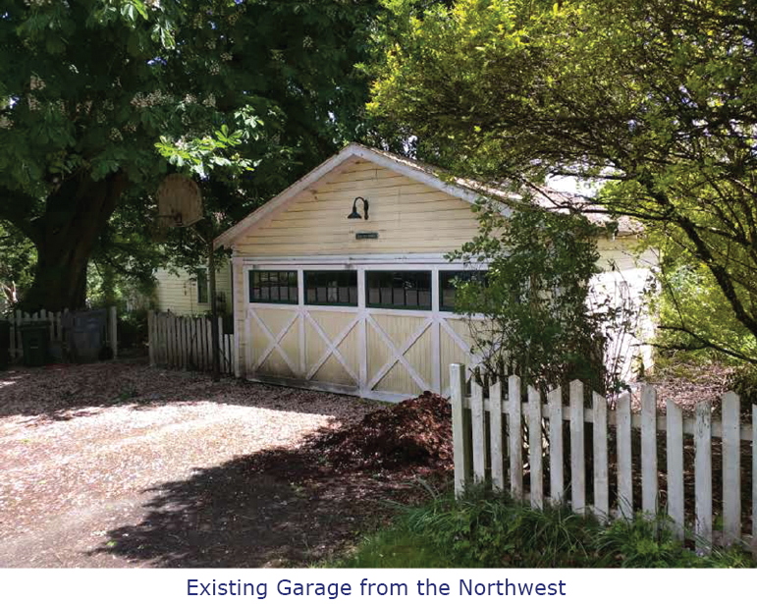
Existing Conditions – June 2017

Slide 6
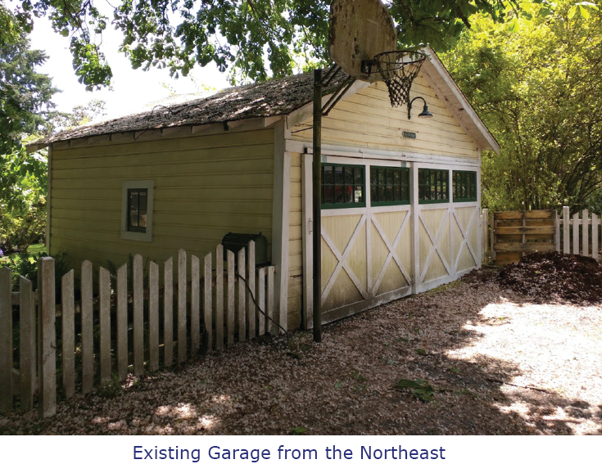
Existing Conditions – June 2017

Slide 7
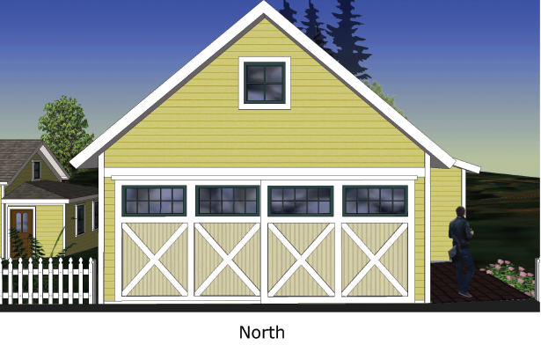
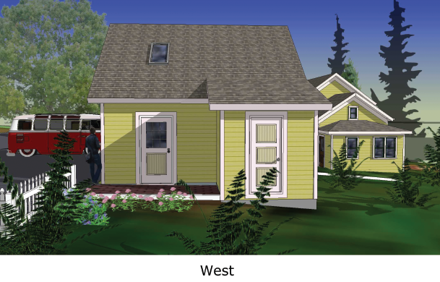
Applicant Submittal – June 2017

Slide 8
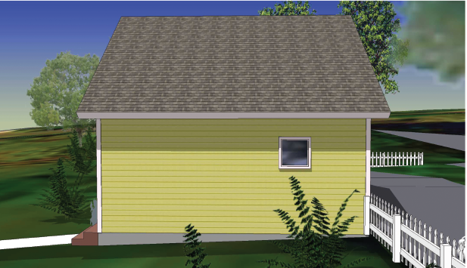
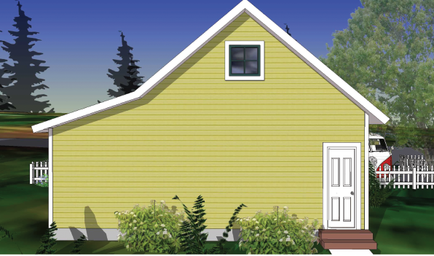
Applicant Submittal – June 2017

Slide 9
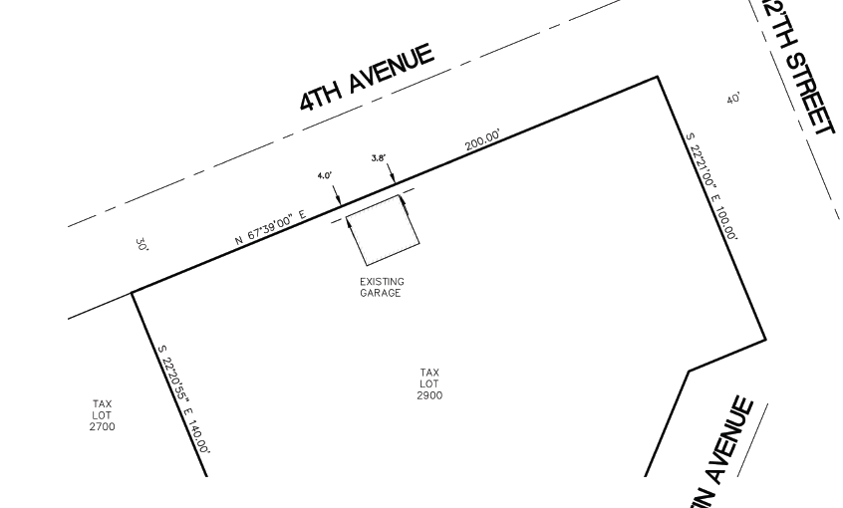
Site Plan – June 2017

Slide 10
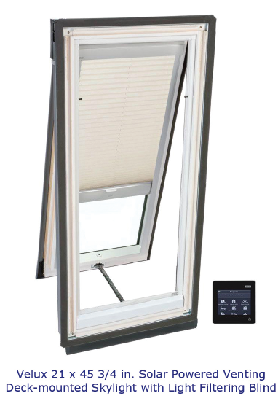
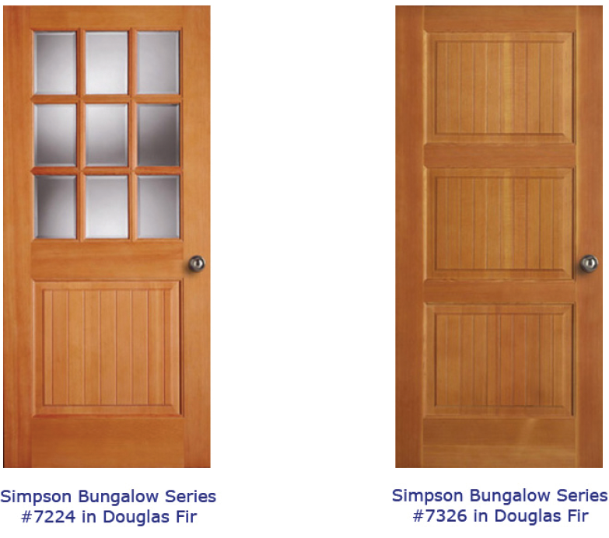
Approval Criteria – CDC Chapter 25, Historic Resources
CDC 25.030 Permitted Uses
CDC 25.040 Historic Design Review Processes
CDC 25.060 Design Standards Applicable to Historic Resources
CDC 25.070 Additional Standards Applicable to Historic Districts

Slide 11
Staff Analysis
The proposed home meets the requirements in CDC Chapter 25
The requirements of the underlying zone (R-10- CDC Chapter 11) are satisfied
Staff recommends approval of the application subject to the following condition:
Site Plan, Elevations, and Narrative. The project shall conform to the plans, elevations, and narrative submitted in Exhibit HRB-4.

Slide 12
Historic Review Board – DR-17-07
QUESTIONS OF STAFF?

