Slide 1
West Linn’s Arch Bridge Property
A survey of west linn residents on what to do with the property.
October 2015

Slide 2
Survey Purpose
To provide West Linn policy makers and citizens information on West Linn residents’ preferences for the property north of the Arch Bridge.
Survey instrument was developed by students after reviewing December 2014 Concept Plan, 80 responses gathered by Karen Park and Angela Dreher at West Linn neighborhood associations, and river developments in other Oregon cities. Draft survey instrument was edited by a professional public opinion researcher.
Surveys were conducted over two weeks in late October 2015.
Survey Methodology:
Students worked in 35 pairs.
Pairs visited homes in assigned neighborhoods throughout the city.
Each pair interviewed a single individual in at least ten different homes.

Slide 3
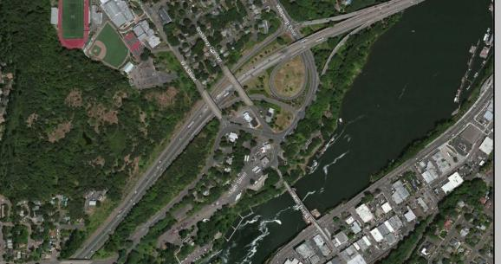
Map shown to respondents

Slide 4
A survey of 300+ West Linn homes.
Number of homes visited by neighborhood:
Willamette – 40
Savanna Oaks – 30
Barrington Heights – 10
Sunset – 30
Parker Crest – 20
Hidden Springs – 80
Bolton – 50
Marylhurst – 30
Robinwood – 40

Slide 5
Respondents by Gender

Slide 6
Respondents by Age

Slide 7
Respondents by Years in West Linn

Slide 8
Zoning the Property

Slide 9
Value Statement – History

Slide 10
Value Statement – River Access

Slide 11
Value Statement – Traffic

Slide 12
Value Statement – Living Space

Slide 13
Value Statement – Retail Space

Slide 14
Value Statement – Play Space

Slide 15
Value Statement – Park/Open Space

Slide 16
Uses acceptable on the property:

Slide 17
Heights of Buildings

Slide 18
Conclusions.
What respondents want for the property:
Access to the river.
Recreation – parks, river activities, community gatherings.
Shopping.
Showcase history and heritage.
Shorter buildings (1-4 stories).
What respondents do not want for the property:
Increased traffic or congestion.
Industrial activity.
Low-density housing.
A parking garage.
A hotel.

