Slide 1
Historic Review Board
Continued Public Hearing: DR-15-05 – 1724 4th St.
October 20, 2015

Slide 2
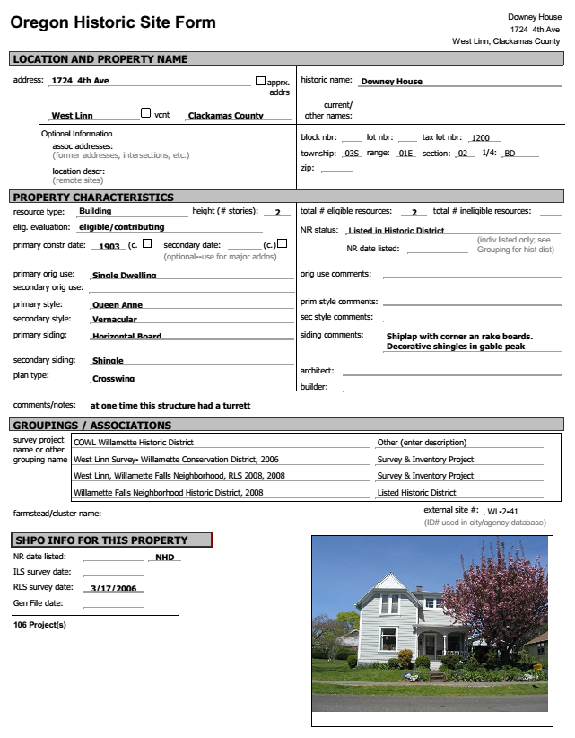
Decision Before the Historic Review Board
Continued Public Hearing for Design Review
Removal of addition and rebuild of original turret on front elevation
Build addition on rear elevation
Convert non-contributing carport into two-story garage
Approve
Approve with Conditions
Deny

Slide 3
Submittal Requests from Historic Review Board
Plan Views
Existing and Proposed
Elevation and Floor Plan
Turret, Rear Addition & Garage
Material Samples
Outdoor Lighting Sample
Garage Door Cut-Sheet
Gable Details
Additional Findings for CDC 26.060(A)
19. Foundations
20. Lighting

Slide 4
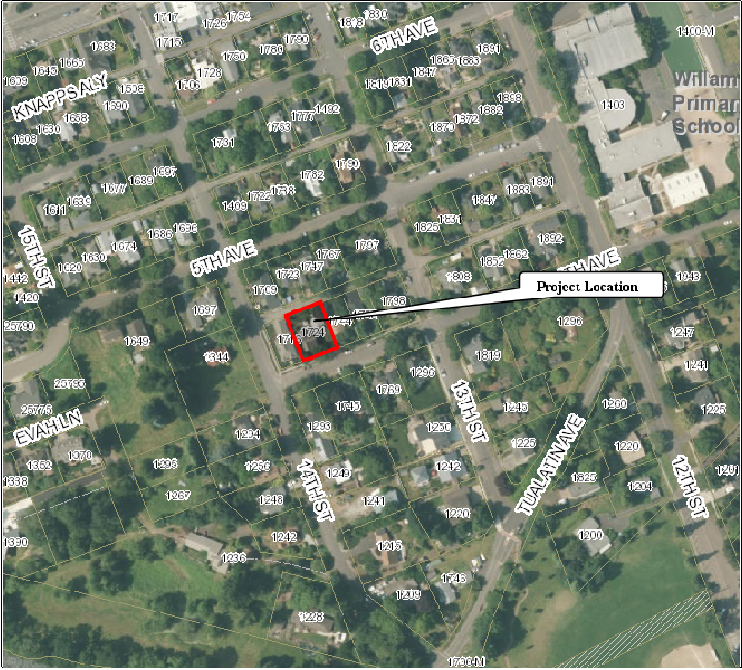
Property Characteristics
Willamette Historic District Overlay &Willamette Historic District National Register
Eligible, Contributing Historic Home
Built c. 1905
Queen Anne Style
Area:
7,500 sq. ft. lot
Applicant/Owner:
Peter Graves
Zoning:
R-5
Comp. Plan:
Medium Density Residential

Slide 5
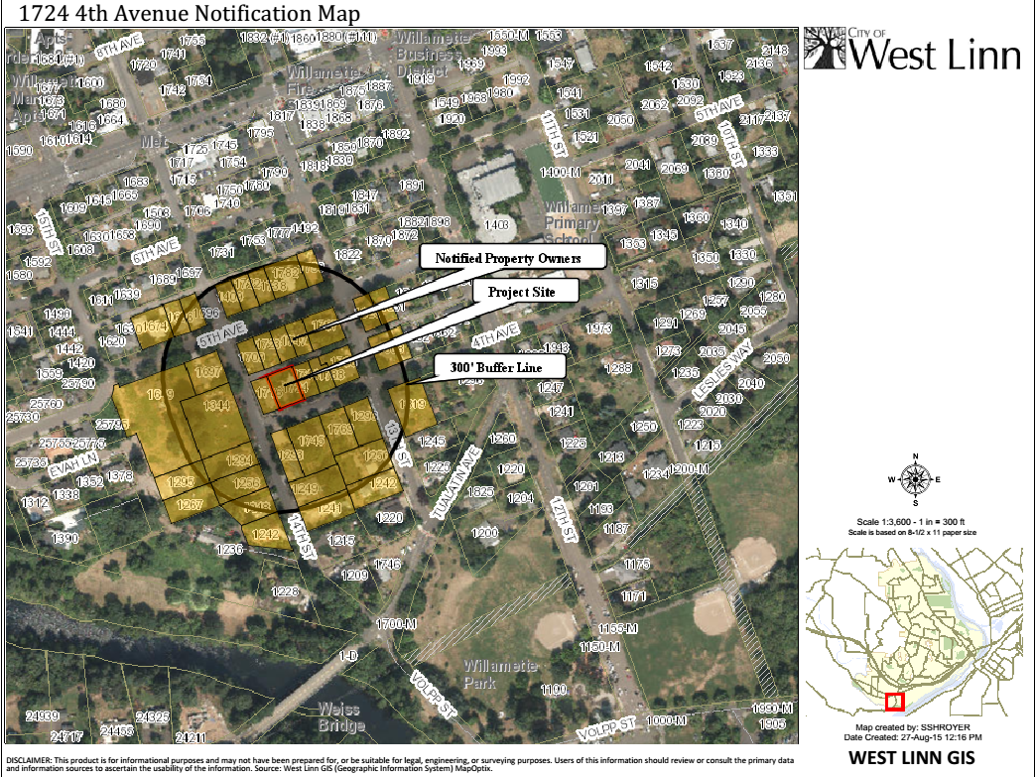
Proposal Background
Application Submitted and Deemed Complete June 8th (Exhibit HRB-7)
Notice Requirements Met (Exhibit HRB-1 & HRB-2)
Previous Approvals:
2015 – Reduced window size in kitchen

Slide 6
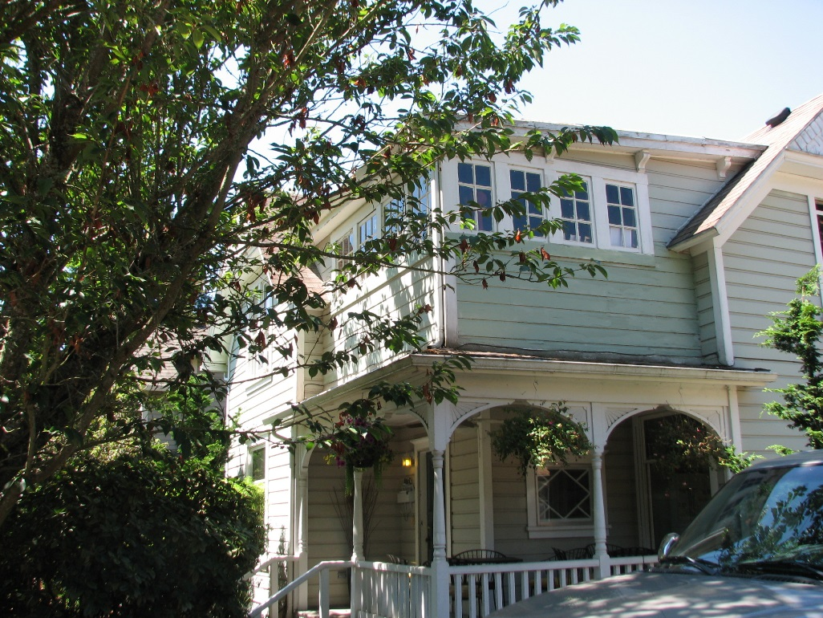
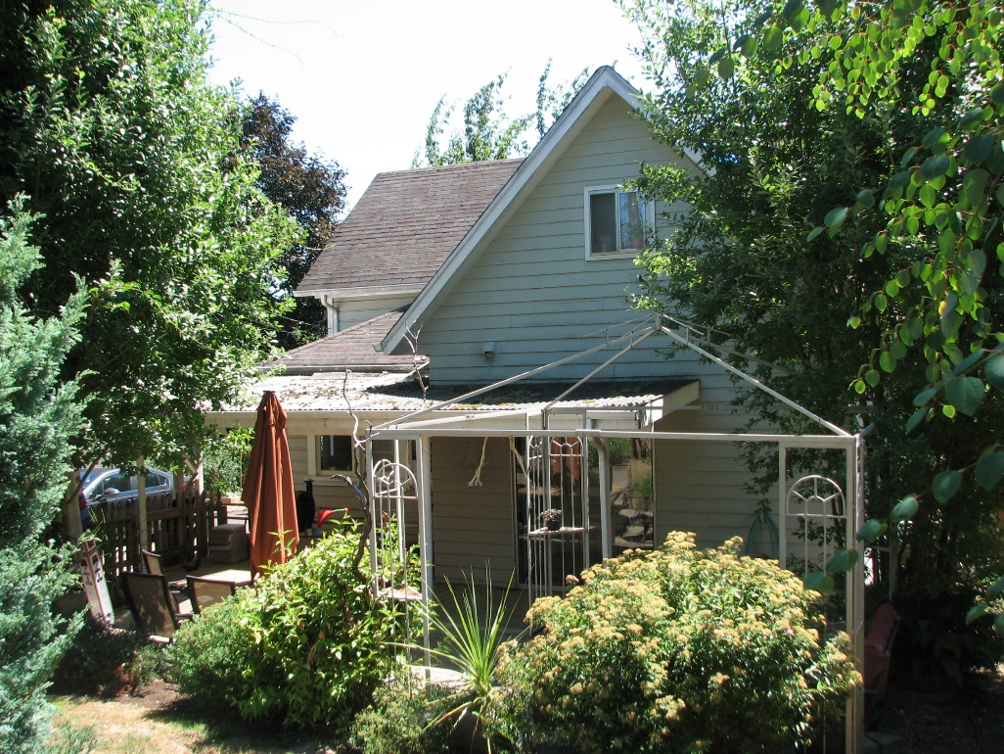
Existing Conditions – August 2015
Front Elevation Addition to Remove
Rear Elevation

Slide 7
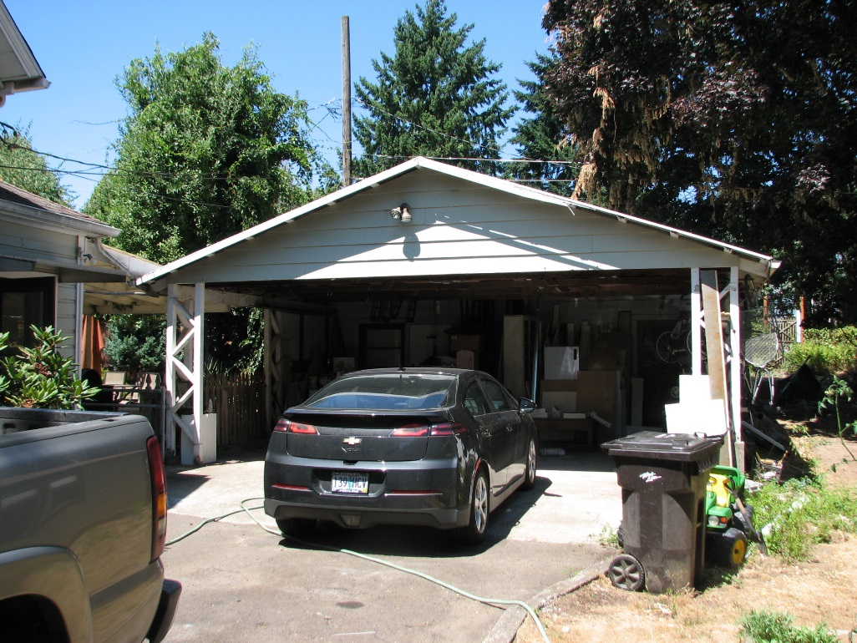
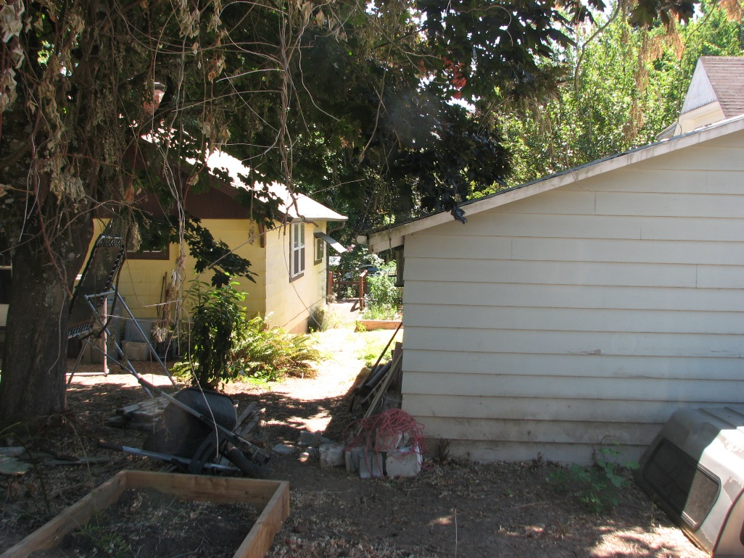
Existing Conditions – August 2015
Non-Contributing Carport
Carport (Rear Alley View)

Slide 8
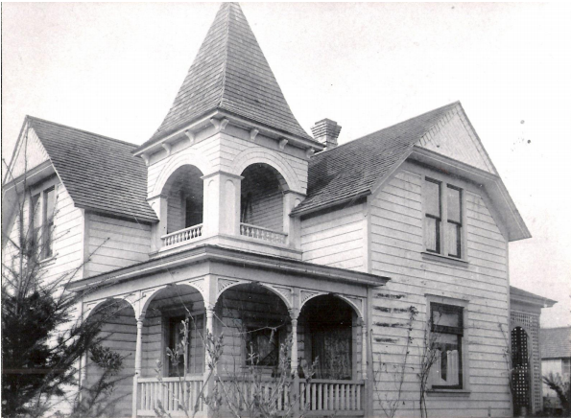
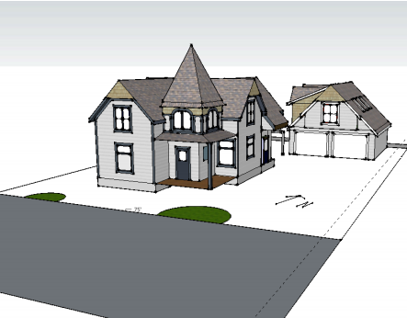
Applicant Submittal – June 2015
South (Front) Elevation – Restore Original Turret

Slide 9
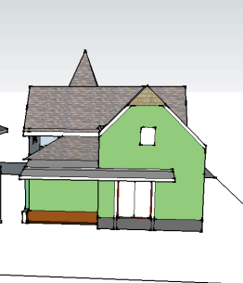
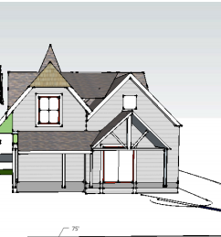
Applicant Submittal – June 2015
Existing Rear Elevation Proposed Rear Elevation

Slide 10
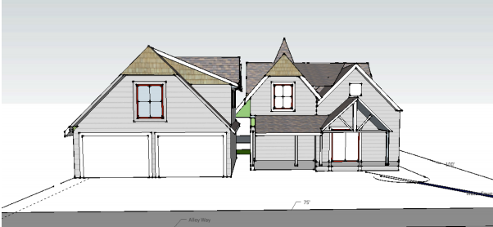
Applicant Submittal – June 2015
Proposed Rear Elevation – Carport Conversion & Rear Addition

Slide 11
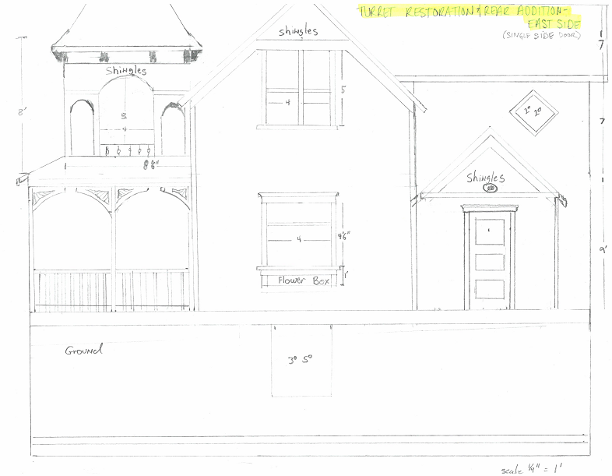
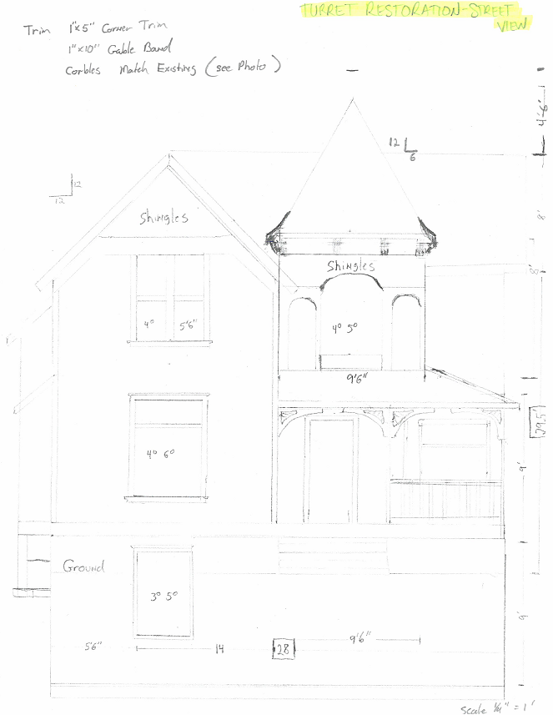
Applicant Submittal – October 2015
Proposed Front Elevation and East Elevation w/Rear Addition

Slide 12
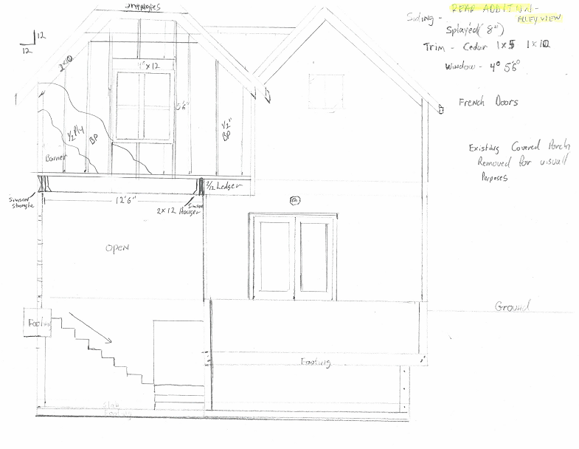
Applicant Submittal – October 2015
Proposed Rear Elevation w/Addition

Slide 13
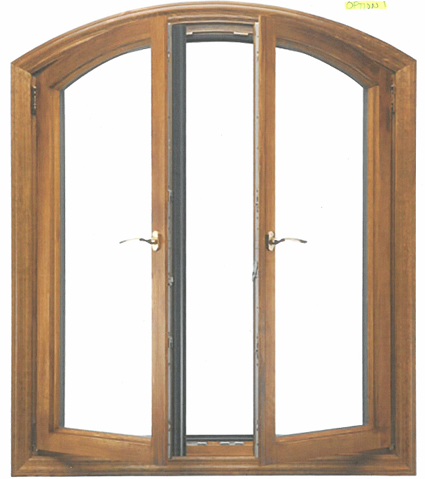
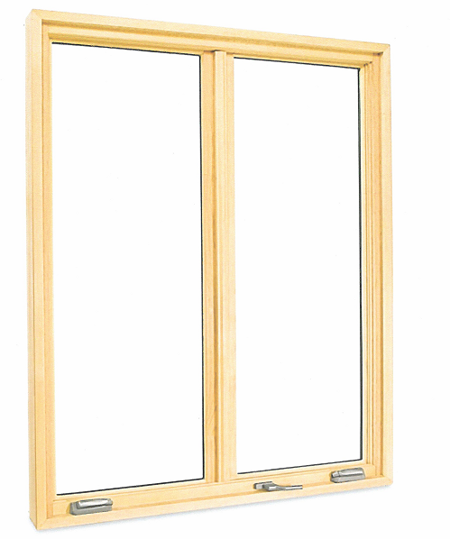
Applicant Submittal – October 2015
Window Options for Turret

Slide 14
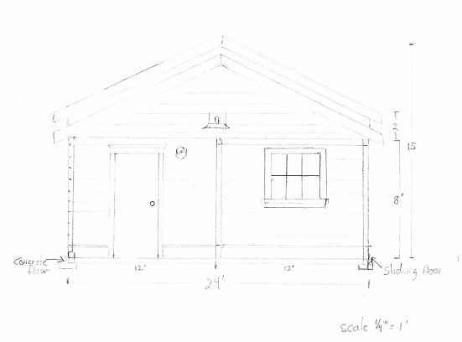
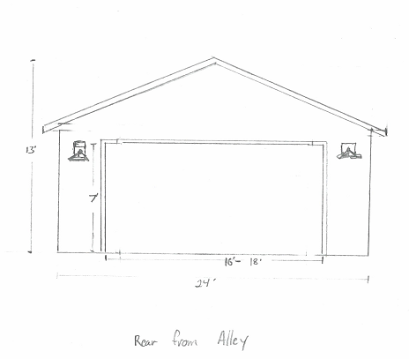
Applicant Submittal – October 2015
Single-Story Garage Option Front and Rear Elevations

Slide 15
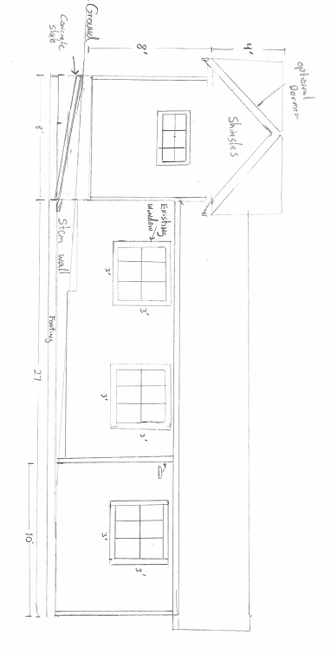
Applicant Submittal – October 2015
Single-Story Garage Option - West Elevation

Slide 16
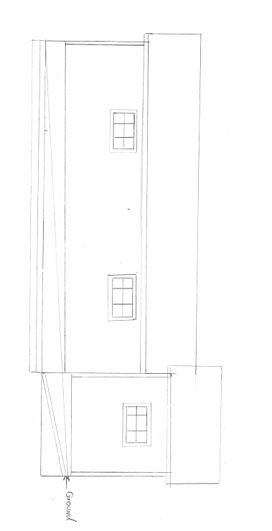
Applicant Submittal – October 2015
Single-Story Garage Option - East Elevation

Slide 17
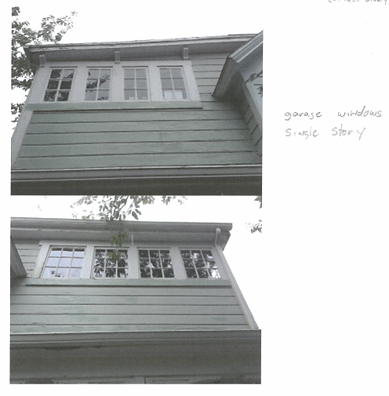
Applicant Submittal – October 2015
Single-Story Garage Option - Windows

Slide 18
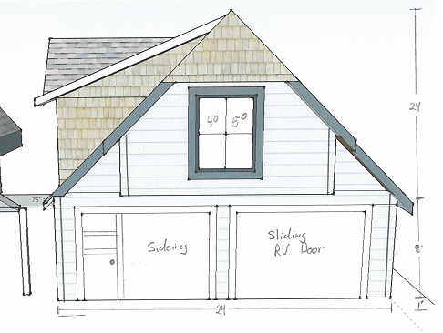
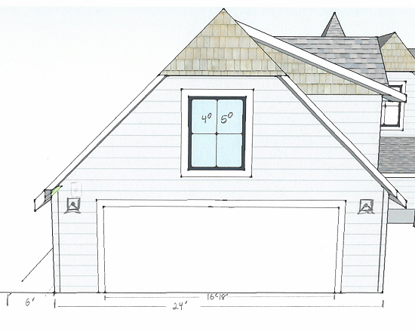
Applicant Submittal – October 2015
Two-Story Garage Option – Front and Rear Elevations

Slide 19
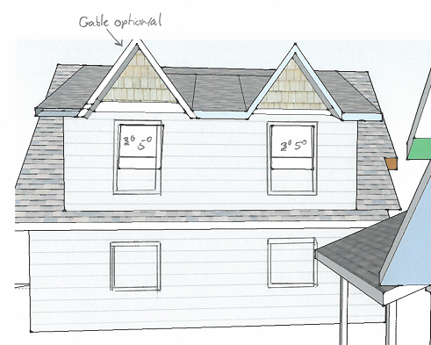
Applicant Submittal – October 2015
Two-Story Garage Option – West Elevation

Slide 20
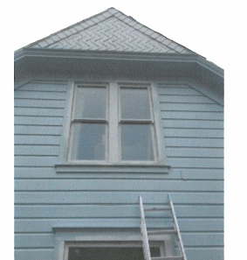
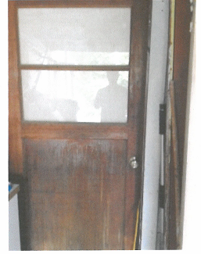
Applicant Submittal – October 2015
Two-Story Garage Option - Windows and Entrance Door

Slide 21
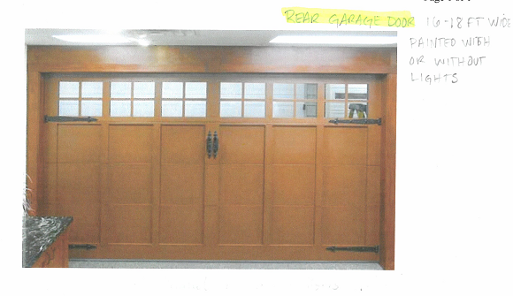
Applicant Submittal – October 2015
Garage Door (Alley Side)

Slide 22
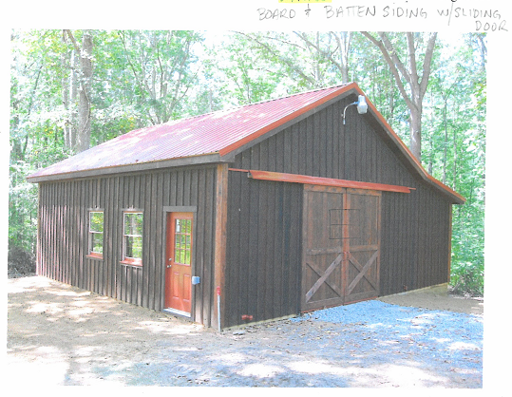
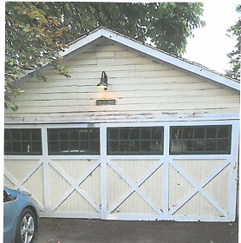
Applicant Submittal – October 2015
Garage Siding and Door (Street Side)

Slide 23
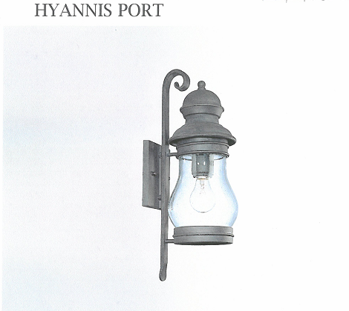
Applicant Submittal – October 2015
Garage Entrance and Side of House Garage - Car Bay

Slide 24
Jon McLoughlin Comments – October 19, 2015
I think everything looks great. Just a couple of comments-
Board and batten works just fine I think, it would be typical of a garage being built at a later date than the house. I like the yellow picture with the sliding barn door for a door option.
Both single and two story options look great, but would definitely make the dormers on both an option but not a necessity.
The lighting looks great as well as the window choices.
If they have to tear the garage down for new foundations, and I think they'll have to, I hope there's a way to keep the current setback for their benefit.

Slide 25
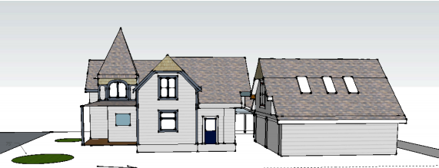
Approval Criteria – CDC Chapter 25, Historic Resources
CDC 25.030 Permitted Uses
CDC 25.040 Historic Design Review Processes
CDC 25.060 Design Standards Applicable to Historic Resources
CDC 25.070 Additional Standards Applicable to Historic Districts

Slide 26
Staff Analysis – Turret and Rear Addition
The proposed turret and rear addition comply with applicable setback and height requirements and roof pitch. The size and scale are appropriate.
The proposed turret will restore original architecture of the home and contribute to the historic district. The rear of the home has two previous additions. The proposed rear addition will mimic the original roof pitch and be subordinate to the original architecture.
The proposed turret and rear addition will use siding and windows that are compatible with existing materials.

Slide 27
Staff Analysis – Two-Story Garage
The applicants request two modifications to design standards for the proposed two-story carport conversion.
1. Reduce side yard setback for two-story accessory structure from 15 feet to 6 feet (CDC 25.070.C.2.b).
2. Allow garage door to face the street when an alley access is available. Primary access will be from the alley (CDC 25.070.C.10.a).
The proposed carport conversion complies with height and rear lot setback standards.
The proposed carport conversion complies with setback standards from the house.
The proposed carport conversion will use siding and windows that are compatible with historic materials.

Slide 28
Staff Analysis – One-Story Garage
The applicants request one modification to design standards for the proposed one-story carport conversion.
1. Allow garage door to face the street when an alley access is available. Primary access will be from the alley (CDC 25.070.C.10.a).
The proposed carport conversion complies with height and rear/side lot setback standards.
The proposed carport conversion complies with setback standards from the house.
The proposed carport conversion will use siding and windows that are compatible with historic materials.

Slide 29
Staff Analysis
Recommendation:
Staff recommends the Historic Review Board approve the historic design review application, subject to the following conditions:
1. Accessory Structure (Two-Story Garage) Side Yard Setback Modification. The accessory structure side yard setback can be modified to six feet only if the east elevation of the accessory structure does not include any dormers/bump outs on the roof to limit encroachment on the property to the east.
2. Garage Access. The garage (both the one and two-story options) access can be modified to maintain an existing street access only if the primary access is from the alley, with the secondary street access disguised with reinforced grass paving and the street façade of the garage containing only a single garage access door that replicates the siding used on the rest of the accessory structure.
3. Site Plan, Elevations, and Narrative. The project shall conform to the plans, elevations, and narrative submitted in Exhibit HRB-4 and Exhibit HRB-8 (additional applicant materials).
4. Minor Amendment. With the Historic Review Board approval of Garage Option 1, the applicant may utilize the minor amendment process to construct Garage Option 2 as the Historic Review Board has found both options to meet the approval criteria.

Slide 30
Historic Review Board – DR-15-08
QUESTIONS OF STAFF?

Slide 31
Historic Review Board – DR-15-08
Potential Condition of Approval to enclose carport into one-story garage:
5. Garage Access. If the existing carport is enclosed and remains one-story, the existing setbacks from the home and side yard meet the applicable standards. The primary access must be from the alley, with the secondary street access disguised with reinforced grass paving and the street façade of the garage containing only a single garage access door that is flush with the façade and replicates the siding of the historic home that is used on the rest of the accessory structure.

