Slide 1
BOLTON RESERVOIR
2012 BOLTON RESERVOIR CLEANING AND INSPECTION

Slide 2
FACTS ABOUT THE BOLTON RESERVOIR
99 YEARS OLD
REPLACEMENT OF BOLTON HAS BEEN LISTED IN THE LAST 3 MASTER PLANS
LINER INSTALLED IN 1992 DUE TO RESERVOIR LEAKS
COVER INSTALLED IN 1996 FOR WATER CLEANLINESS
COVER IS NEAR END OF LIFE AND DANGEROUS TO MAINTAIN
CURRENT SIZE OF THE BOLTON RESERVOIR IS 2 MG
4 MG IS NEEDED, 2.8 MG FOR CURRENT NEEDS AND 1.2 MG FOR FUTURE GROWTH
30% OF REPLACEMENT COSTS ARE PAID BY DEVELOPMENT

Slide 3
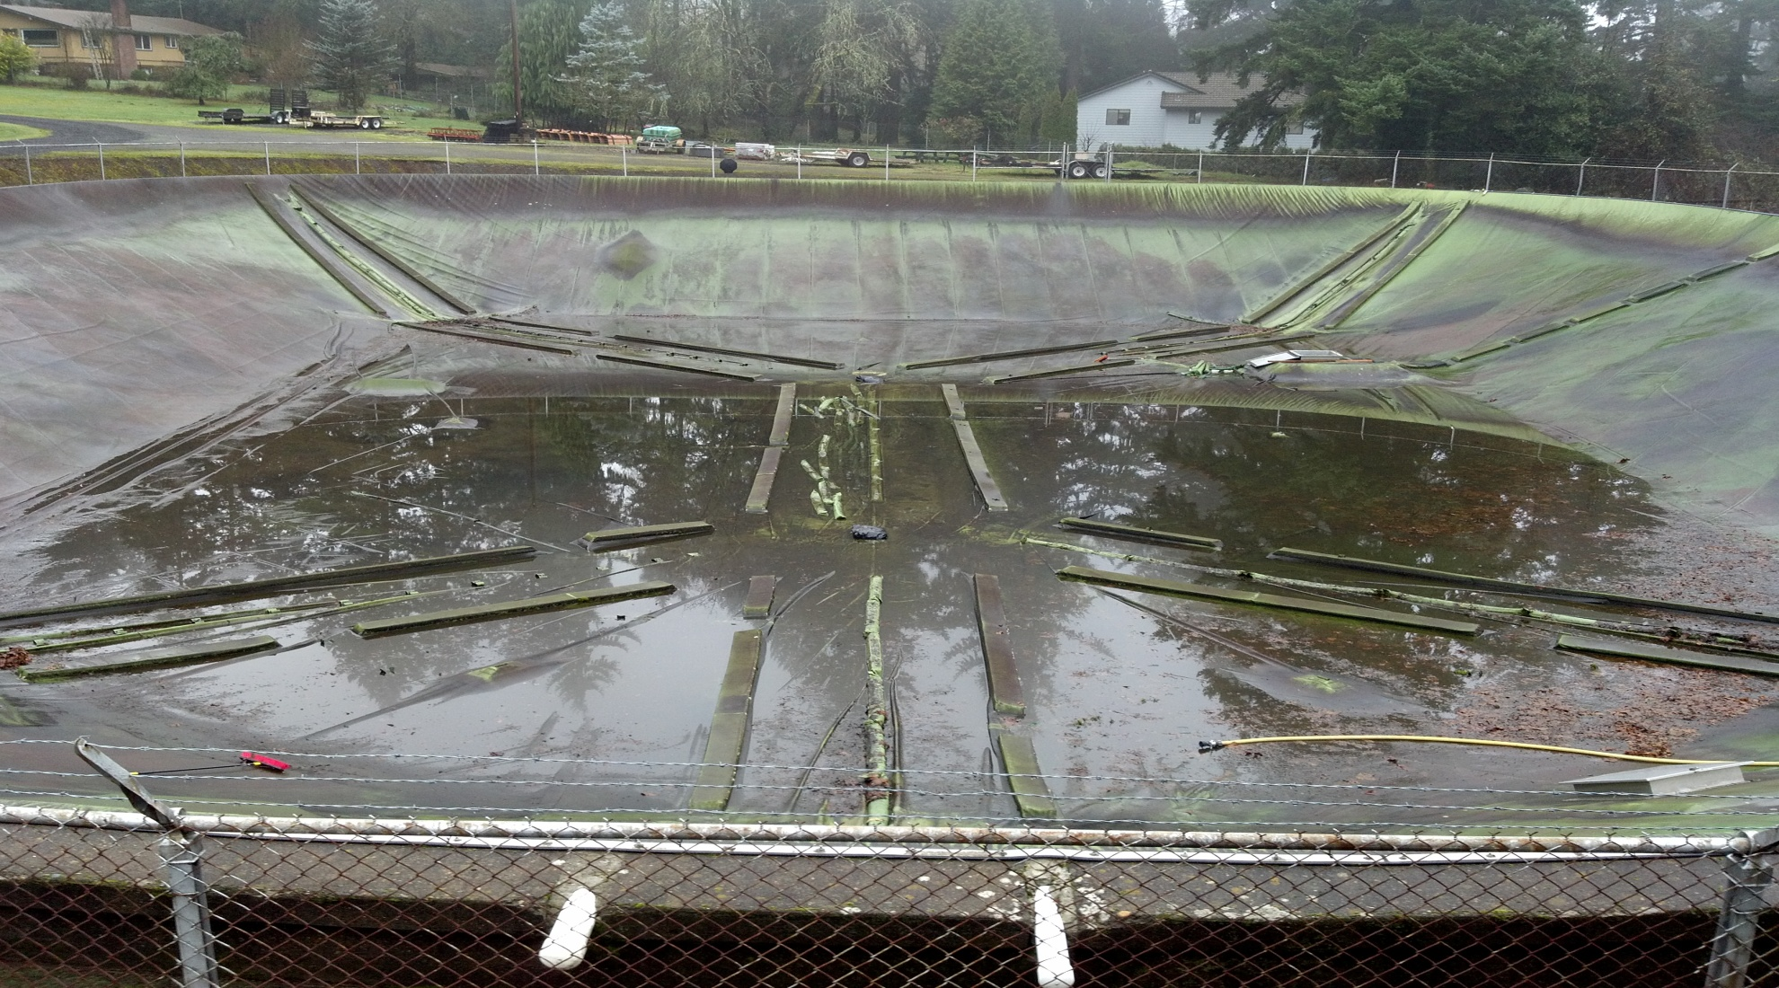
BOLTON RESERVOIR DRAINED

Slide 4
CLEANING DEBRIS OFF COVER

Slide 5
GROUND WATER PASSING THROUGH CONCRETE LIFTING LINER, CUT LINER TO RELIEVE GROUND WATER PRESSURE
Groundwater
Entering Reservoir
Through Liner Cut

Slide 6
INFLATING COVER WITH FAN TO ACCESS INTERIOR

Slide 7
COVER RIPPED OUT WHILE CLEANING THE INTERIOR NO ONE INJURED. REPAIR COSTS AT $11,500
60+ Long Rip
In Cover

Slide 8
36 HOLES REQUIRED PATCHING

Slide 9
MANY CRACKS IN THE CONCRETE, 12 SIMILAR TO THESE

Slide 10
SUMMARY/CONCLUSION
The replacement of the Bolton Reservoir has been identified in the last 3 WMP’s (1999 WMP, 2004 update, and 2008 WMP). Size has varied based equalization, fire demands, and the risk elected officials are willing to take.
Considering the age, capacity, configuration, inspection, repairs, and ongoing operation and maintenance of the Bolton Reservoir, it is the recommendation of staff to replace the Bolton Reservoir with a 4 MG reservoir on the same site as described in the 2008 WMP.

Slide 11
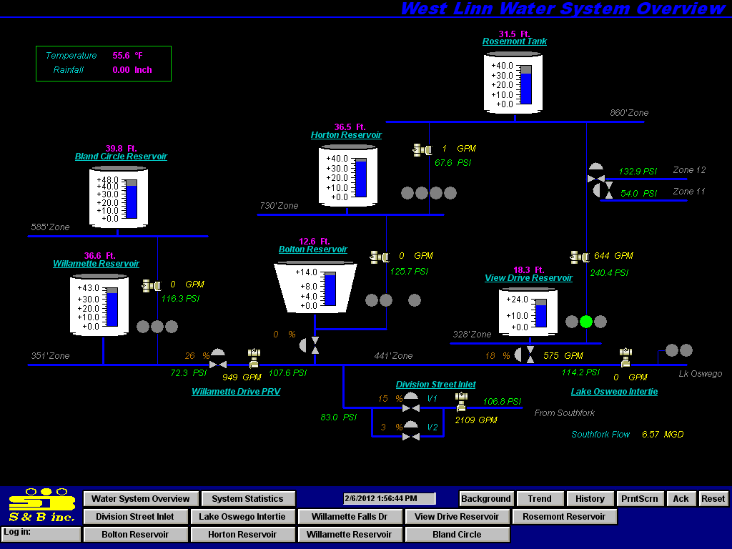
QUESTIONS ????

