Slide 1
Water Rates (Utility versus SDCs)
Information to Utility Advisory Board
September 21, 2009

Slide 2
Step 1 – Determine 20-Year Project List
Water Master Plans estimate needed projects for the next 20 years
  2004 Master Plan estimated $24 million for future projects
    Estimated at $24 million in 2004 dollars
    Estimated at $30 million in 2008 dollars
  2008 Master Plan estimated $33 million for future projects
    Estimated at $33 million in 2008 dollars

Slide 3
Step 2 – Divide List between SDC (Growth) and Existing
Split out SDC (i.e., growth-related) projects or portions thereof:
  2004 Update: Future Projects estimated at $24 million (expressed in 2004 dollars)
    $11 million relate to Growth (i.e., capacity increasing)
    $13 million relate to Existing Infrastructure Needs (i.e., updating existing system)
  2008 Update: Future Projects estimated at $33 million (expressed in 2008 dollars)
    $12 million relate to Growth (i.e., capacity increasing)
    $21 million relate to Existing Infrastructure Needs (i.e., updating existing system)

Slide 4
Step 3 – Perform Financial Analysis
Water SDC Fund
  Use “SDC (i.e., growth-related) projects” in financial projections of the Water SDC Fund to determine Water SDC rates necessary to pay for growth-related water projects
Water Fund
  Use “Existing projects” in financial projections of Water Fund to determine water utility rates necessary to pay for existing infrastructure water improvement projects

Slide 5
Step 4 – Set SDC Rates to pay for Growth Projects and Set Utility Rates to pay for Current Projects
Setting Water SDC Rates
  Refer to FCS Group presentation next
  Recommending 46% base SDC rate increase from $4,628 to $6,747
Setting Water Utility Rates
  Refer to Pioneer Consulting Group presentation next
  Recommending decreasing base rate per month from $14.54 to $9.12
  And increasing usage rate per ccf from $1.67 to $2.32 for every ccf used

Slide 6
Water Rates
Utility Rates & SDCs
Presentation to the West Linn City Council
October 5, 2009

Slide 7
Tonight’s presentation
How are utility and SDC rates set?
  Step 1: determine 20-year project list
  Step 2: break out existing (utility rate) and growth (SDC) projects
  Step 3: perform financial analysis
  Step 4: set rates
Current utility bill comparison
Average rate increases using 8 CCF comparison
Utility bill comparison using potential rate increases
SDC rate comparison
Next discussion areas
Questions

Slide 8
Step 1: determine 20-year project list
Adopted Water Master Plan estimates needed projects over a 20 year span
  Adopted Plan estimates $33 million for future projects in 2008 dollars
    2004 Master Plan estimated $24 million for future projects in 2004 dollars
    2004 Master Plan equates to $30 million for future projects in 2008 dollars
      Why the $3 million variance in 2008 dollars?
        Inflation
        Deferred maintenance

Slide 9
Step 2: break out existing and growth projects
Adopted Water Master Plan estimates $33 million for future projects:
  $21 million in projects relate to existing infrastructure needs
    Example: updating existing system; water line replacement
  $12 million in projects relate to future needs, or “growth”
    Example: capacity increasing; water line expansion
Notes:
2004 Update: Future Projects estimated at $24 million (expressed in 2004 dollars)
$11 million relate to Growth (i.e., capacity increasing)
$13 million relate to Existing Infrastructure Needs (i.e., updating existing system)

Slide 10
Step 3: perform financial analysis
Use cost information and financial projections to determine rates
  Water Fund
    Use “Existing Needs” list to determine water utility rates necessary to pay for projects
  Water SDC Fund
    Use “Future Needs” list to determine water SDC rates necessary to pay for projects

Slide 11
Growth Paid for by Developer SDCs

Slide 12
Investment in West Linn’s Water System
June 28, 2010

Slide 13
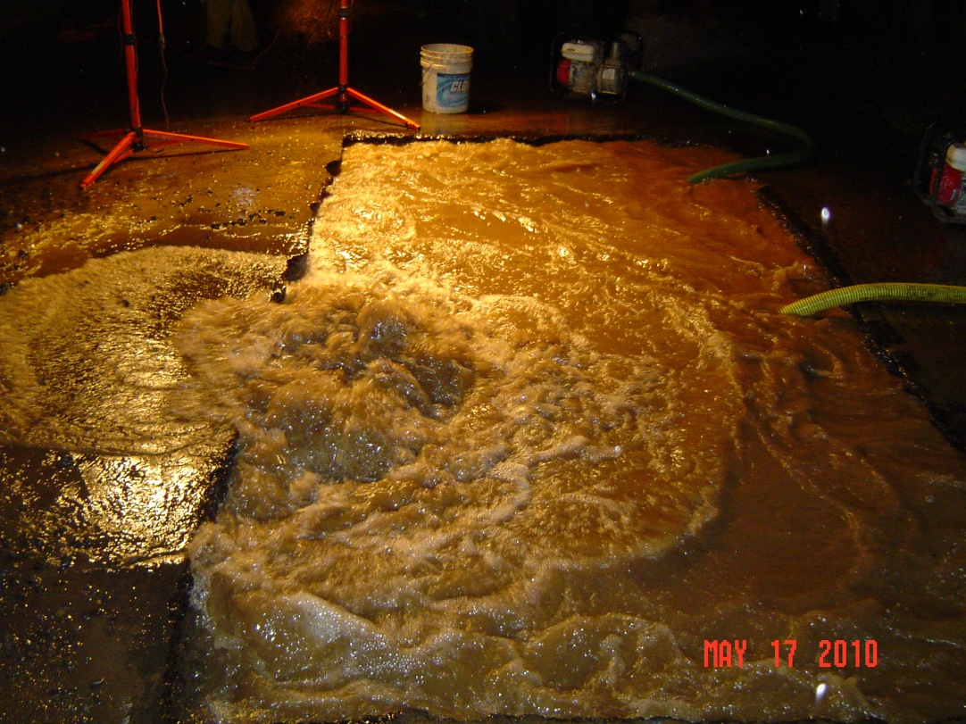
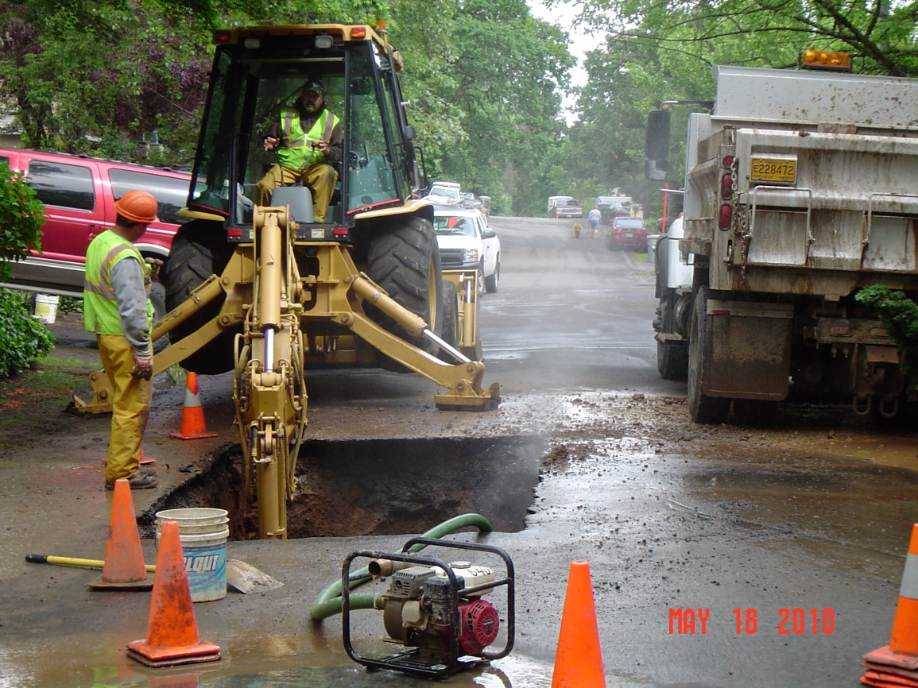
Ripped From the Headlines
May 17, 2010 Break on Broadway

Slide 14
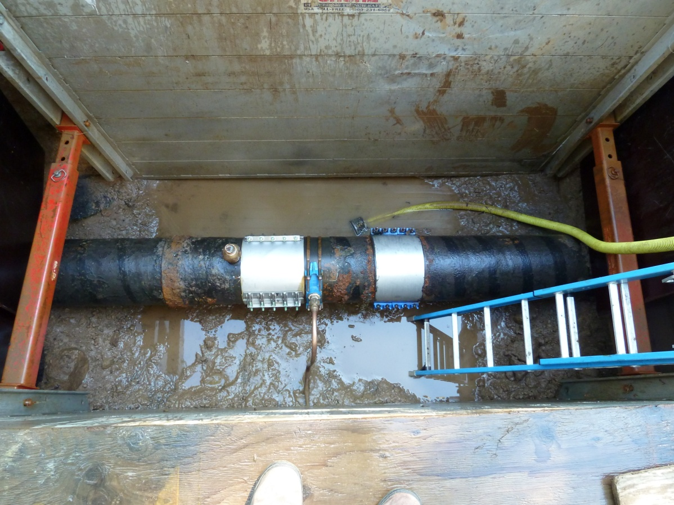
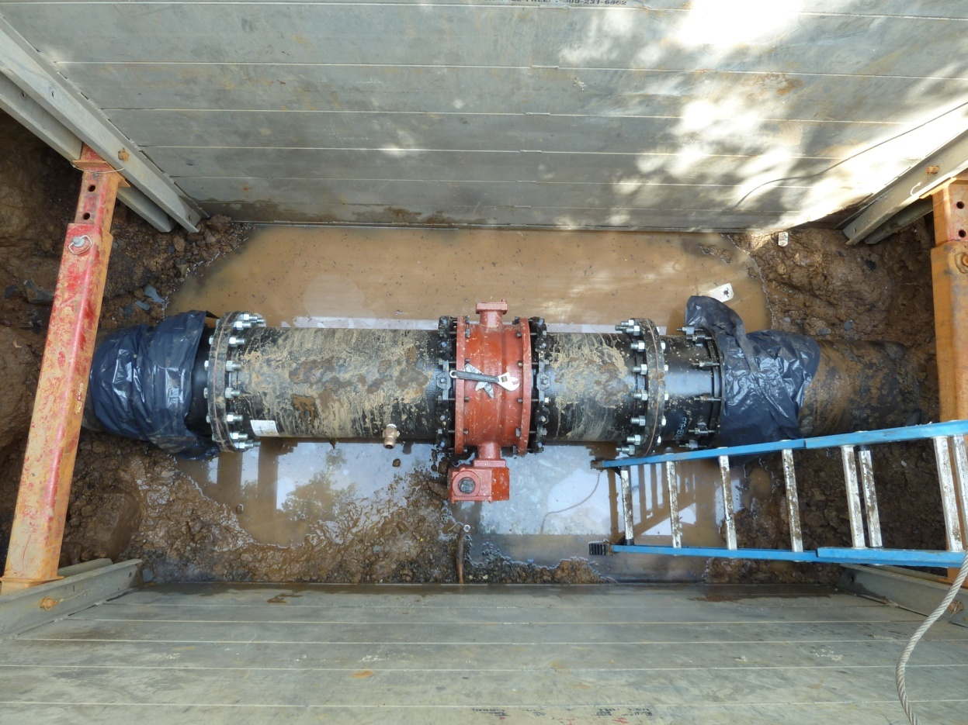
Repairs Completed Last Week
Before
After

Slide 15
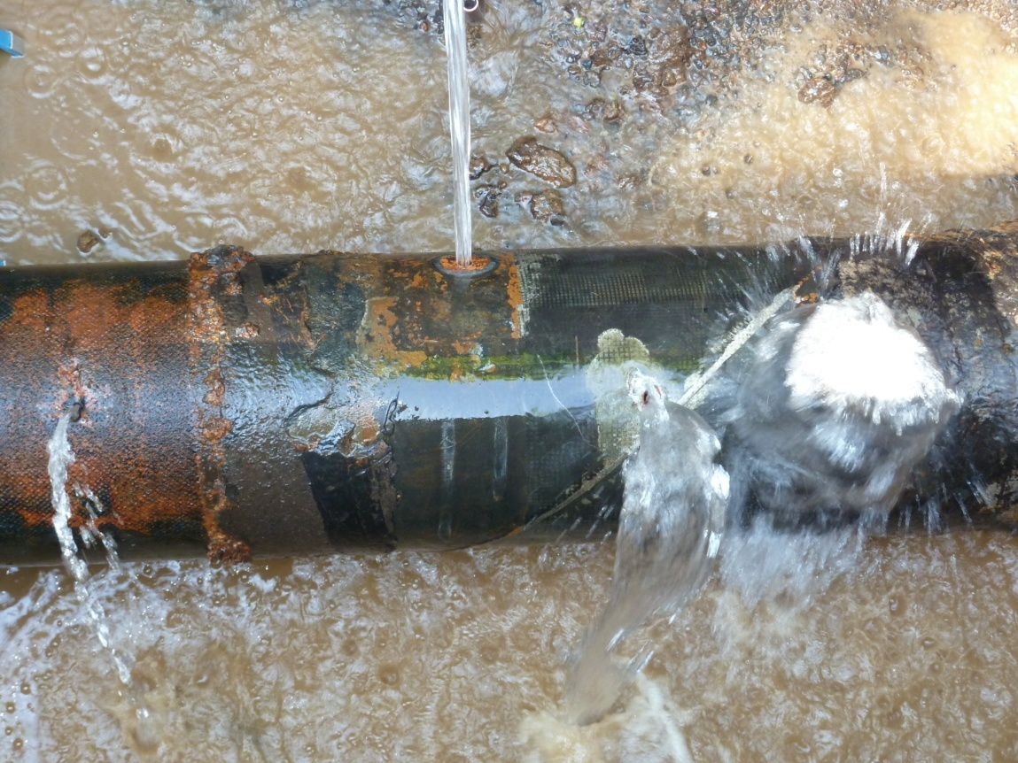
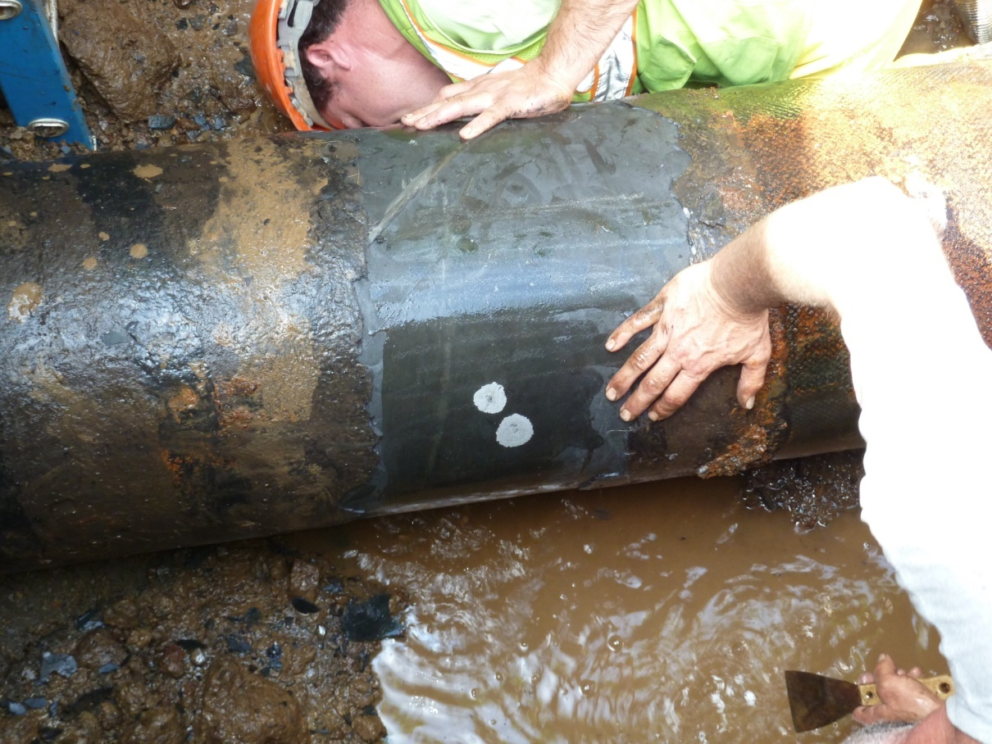
Broadway Fix Was Time Consuming and Costly
Holes
Corrosion

Slide 16
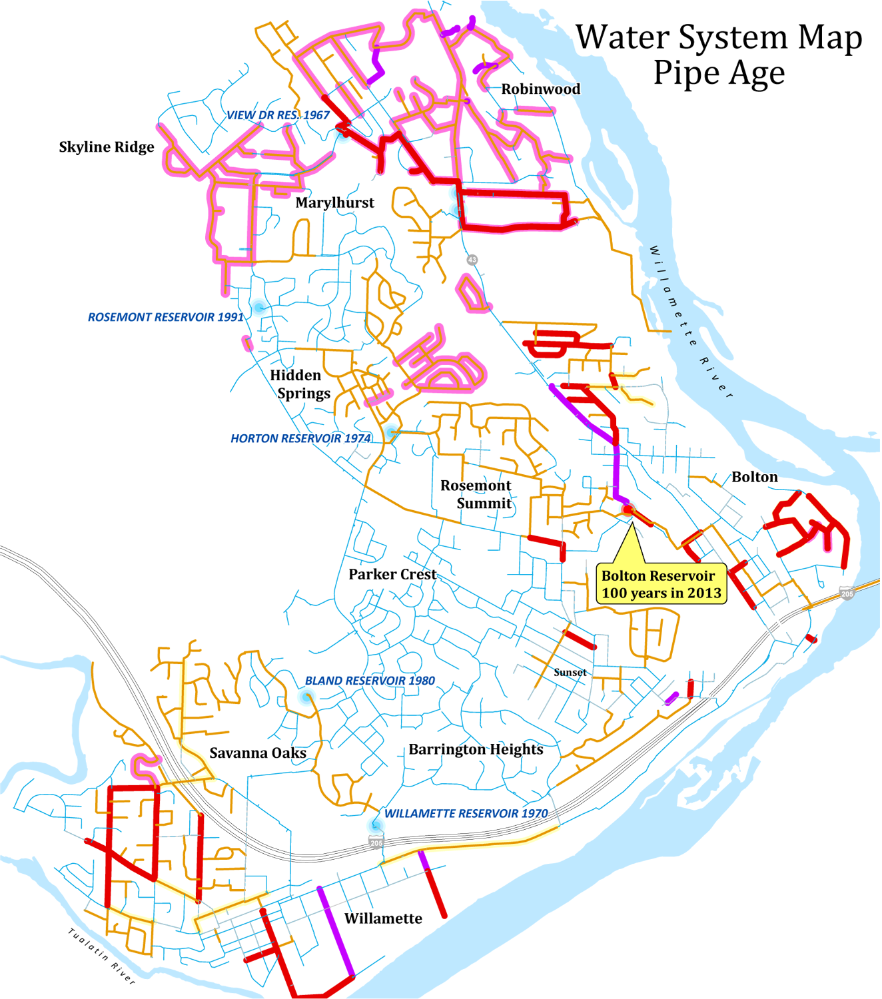
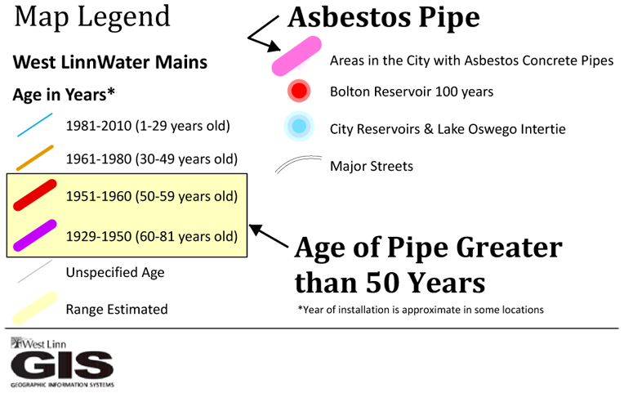
Aging & Unsafe System

Slide 17
Feedback from the School District
“This district believes the one tier model is more equitable…”

Slide 18
Ask the Voters?
RESOLUTION 2010-27
WEST LINN, OREGON
A RESOLUTION OF THE WEST LINN CITY COUNCIL CALLING AN ELECTION TO SUBMIT
TO THE VOTERS A MEASURE TO UPGRADE WATER SYSTEM, INCREASE SAFETY OF
DRINKING WATER, AND PROMOTE CONSERVATION BY BASING WATER PRICING ON
WATER CONSUMPTION

Slide 19
Three Tier or One Tier?
ATTACHMENT A

Slide 20
Questions?
For more information:
  Richard W. Seals, CPA CMA CFM
  Finance Director
  City of West Linn, Oregon
  rseals@westlinnoregon.gov

