Slide 1



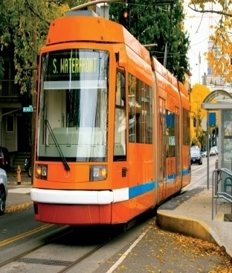
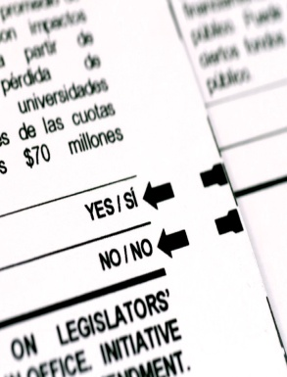



Community Telephone Survey
Public Preferences and Behaviors
PREPARED FOR
City of West Linn
February 2014
www.dhmresearch.com

Slide 2
Survey Methodology
Telephone survey of 300 residents (ages 18+)
  Separate online survey conducted of City residents (N=357)
Conducted December 13-18, 2013
Past surveys in 2008/2010/2012
Averaged 15 minutes in length
Quotas were set for age and gender to ensure representative sample
Quality control measures including callbacks and validations
Land line and cell numbers incorporated
Margin of error +/- 5.7%, at 95% confidence level

Slide 3
KEY FINDINGS

Slide 4
Residents continue to feel that the City of West Linn is a good place to live: mean of 8.4 on a 0-10 scale.
Mean Score
on 0-10 Scale: 8.4
Notes:
Demographic Differences: Mean scores were 7.5 or higher across all demographic subgroups.
Q1
N=300

Slide 5
Residents feel that the City of West Linn does a quality job communicating with the public: 76% were very/somewhat satisfied.
Notes:
Demographic Differences: Younger residents rated the City’s communications efforts more positively than their older counterparts, a trend that would continue throughout the survey.
Q2
N=300

Slide 6
A majority of residents rated the City positively on a number of aspects of its communications efforts, particularly advertising events and providing opportunities for public input.
Notes:
Q3-8
N=300

Slide 7
Visitation of the City’s website is high among residents. This is also the top source that residents use to get information about the City, a shift from 2012.
What sources do you use to get information about the City (open)?
City website (39%)
West Linn Tidings (26%)
Newspaper ads (23%)
City paper newsletter (included with utility bill) (12%)
Word of mouth (12%)
Notes:
Note: In the 2012 West Linn Community Survey, West Linn Tidings was the top-rated source of information, while the City Website was rated fifth.
Q9/Q13
N=300

Slide 8
Nine in ten of those who had visited the City’s website rated it positively, with more than 80% of all demographic groups saying it was very good or good.
Notes:
Demographic Differences: Notably high positive scores were provided by those ages 18-34 (100%). Overall positive ratings decreased with age (18-34: 100%; 35-54: 90%; 55+: 82%).
Q11
N=191

Slide 9
When prioritizing a list of 15 methods for communicating with the public that the City could allocate time and money for, residents preferred requested email notices and the City website.
Notes:
Note: On a later question (Q34), nearly one-half of residents (45%) could not name their neighborhood association.
Demographic Differences: Email notices to residents who sign up with the City received the highest means scores provided by all age groups for all 15 communication methods.
Q14-28
N=300

Slide 10
Two-thirds of West Linn residents use social media, similar to 2012 (63%). One-fourth of those users are connected with the City.
Notes:
Note: Of those residents who said they use social media, 26% said they were connected with the City, which equates to 17% of the total West Linn 18+ population (50/300). Of those who said they use social media but are not connected with the City, one of the top reasons for not being connected was that they weren’t aware of the city’s social media status (24%). This is an area of potential communications outreach for the City.
Q29/30
N=300/N=192

Slide 11
One-fourth of residents had attended a public meeting in the last year, little changed from 2012, with those who had attended rating their experience positively.
Notes:
Demographic Differences: Those ages 55+ were the only demographic group that had attended at a rate at or above 30% (31%).
Q32/Q33
N=300/N=68

Slide 12

Ari Wubbold
Associate
awubbold@dhmresearch.com
(503) 220-0575
www.dhmresearch.com
@DHMresearch
facebook.com/dhmresearch

